Slide 1
Writing and Graphing Linear Equations

Slide 2
Linear equation – An equation whose solutions form a straight line on a coordinate plane. Collinear – Points that lie on the same line. Slope – A measure of the steepness of a line on a graph; rise divided by the run.

Slide 3
A linear equation is an equation whose solutions fall on a line on the coordinate plane. All solutions of a particular linear equation fall on the line, and all the points on the line are solutions of the equation.
Look at the graph to the left, points (1, 3) and (-3, -5) are found on the line and are solutions to the equation.

Slide 4
The equation y = 2x + 6 is a linear equation because it is the graph of a straight line and each time x increases by 1 unit, y increases by 2

Slide 5
Complete the table below, then graph and tell whether it is linear.

Slide 6
Can you determine if the equation is linear? The equation y = 2x + 3 is a linear equation because it is the graph of a straight line. Each time x increases by 1 unit, y increases by 2.

Slide 7
Slope-intercept Form
y = mx + b

Slide 8
Slope-intercept Form
Y = mx + b
(if you know the slope and where the line crosses the y-axis, use this form)
An equation whose graph is a straight line is a linear equation.
m = slope
b = y-intercept

Slide 9
y = 3x + 6
y = 4/5x -7
m = 3 b = +6
m = 4/5 b = -7
Please note that in the slope-intercept formula;
the “y” term is all by itself on the left side of the equation.
That is very important!

Slide 10
WHY? If the “y” is not all by itself, then we must first use the rules of algebra to isolate the “y” term. For example in the equation:
2y = 8x + 10
Only now can we determine that:
slope = 4
y-intercept = 5

Slide 11
OK…getting back to the lesson… Your job is to write the equation of a line after you are given the slope and y-intercept…
Let’s try one…
Given “m” (the slope remember!) = 2
And “b” (the y-intercept) = +9
y = mx + b
y = 2x + 9

Slide 12
Let’s do a couple more to make sure you are expert at this.
Given m = 2/3, b = -12,
Write the equation of a line in slope-intercept form.
Y = mx + b
Y = 2/3x – 12

Slide 13
Using slope-intercept form to find slopes and y-intercepts The graph at the right shows the equation of a line both in standard form and slope-intercept form. You must rewrite the equation 6x – 3y = 12 in slope-intercept to be able to identify the slope and y-intercept.

Slide 14
Using slope-intercept form to write equations, Rewrite the equation solving for y = to determine the slope and y-intercept.
3x – y = 14
-y = -3x + 14
-1 -1 -1
y = 3x – 14 or
3x – y = 14
3x = y + 14
3x – 14 = y
x + 2y = 8
2y = -x + 8
2 2 2
y = -1x + 4
2

Slide 15
Graphing in Slope-Intercept Form
Y = mx + b
m = slope
b = y-intercept
Why m?
Why b?
Move to next point….
Begin graphing here….

Slide 16
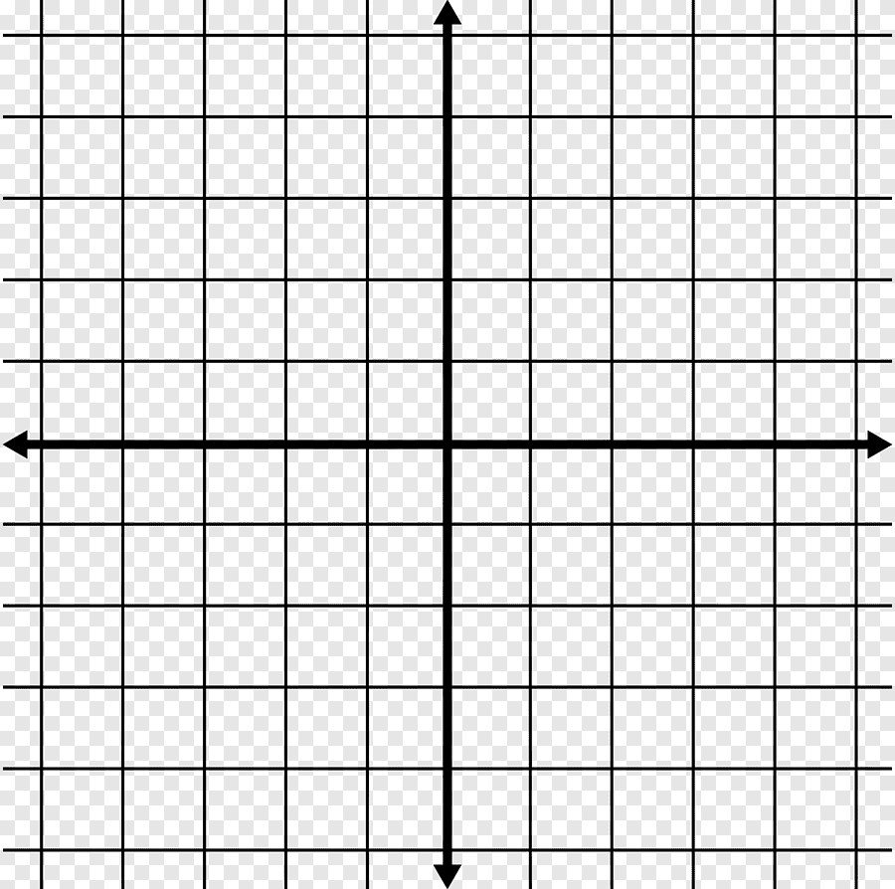
Y = 3x - 4
Move to next point….
Begin graphing here….

Slide 17
Equation Forms (review)
When working with straight lines, there are often many ways to arrive at an equation or a graph.

Slide 18
There are several ways to graph a straight line given its equation. Let’s quickly refresh our memories on equations of straight lines:

