Slide 1

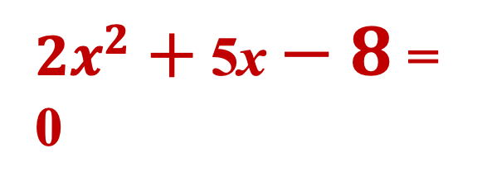
Solving Quadratic Equations:
Quadratic Formula
Not every quadratic equation can be solved by factoring or by taking the square root!
${2x}^{2}$ $+$ 5x $− 8$= 0

Slide 2
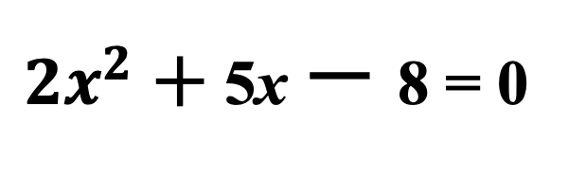
Solve using Quadratic Formula
${2x}^{2}$ $+$ 5x $−$8 = 0

Slide 3
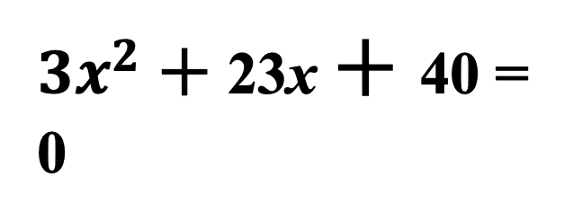
Solve using Quadratic Formula
${3x}^{2}$ $+$ 23x $+$40 = 0

Slide 4

Solve using Quadratic Formula
$${9x}^{2}+6x−1=0$$

Slide 5
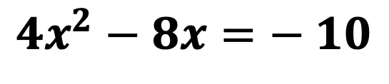
Solve using Quadratic Formula*
$${4x}^{2}−8x=− 10$$

Slide 6

Solve using Quadratic Formula
$${25x}^{2}−30x+12=0$$

Slide 7

Solve using Quadratic Formula
$${3x}^{2}−2x+4=0$$

Slide 8
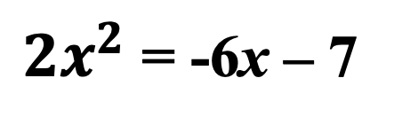
Solve using Quadratic Formula
${2x}^{2}$ = -6x – 7

