Slide 1
Vertex Form
y = a(x – h)² + k
where (h, k) is the vertex.

Slide 2
Example 1: Graphing from Vertex Form
y = 2(x – 1) ² + 2
Direction: _____
Vertex: ______
Axis: _______

Slide 3
Example 2: Graphing from Vertex Form
y = (x + 3) ² – 1
Direction: _____
Vertex: ______
Axis: _______

Slide 4
Example 3: Graphing from Vertex Form
y = $\frac{−1}{2}$ (x – 3) ² – 2
Direction: _____
Vertex: ______
Axis: _______

Slide 5
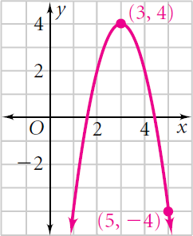
Example 4: Write quadratic equation in vertex form.

Slide 6
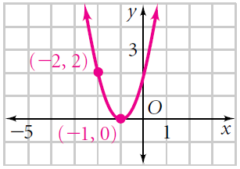
Example 5: Write quadratic equation in vertex form.

