Slide 1
Rational Functions

Slide 2
After this lesson…
• I can identify equations and data sets that show direct variation.
• I can identify equations and data sets that show inverse variation.
• I can write inverse variation equations.
• I can solve real-life problems using inverse variation functions.

Slide 3
Inverse Variation
Direct Variation: y = ax
x ↑, y ↑
Inverse Variation: $y=\frac{a}{x}$
x ↑, y ↓

Slide 4
Inverse Variation
What type of variation is each of the following?
xy = 48
2y = x
y = 2x + 3
$y=\frac{2}{x}$
Notes:
y = 48 / x → inverse
y = ½ x → direct
+3 means neither
359#1: inverse

Slide 5
Inverse Variation
Checking data for variation
Look at the y-values
If y increases as x increases, check direct variation
If y decreases as x increases, check inverse variation
Plug each of the data points in one of the variation equations to find a
If the a stays the same, the data has that type of variation
What type of variation?
x | 2 | 4 | 8
y | 8 | 4 | 2
Notes:
y decreases as x increases, check inverse variation
(2, 8) → xy = 2(8) = 16
(4, 4) → xy = 4(4) = 16
(8, 2) → xy = 8(2) = 16
359#9: direct

Slide 6
Graphing Rational Functions
After this lesson…
• I can graph rational functions.
• I can describe transformations of rational functions.
• I can explain how to find the asymptotes of a rational function from an equation.
• I can write rational functions in different forms.

Slide 7
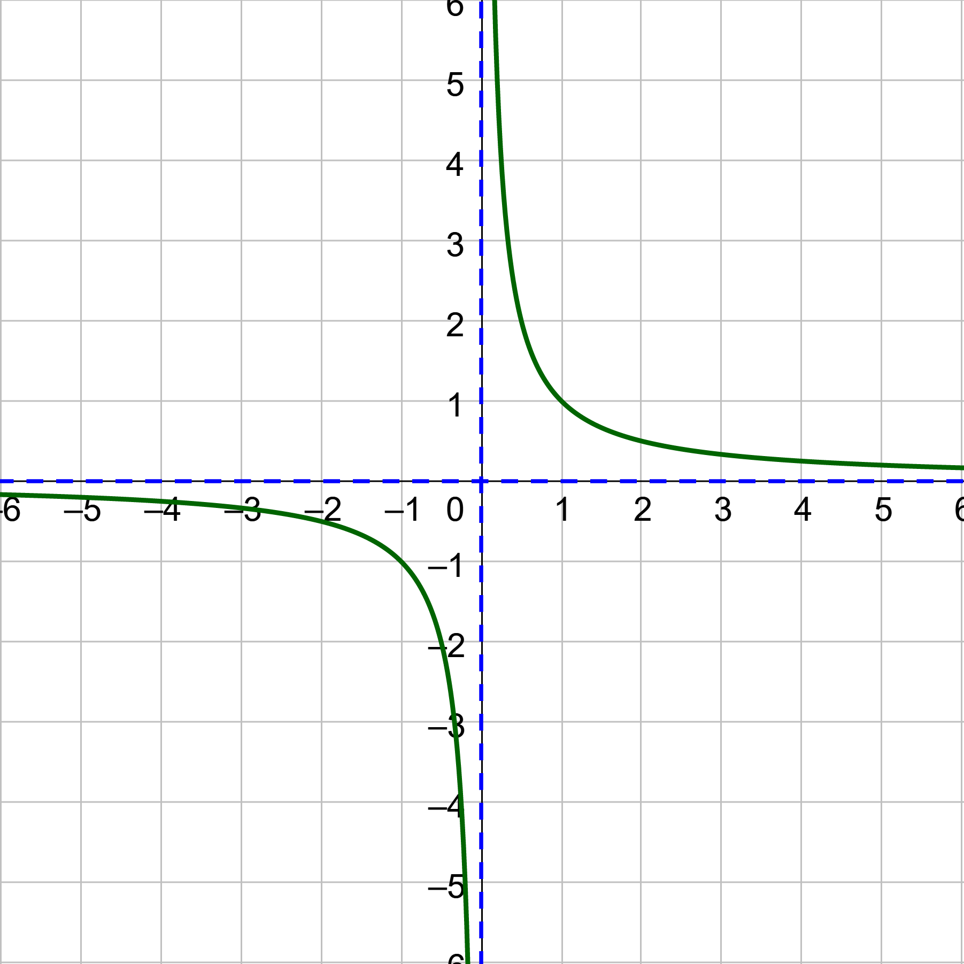
Graphing Rational Functions
Rational Functions
Functions written as a fraction with x in the denominator
$y=\frac{1}{x}$
Shape called hyperbola
Asymptotes
Horizontal: x-axis
Vertical: y-axis
Domain: x ≠ 0
Range: y ≠ 0

Slide 8
Graphing Rational Functions
General form
$y=\frac{a}{x−h}+k$
a → stretches vertically
h → moves right
k → moves up
How i$s y=\frac{2}{x+3}+4$ transformed from $y=\frac{1}{x}$?
Notes:
Stretches vertically by factor of 2
Moves left 3
Moves up 4

Slide 9
Graphing Rational Functions
How to find asymptotes
Vertical
Make the denominator = 0 and solve for x

Slide 10
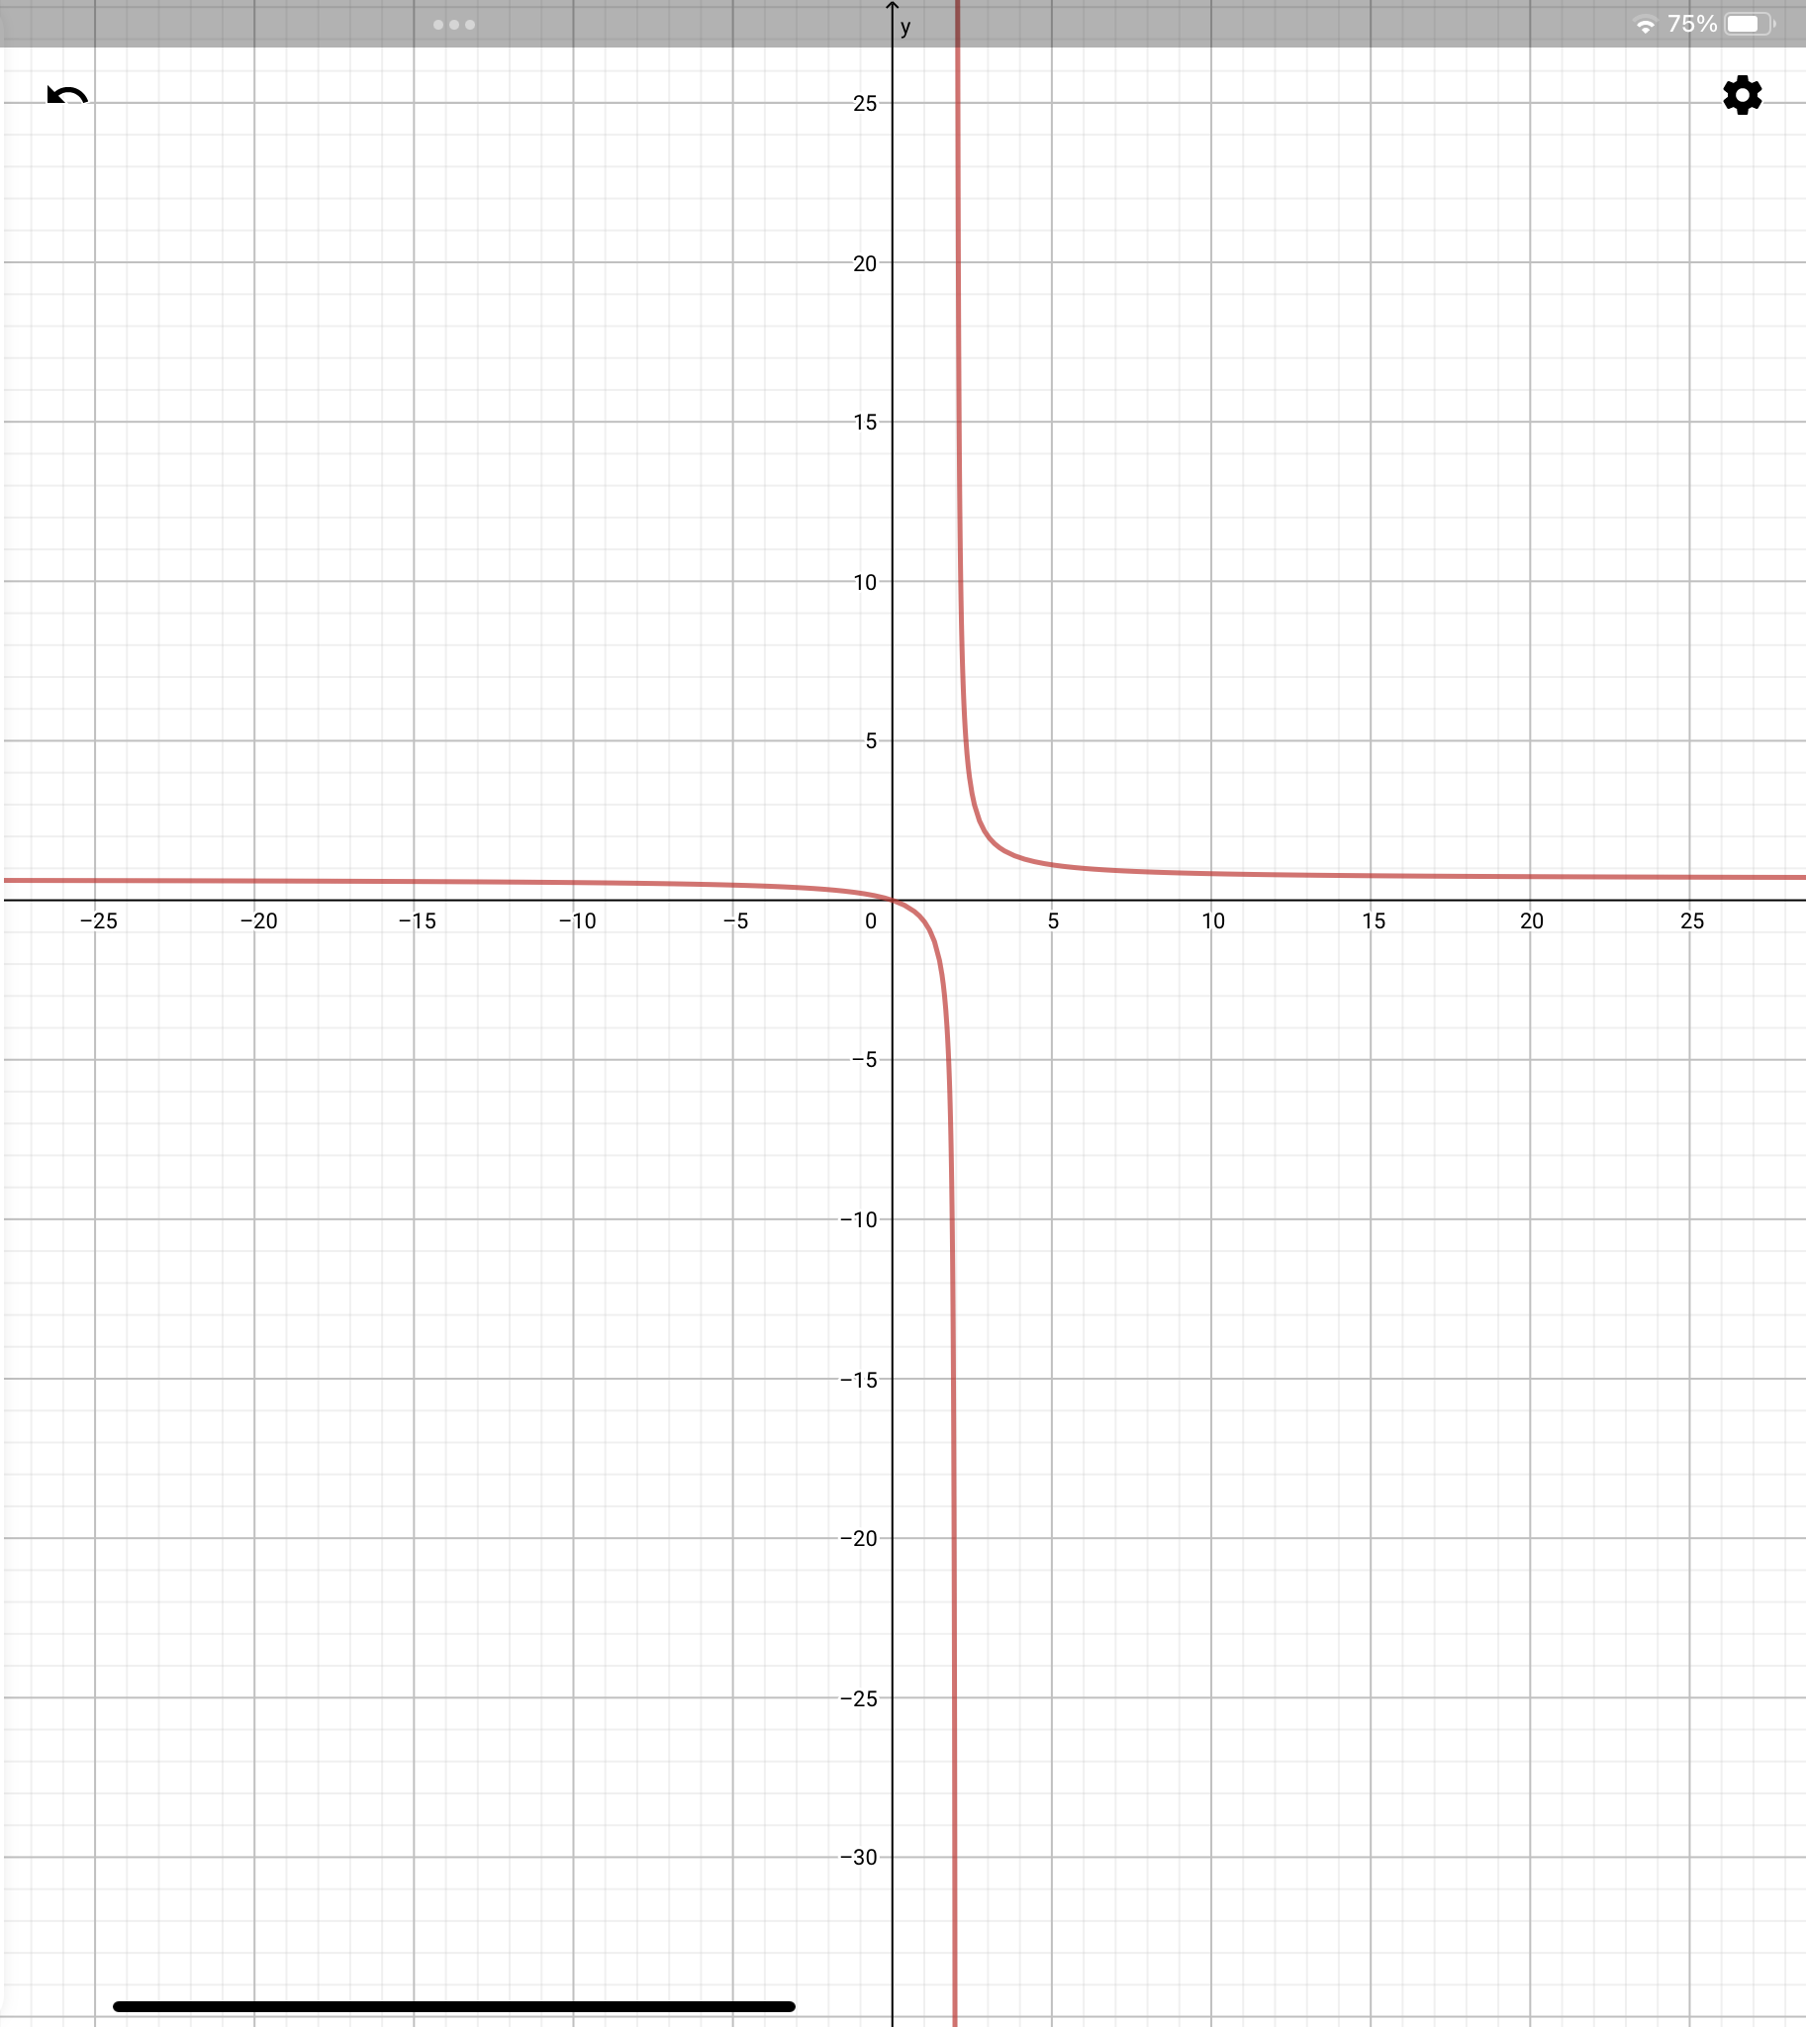
Graphing Rational Functions
Horizontal
Substitute a very large number for x and estimate y
Or
Find the degree of numerator (N)
Find the degree of denominator (D)
If N < D, then y = 0
If N = D, then y = leading coefficients
If N > D, then no horizontal asymptote
Find the asymptotes for $y=\frac{2x}{3x−6}$
Notes:
Vertical:
Horizontal:

Slide 11
Graphing Rational Functions
Domain
All x’s except for the vertical asymptotes
Range
All the y’s covered in the graph
Usually all y’s except for horizontal asymptote

Slide 12
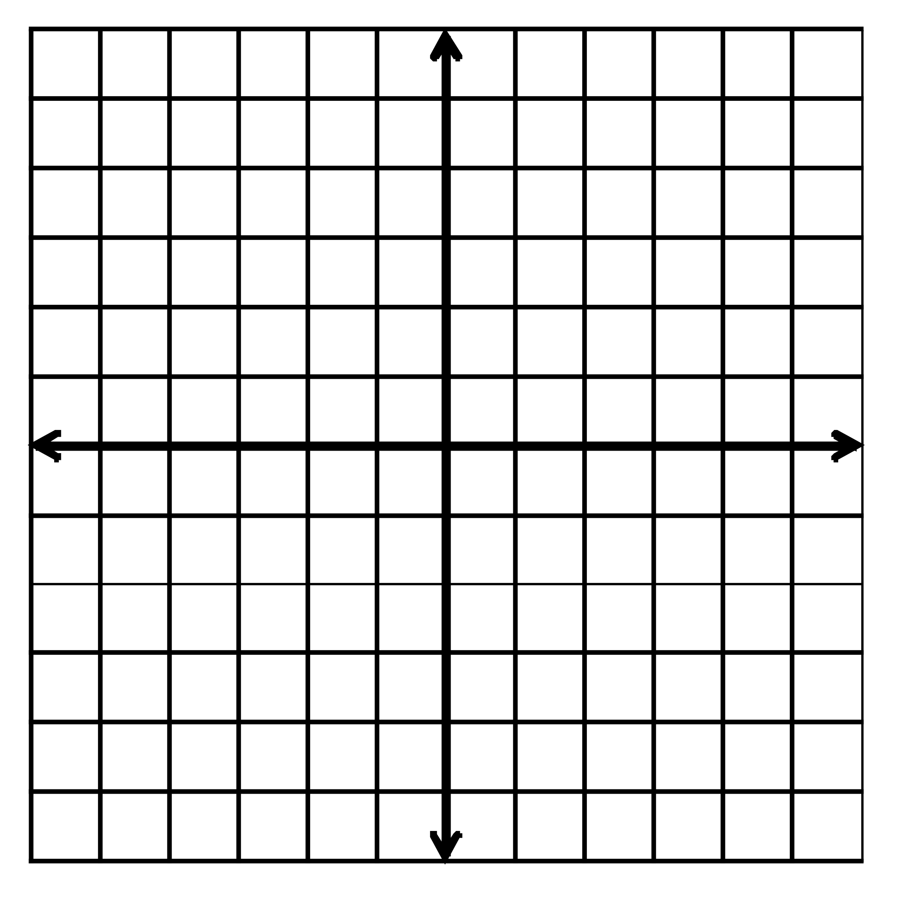
Graphing Rational Functions
Graph by finding asymptotes and making a table
Graph $y=\frac{2}{x+3}+4$ and state the domain and range
$g\left(x\right)=\frac{4}{x}+3$
Notes:
Asymptotes
Vertical: x + 3 = 0 → x = −3
Horizontal:
Domain: x≠−3
Range: y≠4
Asymptotes:
Vertical: x = 0
Horizontal:
Domain: x ≠ 0
Range: y ≠ 3

Slide 13
Graphing Rational Functions
$g\left(x\right)=\frac{2x+5}{x+2}$
Rewrite in the form $g\left(x\right)=\frac{a}{x−h}+k$. Graph the function. Describe the graph of g as a transformation of the graph of $f\left(x\right)=\frac{a}{x}$.
Notes:
Synthetic or Long Division
-2 | 2 5
-4
-2 | 1
Domain: x≠−2
Range: y≠−2

Slide 14
Graphing Rational Functions
$g\left(x\right)=\frac{5x+6}{x+1}$
Rewrite in the form $g\left(x\right)=\frac{a}{x−h}+k$. Graph the function. Describe the graph of g as a transformation of the graph of $f\left(x\right)=\frac{a}{x}$.
Notes:
Synthetic or Long Division
-1 | 5 6
-5
5 | 1
Domain: x≠−1
Range: y≠5

Slide 15
Graphing Rational Functions
$\frac{x^{2}+11x+18}{x^{3}+8}$

Slide 16
Graphing Rational Functions
$\frac{2x^{2}}{3x^{2}−4x}$

