Slide 1
7.5 Solving Rational Equations
After this lesson…
• I can solve rational equations by cross multiplying and by using least common denominators.
• I can identify extraneous solutions of rational equations.
• I can solve real-life problems using inverses of rational functions.

Slide 2
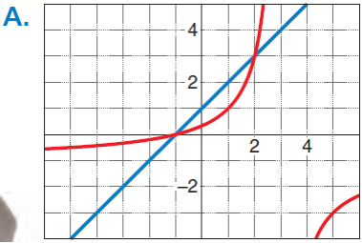
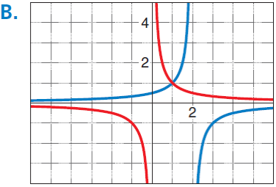
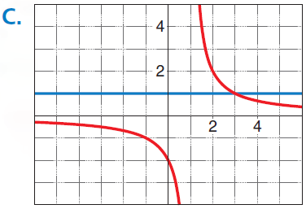
7.5 Solving Rational Equations
Work with a partner.
a. Match each equation with its related graph. Explain your reasoning. Then use the graph to approximate the solution(s) of the equation.
i. $\frac{2}{x−1}=1$ ii. $\frac{−x−1}{x−3}=x+1$ iii. $\frac{1}{x}=\frac{−1}{x−2}$

Slide 3
7.5 Solving Rational Equations
Only when the = sign is present!!!
Method 1: simplify both sides and cross multiply
Method 2:
Multiply both sides by LCD to remove fractions
Solve
Check answers

Slide 4
7.5 Solving Rational Equations
390#5
$\frac{x}{2x+7}=\frac{x−5}{x−1}$
390#1
$\frac{4}{2x}=\frac{5}{x+6}$
Notes:
Cross multiply

Slide 5
7.5 Solving Rational Equations
390#21
$\frac{6x}{x+4}+4=\frac{2x+2}{x−1}$
Try 390#17
$\frac{3}{2}+\frac{1}{x}=2$

Slide 6
7.5 Solving Rational Equations
Determine in the inverse of a function is a function
Graph the function
If any horizontal line touches the graph more than once, then the inverse is not a function
Finding Inverse of Rational Functions
Switch x and y
Solve for y

Slide 7
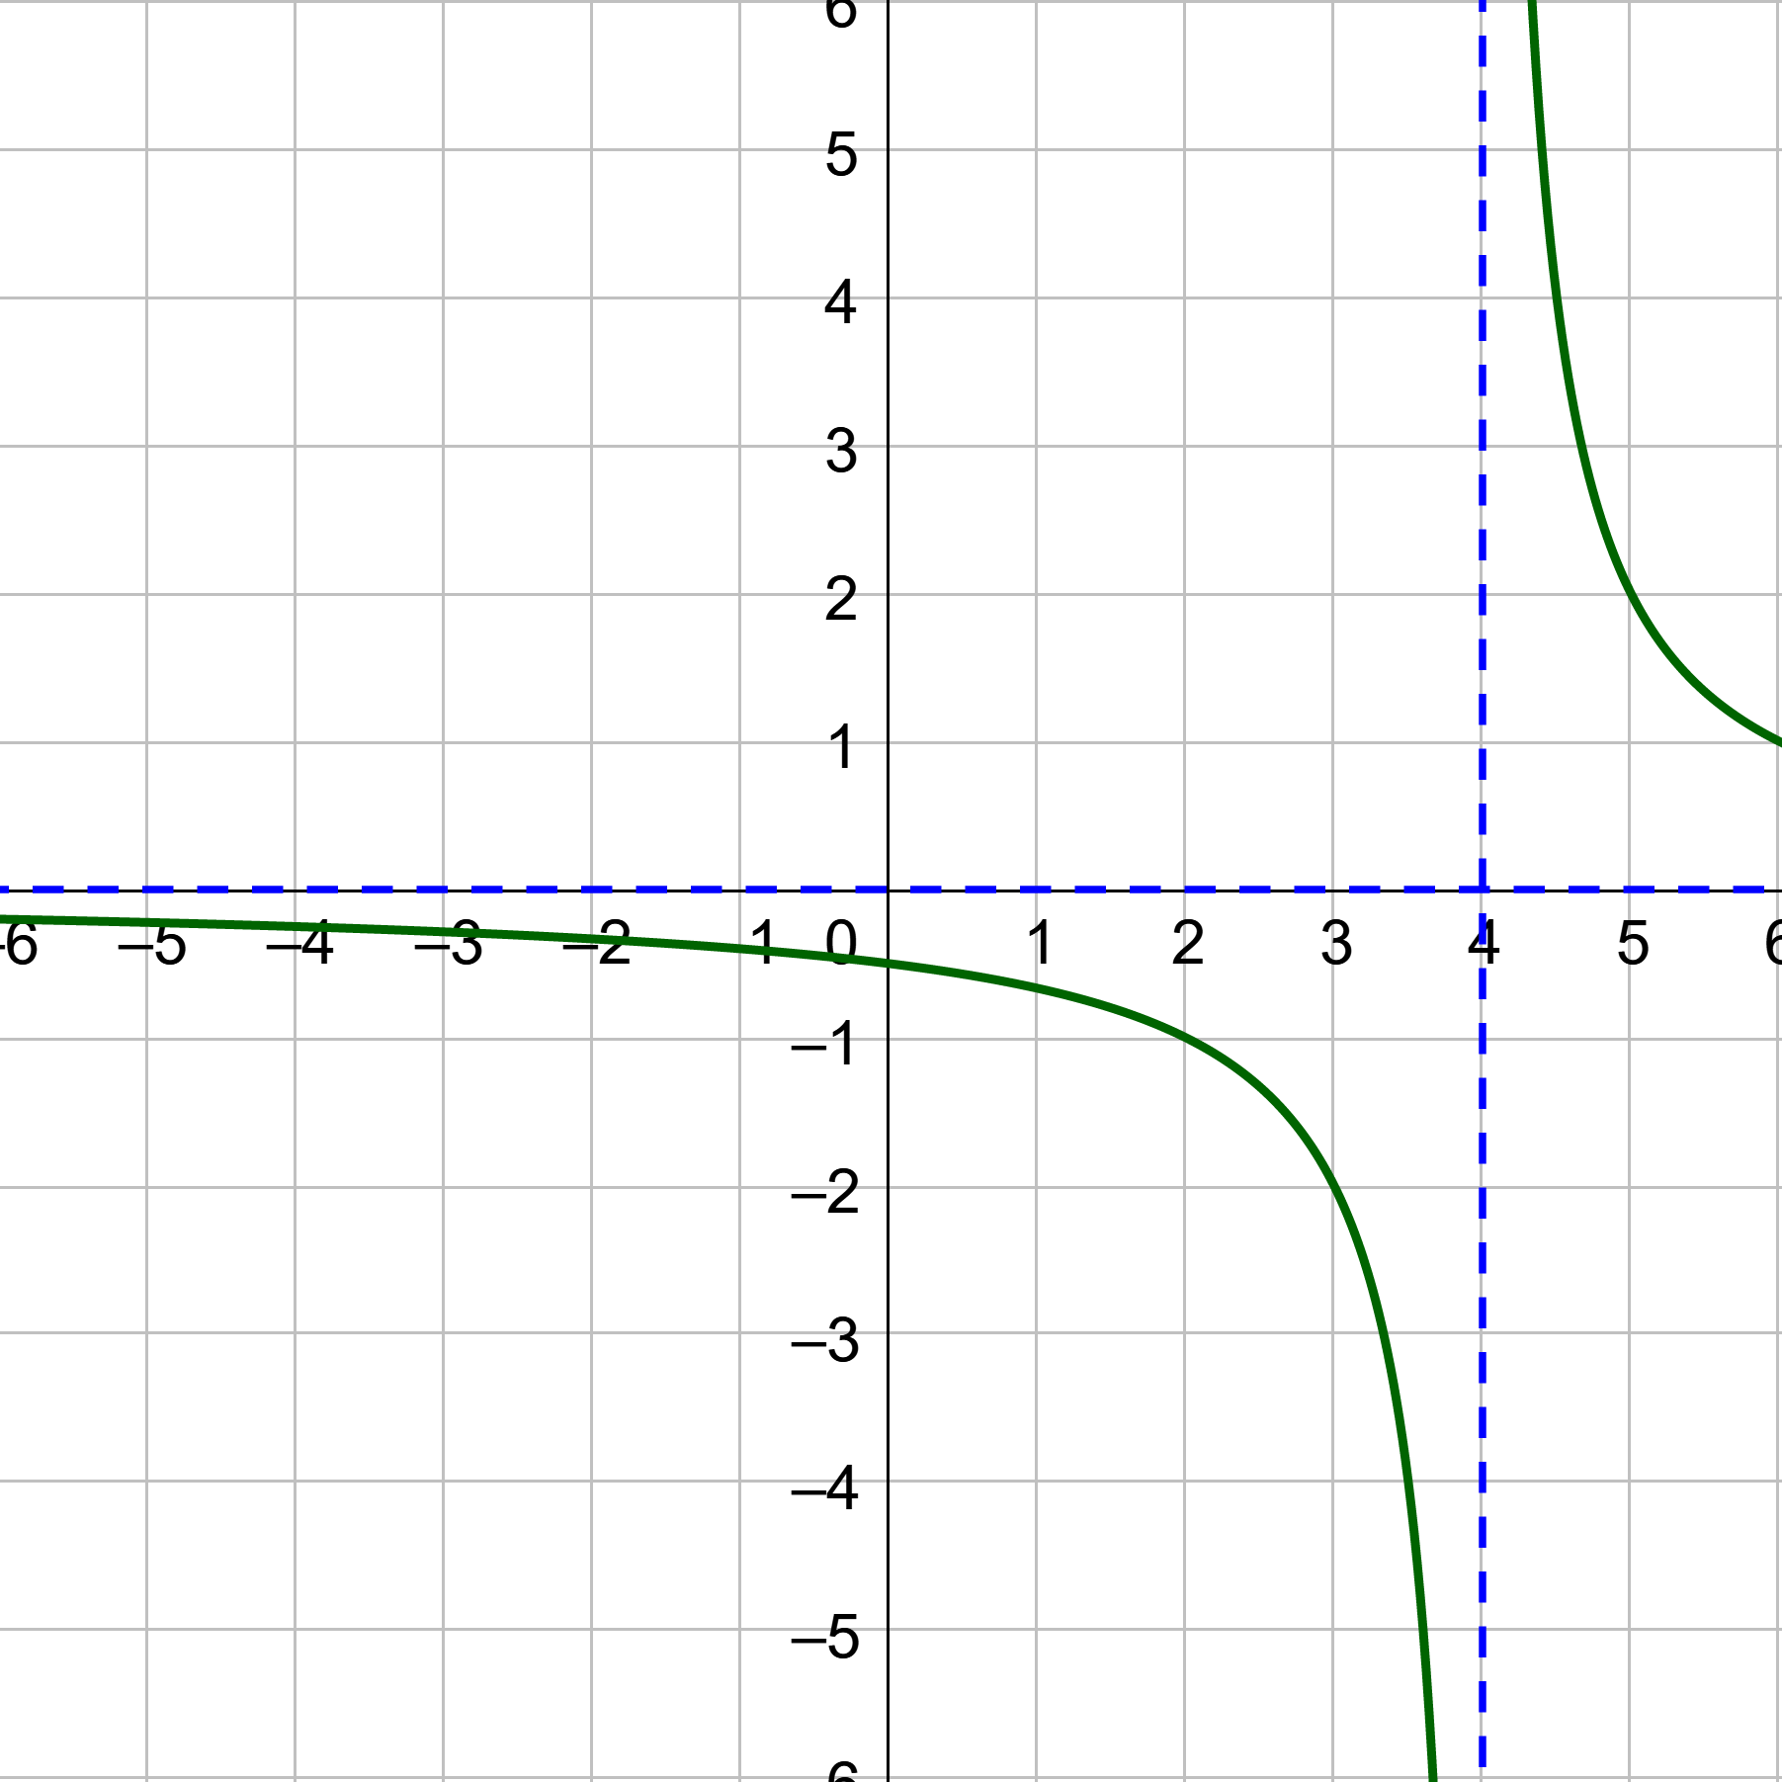
7.5 Solving Rational Equations
391#35 $f\left(x\right)=\frac{2}{x−4}$. Determine whether the inverse of f is a function. Then find the inverse.
Notes:
The graph passes the horizontal line test, so the inverse is a function
Switch x and y
Solve for y

Slide 8
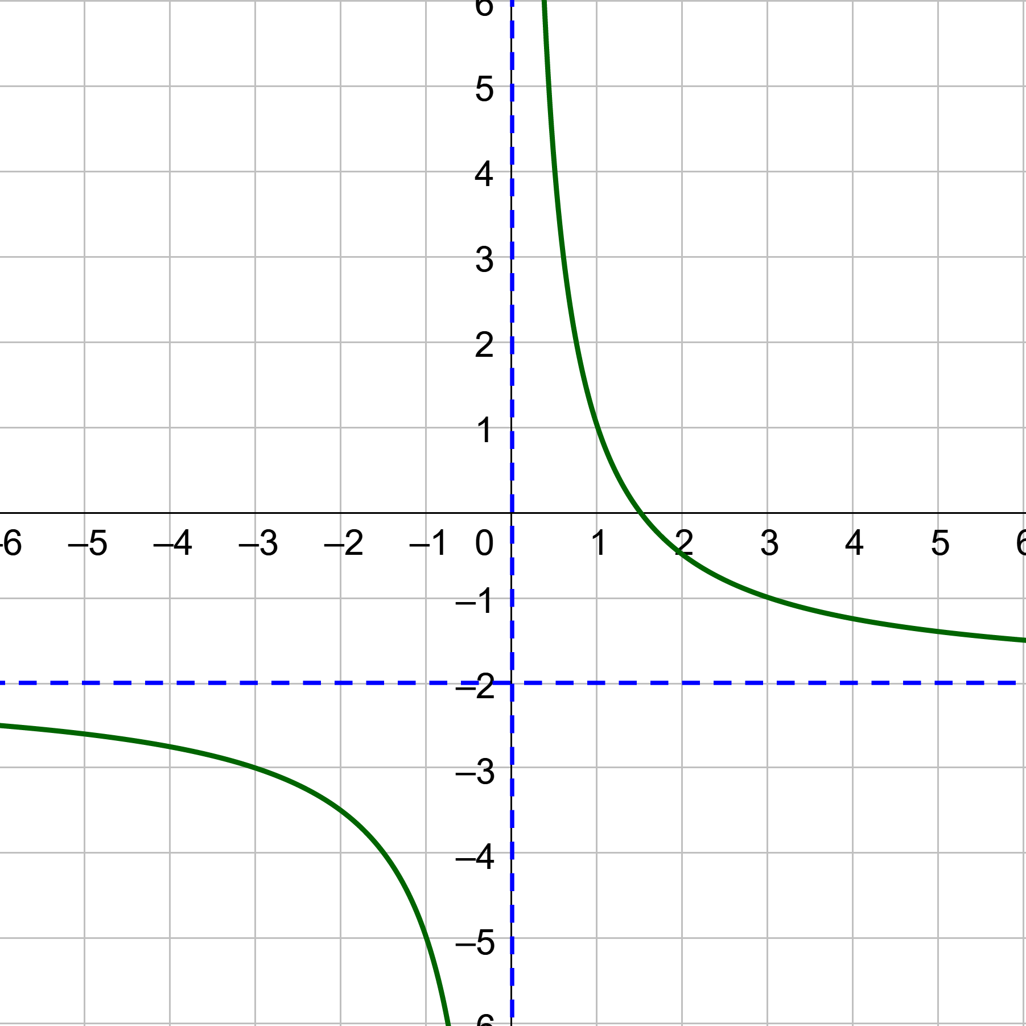
7.5 Solving Rational Equations
Try 391#37 $f\left(x\right)=\frac{3}{x}−2$. Determine whether the inverse of f is a function. Then find the inverse.
390 #1, 5, 11, 13, 15, 17, 19, 21, 23, 25, 27, 29, 35, 37, 39, 57, 59, 61, 63, 65
Notes:
The graph passes the horizontal line test, so the inverse is a function
Switch x and y
Solve for y

