Slide 1
Exponential Functions

Slide 2
What You Should Learn
Recognize and evaluate exponential functions with base a.
Graph exponential functions with base a.
Recognize, evaluate, and graph exponential functions with base e.
Use exponential functions to model and solve real-life problems.

Slide 4
Example 1 – Evaluating Exponential Functions
Try this on your calculator, but do not write it down.
Use a calculator to evaluate each function at the indicated value of x.
Function Value
a. f (x) = 2^{x} x = –3.1
b. f (x) = 2 ^{–x} x = π
c. f (x) = 0.6^{x} x =
d. f (x) = 1.05^{2x} x = 12

Slide 5
Example 1 – Solution

Slide 6
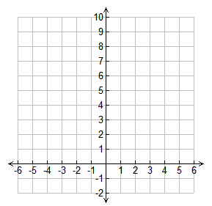
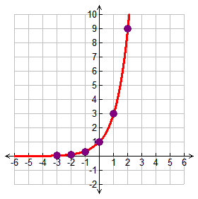
Complete the table.
Substitute -3 for x
y = 3⁻³
y = 1/27 or 0.04
Example 1
Graph y = 3^{x}.
x | y
-3
-2
-1
0
1
2
0.04
Write 0.04 in the table
0.1
Substitute -2 for x
y = 3⁻²
y = 1/9 or 0.1
0.3
1
Write 0.1 in the table
Continue substituting numbers for x until the table is complete
3
9
Plot the points on the graph and connect the points with a smooth curve with arrows at both ends – DO NOT CROSS THE x-axis!

Slide 7
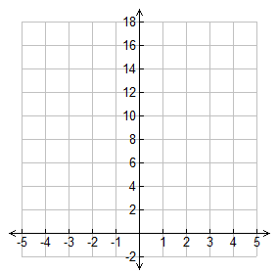
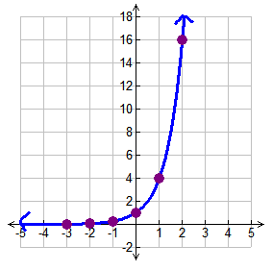
1. Graph y = 4^{x}.
x | y
-3
-2
-1
0
1
2
x | y
-3 | 0.02
-2 | 0.06
-1 | 0.25
0 | 1
1 | 4
2 | 16

Slide 9
Transformations
The graph of f(x) = b represents a parent graph of the exponential functions. The same techniques used to transform the graphs of other functions we have studied can be applied to the graphs of exponential functions.
x

Slide 12
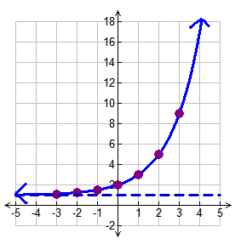
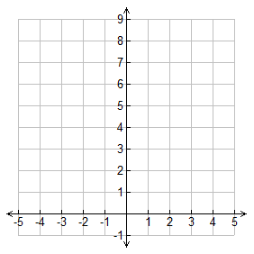
Example 2
Graph each function.
a. y = 2^{x} + 1
Complete the table.
Substitute -3 for x
y = 2⁻³ + 1
y = 1.125
x | y
-3
-2
-1
0
1
2
3
Write 1.1 in the table
1.1
Substitute -2 for x
y = 2⁻² + 1
y = 1.25
1.25
1.5
Write 1.25 in the table
Continue substituting
numbers for x until the table is complete then graph the points and draw the graph
2
3
This graph has a horizontal asymptote at y = 1 because of the +1 after the 2^{x} in the equation, so draw a dashed line at 1 – The graph can NOT cross or touch this line
5
9

Slide 13
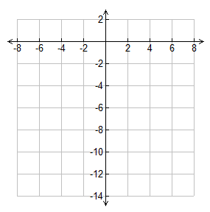
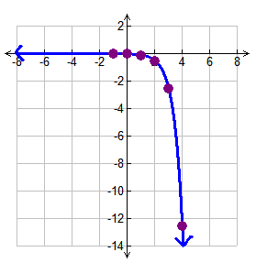
Complete the table.
Substitute -1 for x
Example 2
Graph each function.
y = -0.004
x | y
-1
0
1
2
3
4
Continue substituting
numbers for x until the table is complete then graph the points and draw the graph
-0.004
-0.02
-0.1
-0.5
This graph is reflected because the ½ is negative – the graph does NOT cross or touch the x-axis
-2.5
-12.5

Slide 14
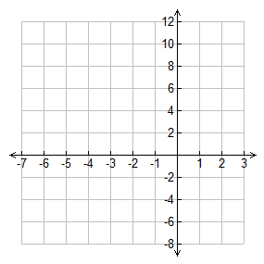
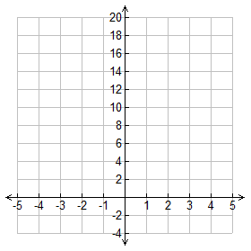
Practice.
Graph each function.
x | y
-5
-4
-3
-2
-1
0
1
x | y
-2
-1
0
1
2
3

Slide 15
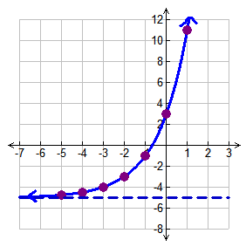
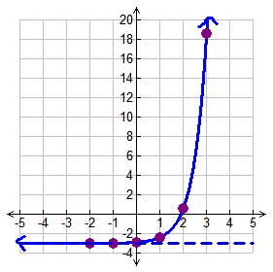
Practice.
Graph each function.
x | y
-5 | -4.75
-4 | -4.5
-3 | -4
-2 | -3
-1 | -1
0 | 3
1 | 11
x | y
-2 | -3
-1 | -2.98
0 | -2.9
1 | -2.4
2 | 0.6
3 | 18.6
There is a horizontal asymptote at y = -5 (This is the dashed line on the graph)
There is a horizontal asymptote at y = -3 (This is the dashed line on the graph)

Slide 17
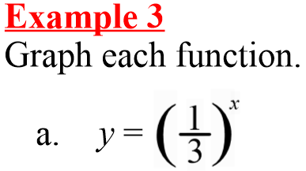
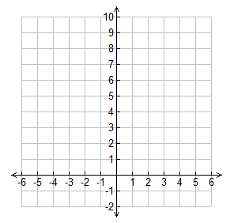
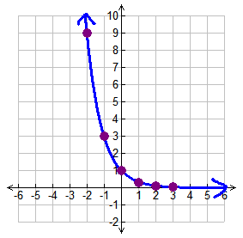
Complete the table.
Substitute -2 for x
x | y
-2
-1
0
1
2
9
y = 9
3
Continue substituting
numbers for x until the table is complete then graph the points and draw the graph
1
0.3
0.1

Slide 18
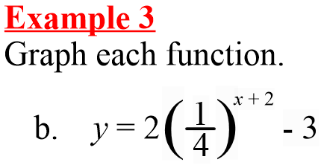
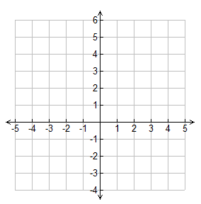
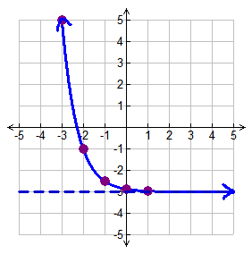
x | y
-3
-2
-1
0
1
Complete the table and sketch the graph.
5
-1
This graph has a horizontal asymptote at y = -3
-2.5
-2.9
-2.97

Slide 20
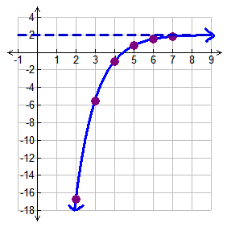
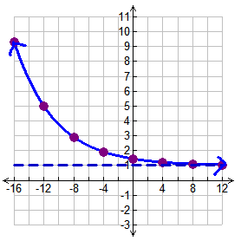
9.3
-16.75
5.01
-5.5
2.9
-1
1.9
0.8
1.45
1.2
1.52
There is a horizontal asymptote at y = 2
1.1
There is a horizontal asymptote at y = 1
1.808
1.05

