Slide 1
Exponential Growth and Decay Functions
Letterman
Lesson 38
Notes:
Chapter 6

Slide 2
Welcome Ritual
What is something that you have had to work to get better at in your life?

Slide 3
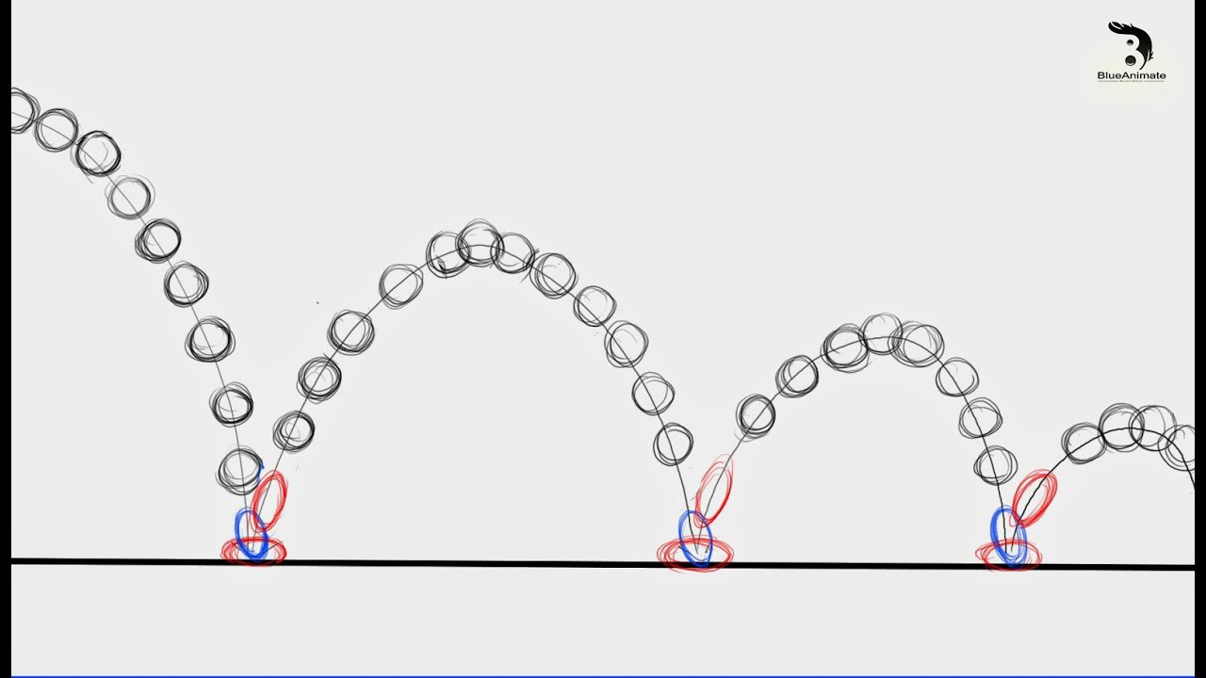
Ball Bounce Exploration
If we drop a tennis ball from 2,000 meters how high would it bounce?
How many bounces would it be before the height is less than 1000m?
Less than 500m?
Less than 100m?
Less than 10m?

Slide 4
Homework Exploration

Slide 5
8-1 Exponential Growth
Notes:
How much work will be done the last week of school?
Formula is 2^{n-1}
Plug in 36: 2³⁶⁻¹ = 3.436x10¹⁰ seconds → 9544371.769 hours → 397682.157 days → 1088.8 years

Slide 6
WRIGHT

Slide 7
Homework Exploration
Work with a partner.
Calculate how much time you will spend on your homework the last week of the 36-week school year. You start with 1 second of homework on week one and double the time every week.

Slide 8
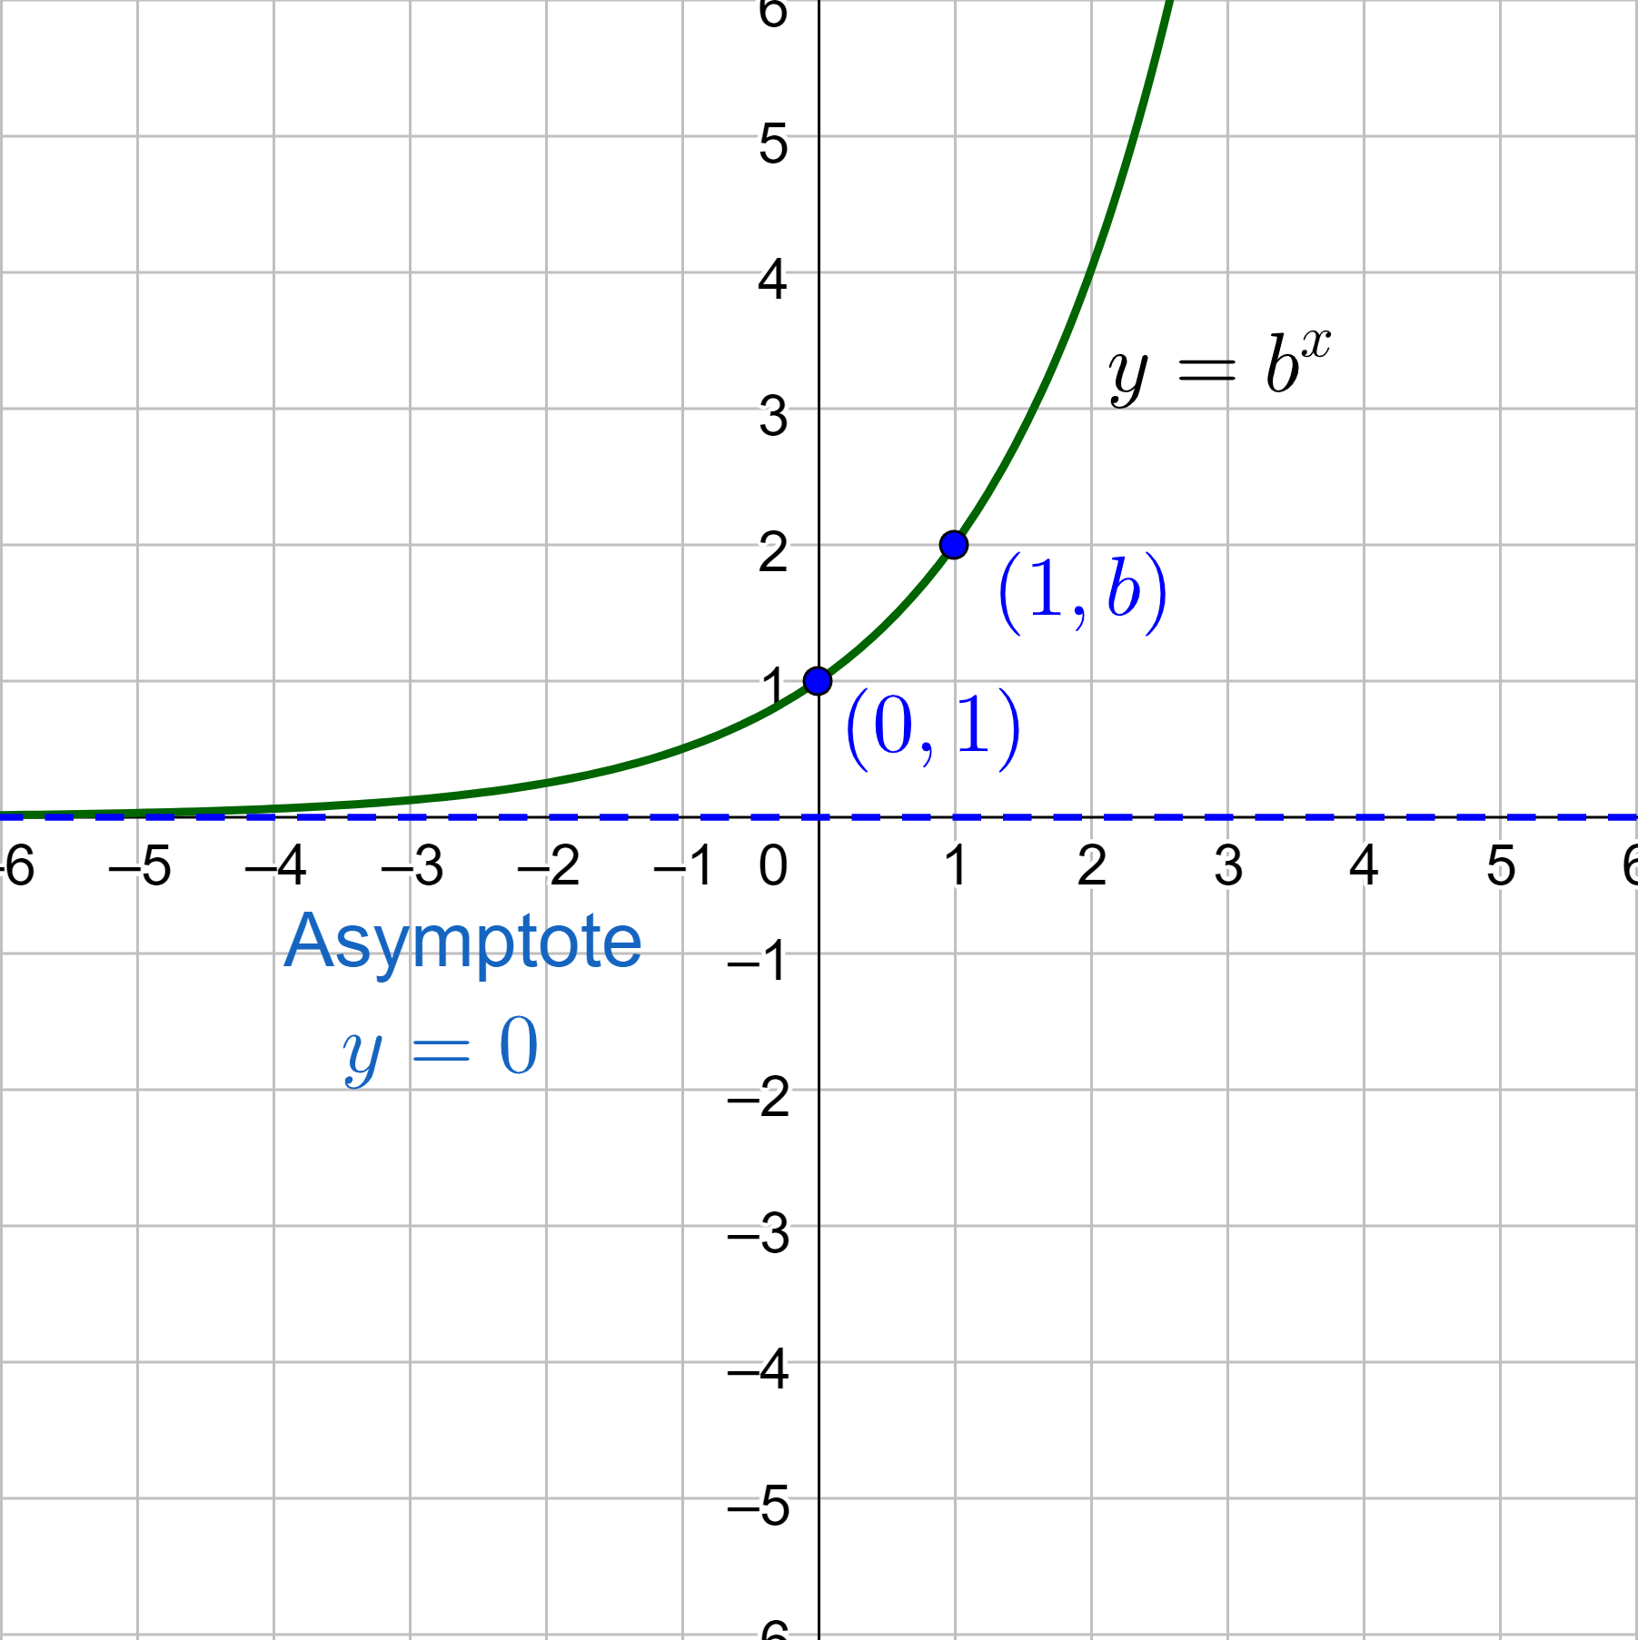
Exponential Growth and Decay Functions
Exponential Function
y = b^{x}
Base (b) is a positive number other than 1
Exponential Growth
Always increasing and rate of change is increasing
b > 1
y-intercept is (0, 1)
Horizontal asymptote y = 0
b is the growth factor

Slide 9
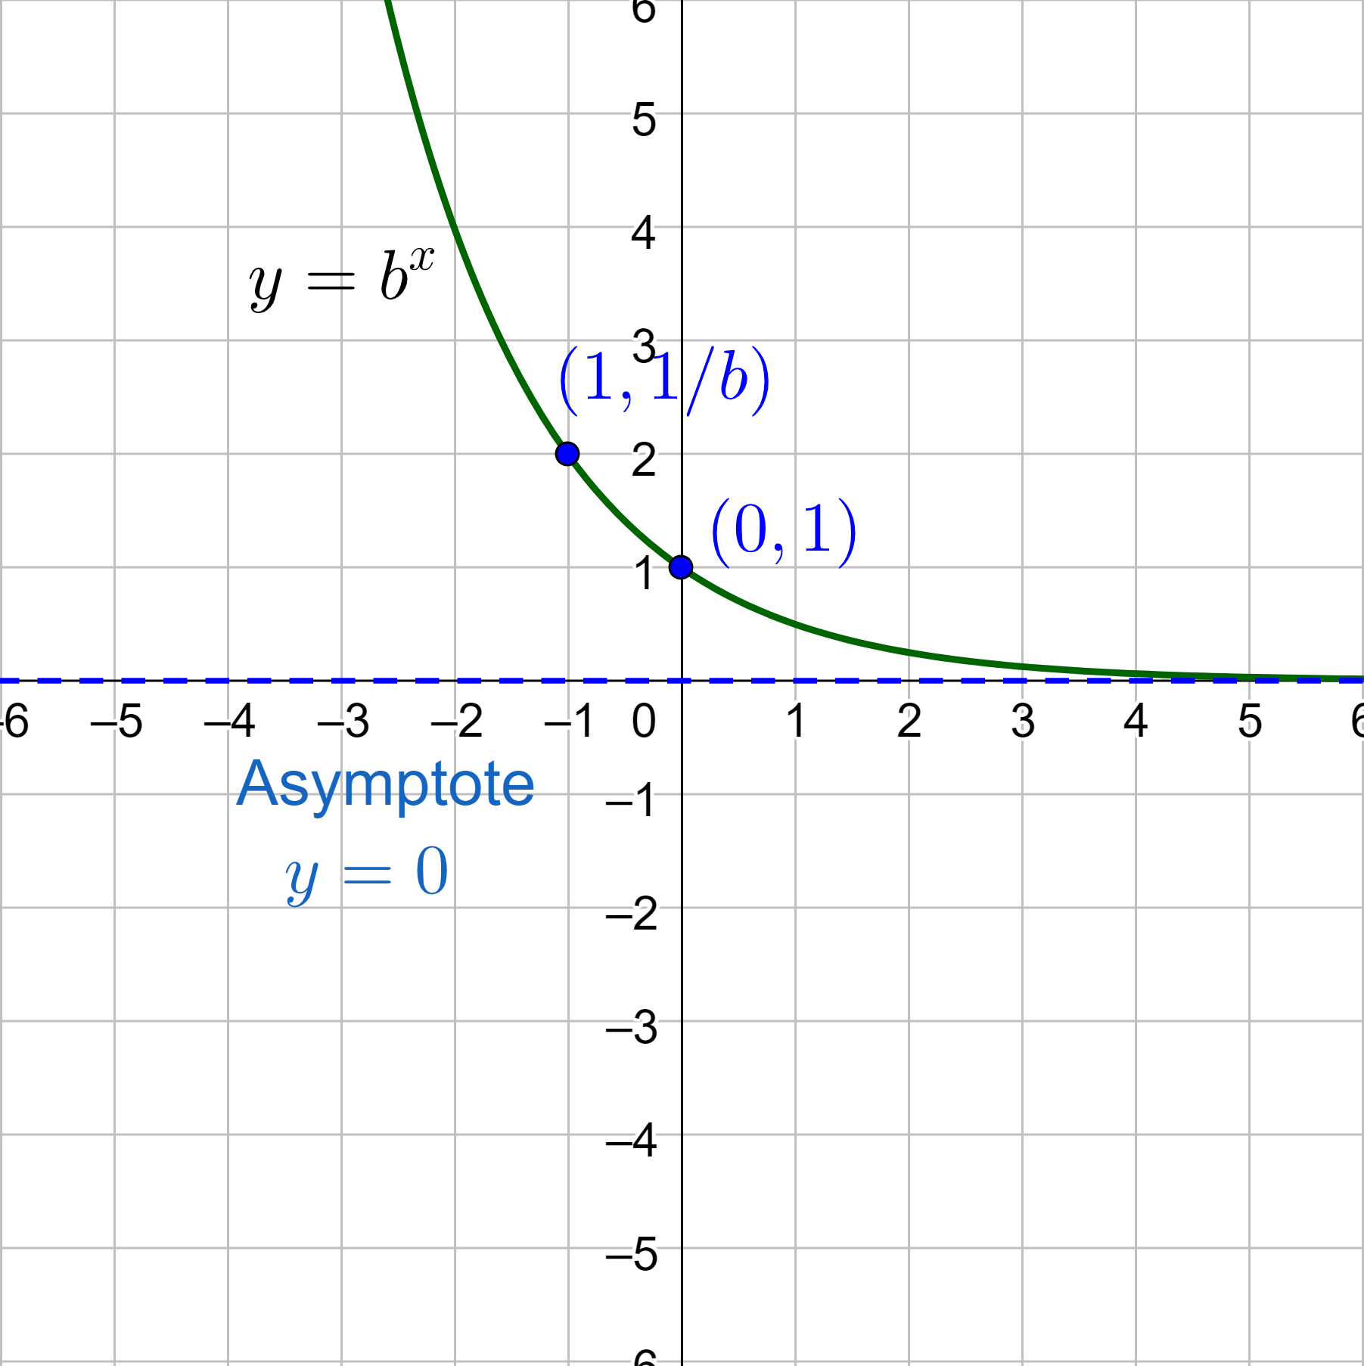
Exponential Growth and Decay Functions
Exponential Decay
Always decreasing and rate of change is decreasing
0 < b < 1
y-intercept is (0, 1)
Horizontal asymptote y = 0
b is the decay factor

Slide 10
Exponential Growth and Decay Functions
Exponential Growth Model (word problems)
$$y=a{\left(1+r\right)}^{t}$$
y = current amount
a = initial amount
r = growth percent
1 + r = growth factor
t = time
Exponential Decay Model (word problems)
$$y=a{\left(1−r\right)}^{t}$$
y = current amount
a = initial amount
r = decay percent
1 – r = decay factor
t = time

Slide 11
Exponential Growth and Decay Functions
The population P (in millions) of Peru during a recent decade can be approximated by $P=28.22{\left(1.01\right)}^{t}$, where t is the number of years since the beginning of the decade.
(a) Determine whether the model represents exponential growth or decay
(b) identify the annual percent increase or decrease in population
(c) Estimate when the population was about 30 million
Notes:
Base is 1.01 > 1 growth
1.01 = 1 + r → 0.01 = r = 1%
about 6.2 years since the beginning of the decade

Slide 12
Exponential Growth and Decay Functions
The value of a mountain bike y (in dollars) can be approximated by the model $y=200{\left(0.65\right)}^{t}$, where t is the number of years since the bike was purchased.
(a) Determine whether the model represents exponential growth or decay
(b) Identify the annual percent increase or decrease
(c) Estimate when the value of the bike will be $50
Notes:
Base = 0.65 < 1 decay
0.65 = 1 – r → -0.35 = -r → r = 0.35 = 35%
about 3.2 years after it was purchased

Slide 13
Exponential Growth and Decay Functions
Compound Interest
$$A=P{\left(1+\frac{r}{n}\right)}^{nt}$$
A = amount at time t
P = principle (initial amount)
r = annual rate
n = number of times interest is compounded per year
Find the balance in the account earning compound interest after 6 years when the principal is $3500. r = 2.16%, compounded quarterly

