Slide 1
The Natural Base e

Slide 2
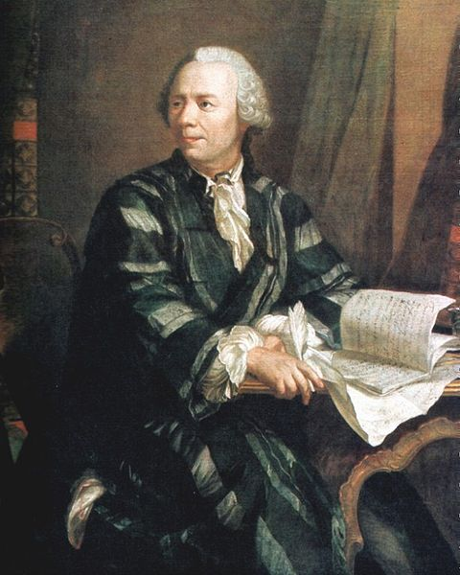
The Number e
Euler’s number
Leonhard Euler (pronounced “oiler”)
Swiss mathematician and physicist

Slide 3
The Number e
Compute:
x
x
–.1
2.868
.1
2.5937
–.01
2.732
.01
2.7048
–.001
2.7196
.001
2.7169

Slide 4
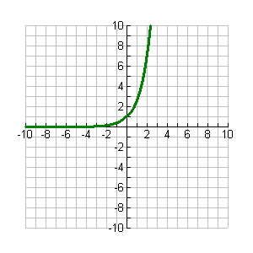
The Exponential Function
f (x) = e^{x}

Slide 5
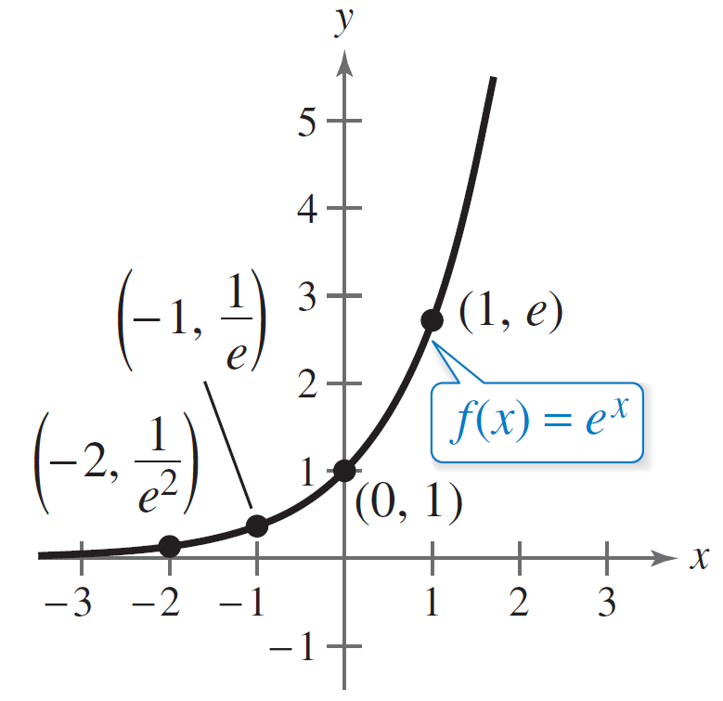
The Natural Base e
For many applications, the convenient choice for a base is the irrational number
e = 2.718281828 . . . .
This number is called the natural base. The function
f (x) = e^{x}
is called the natural exponential function and its graph is shown in Figure 3.9.
The Natural Exponential Function
Figure 3.9

Slide 6
Example 6 – Evaluating the Natural Exponential Functions
Use a calculator to evaluate the function
f (x) = e^{x}
at each indicated value of x.
a. x = –2
b. x = 0.25
c. x = –0.4
d. x =
Do this on your calculator, but do not write it down.

Slide 7
Example 6 – Solution

Slide 8
Logarithmic Functions
After this lesson…
I can evaluate logarithms.
I can rewrite exponential equations as logarithmic equations.
I can rewrite logarithmic equations as exponential equations.

Slide 9
Exponential Growth and Decay Functions
The population P (in millions) of Peru during a recent decade can be approximated by $P=28.22{\left(1.01\right)}^{t}$, where t is the number of years since the beginning of the decade.
(a) Determine whether the model represents exponential growth or decay
(b) identify the annual percent increase or decrease in population
(c) Estimate when the population was about 30 million
Notes:
Base is 1.01 > 1 growth
1.01 = 1 + r → 0.01 = r = 1%
$30=28.22{\left(1.01\right)}^{t}$ $1.063={1.01}^{t}$ $\log_{1.01}{1.063}={\log_{1.01}{1.01}}^{t}$ $6.15=t$ about 6.2 years since the beginning of the decade

Slide 10
Rewrite Exponential as Logarithmic Functions
Logarithms are exponents
$\log_{b}{a}=$ exponent of b to get a
$\log_{3}{81}$
$\log_{3}{3}$
Notes:
$$\log_{3}{81}$$
$$3^{x}=81$$
$$x=4$$
Can use trial and error
$$\log_{3}{3}$$
$$3^{x}=3$$
$$x=1$$

Slide 11
Rewrite Exponential as Logarithmic Functions
Calculator has two logs
Common Log: log = $\log_{10}{}$
Natural Log: ln = $\log_{e}{}$
(Some calculators can do log of any base.)
$\log{6}$
$\ln{\frac{1}{3}}$
Notes:
$$\log{6}=0.778$$
$$\ln{\frac{1}{3}}=−1.099$$

Slide 12
Rewrite Exponential as Logarithmic Functions
Definition of Logarithm with Base b
$\log_{b}{y}=x ⇔ b^{x}=y$
Read as “log base b of y equals x”
Logs = exponents!!
Logs and exponentials are inverses
They undo each other
They cancel each other out
Notes:
3² = 9
8⁰ = 1
5⁻² = 1/25

Slide 13
Rewrite Exponential as Logarithmic Functions
Rewrite as an exponential
$\log_{3}{9}=2$
Rewrite as a log
$6^{2}=36$
Notes:
$$\log_{3}{9}=2$$
Base = 3, exponent = 2, other = 9
$$3^{2}=9$$
$$6^{2}=36$$
Base = 6, exponent = 2, other = 36
$$\log_{6}{36}=2$$

Slide 14
Rewrite Exponential as Logarithmic Functions
Simplify log expressions
If exponential with base b and log with base b are inside each other, they cancel
$7^{\log_{7}{x}}$
$\log_{3}{3^{2x}}$
Notes:
$$7^{\log_{7}{x}}=7^{\log_{7}{x}}=x$$
$$\log_{3}{3^{2x}}=\log_{3}{3^{2x}}=2x$$

Slide 15
Exponential Growth and Decay Functions
The population P (in millions) of Peru during a recent decade can be approximated by $P=28.22{\left(1.01\right)}^{t}$, where t is the number of years since the beginning of the decade.
Estimate when the population was about 30 million
Notes:
Base is 1.01 > 1 growth
1.01 = 1 + r → 0.01 = r = 1%
$30=28.22{\left(1.01\right)}^{t}$ $1.063={1.01}^{t}$ $\log_{1.01}{1.063}={\log_{1.01}{1.01}}^{t}$ $6.15=t$ about 6.2 years since the beginning of the decade

