Slide 1
Graphing Logarithmic Functions
After this lesson…
I can graph exponential functions.
I can graph logarthmic functions.
I can find inverses of exponential and logarithmic functions.

Slide 2
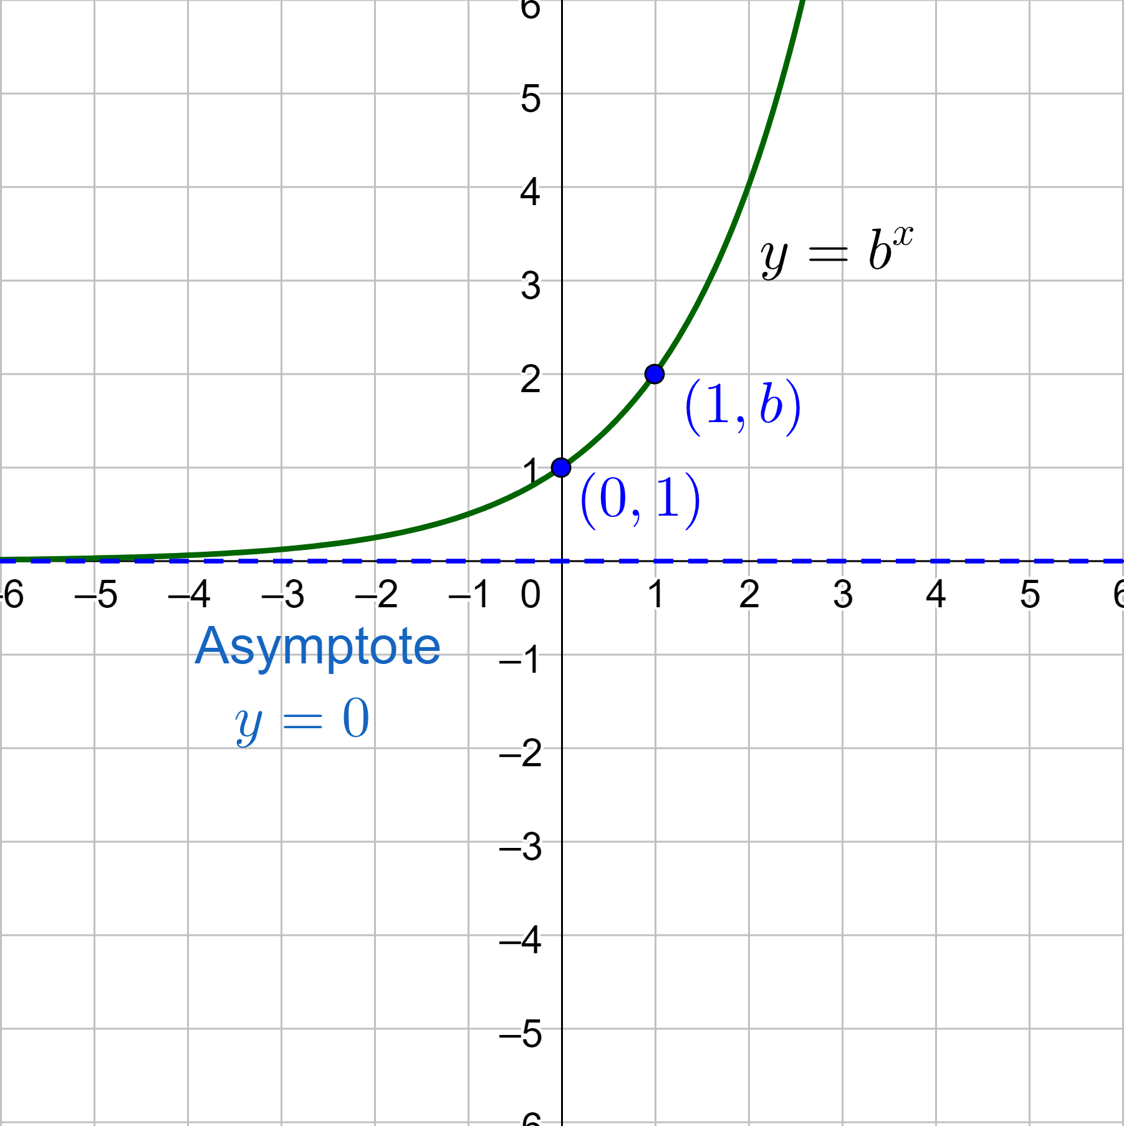
6-05 Graph Exponential and Logarithmic Functions (6.4)
Exponential Function
y = b^{x}
Base (b) is a positive number other than 1
In general
$$y=ab^{cx−h}+k$$
a is vertical stretch
If a is −, reflect over x-axis
c is horizontal shrink
Shrink by $\frac{1}{c}$
h is horizontal shift
k is vertical shift
Horizontal asymptote: y = k

Slide 3
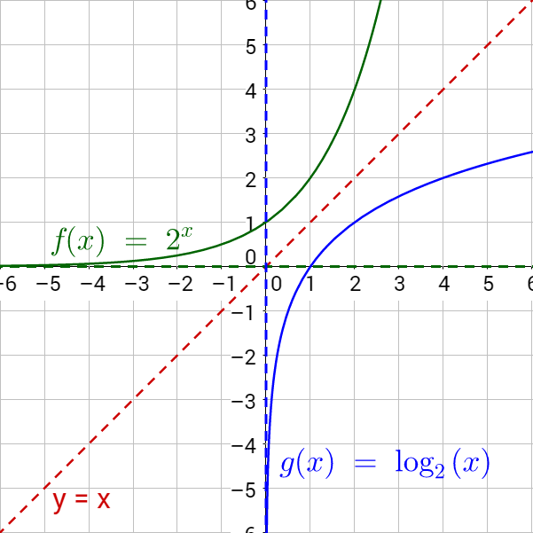
6-05 Graph Exponential and Logarithmic Functions (6.4)
Logarithmic Function
$$y=\log_{b}{x}$$
Base (b) is a positive number other than 1
Logarithms and exponentials are inverses
x and y are switched
Graphically, reflected over y = x
Horizontal asymptote becomes vertical asymptote

Slide 4
Graphing Logarithmic Functions
In general
$$y=a\log_{b}\left(cx−h\right)+k$$
a is vertical stretch
If a is −, reflect over x-axis
c is horizontal shrink
Shrink by $\frac{1}{c}$
h is horizontal shift
k is vertical shift
Vertical asymptote: x = h
Graph Logarithmic Functions
Find and graph the vertical asymptote
Make a table of values
You may need to use the change-of-base formula
Plot points and draw the curve
Make sure the curve is near the asymptotes at the edge of the graph
Notes:
To put in calculator, you might need to use change-of-base formula

Slide 5
Graphing Logarithmic Functions
(a) Describe the transformations.
(b) Graph the function.
$g\left(x\right)=−\log_{1/5}\left(x−7\right)$
Notes:
Transformations: a = -1, h = 7, k = 0
Reflection in x-axis (−a) and shift 7 to right
Vertical asymptote: x = 7

Slide 6
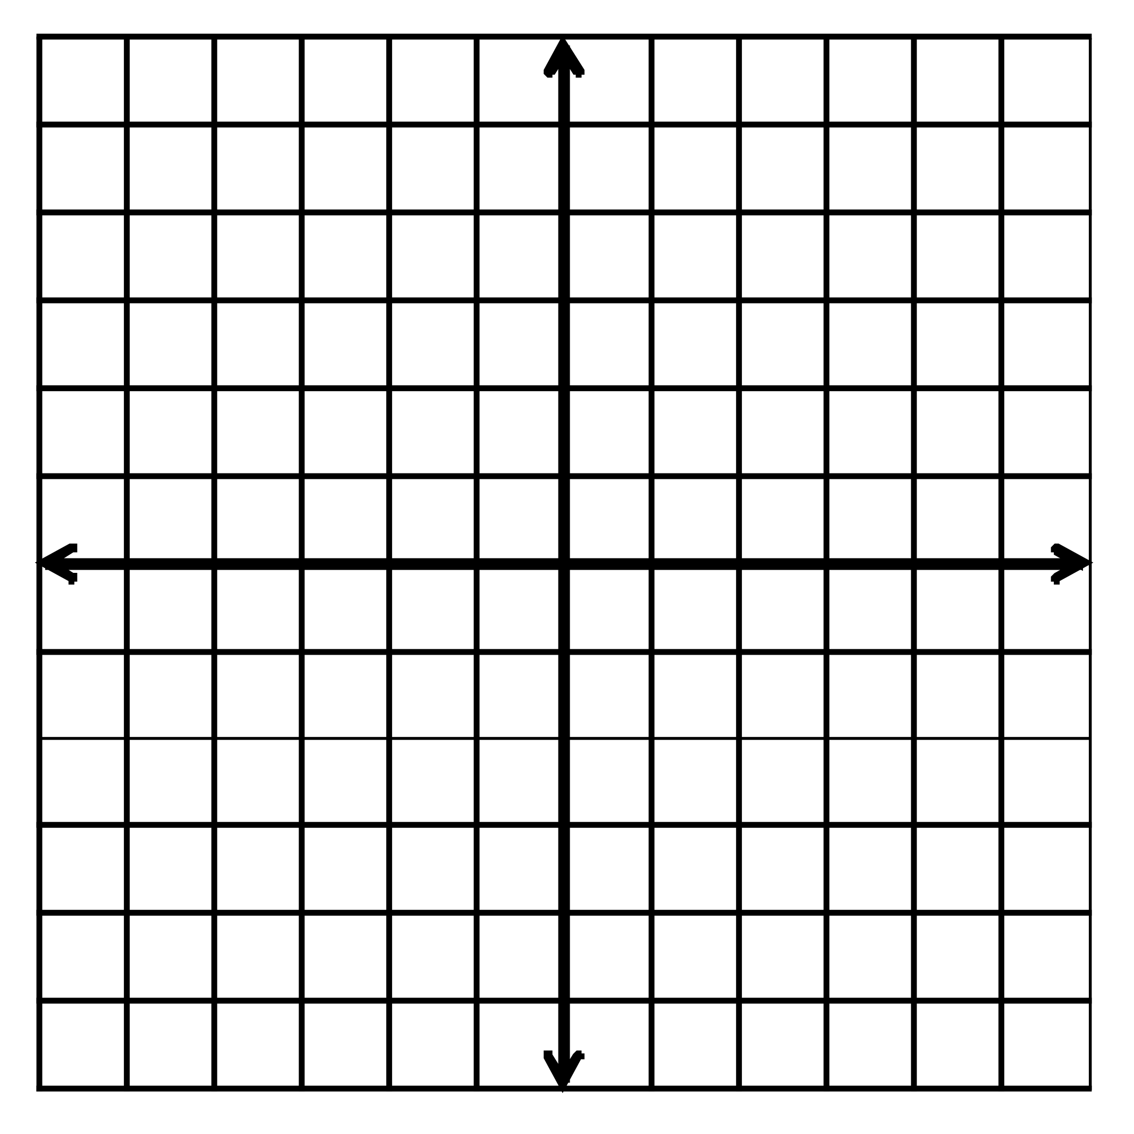
Graphing Logarithmic Functions
Describe the transformations.
Graph the function.
$g\left(x\right)=3\log_{4}{x}−5$
Notes:
Transformations: a = 3, h = 0, k = -5
Vertical stretch by factor of 3; vertical shift up 5
Vertical asymptote: x = 0

Slide 7
Graphing Logarithmic Functions
Find the inverse
Isolate log or exponential part
Switch x and y
Then rewrite as exponential or log
$$y=\ln\left(x−1\right)$$
$$y=5^{x}−9$$
Notes:
Base = e, exponent = x, other = y – 1
Base = 5, exponent = y, other x – 9

Slide 8
6-05 Graph Exponential and Logarithmic Functions (6.4)
Assignment: 15 total
Graph Exponential Functions: 320#15, 17, 21
Graph Logarithmic Functions: 313#57, 59; 320#25, 27
Find Inverses: 313#43, 45, 47, 51
Mixed Review: 322# 53, 55, 62, 65

