Slide 1
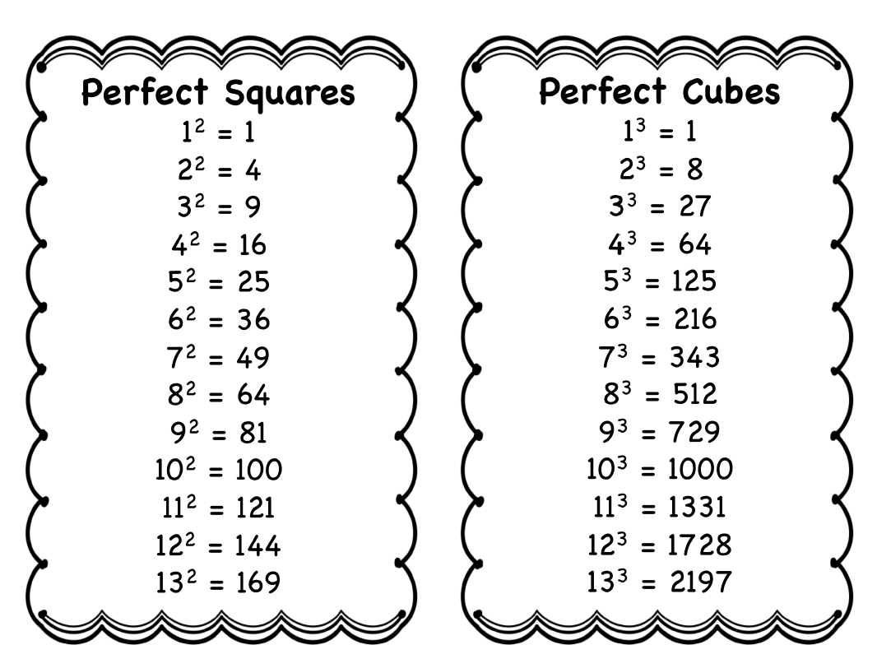

Slide 2
Radical Expressions and Graphs
7.1
1. Find roots of numbers.
2. Find principal roots.
3. Graph functions defined by radical expressions.
4. Find nth roots of nth powers.
5. Use a calculator to find roots.

Slide 3
Objective 1
Find roots of numbers.

Slide 4
Find roots of numbers.

Slide 5
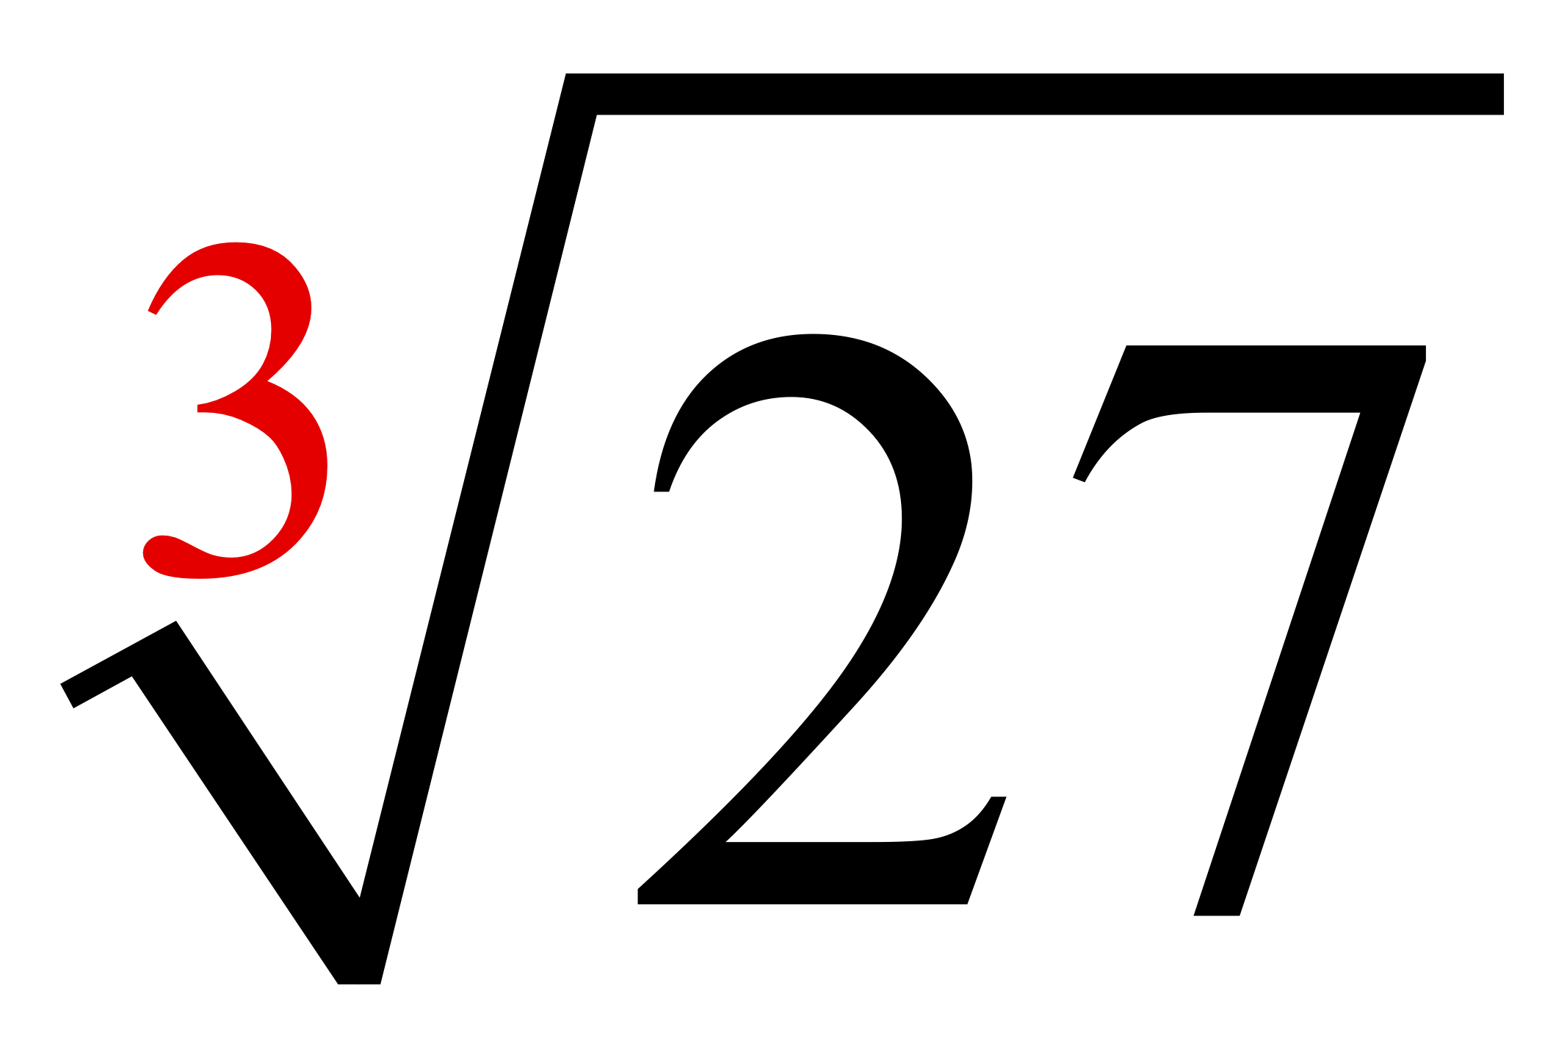
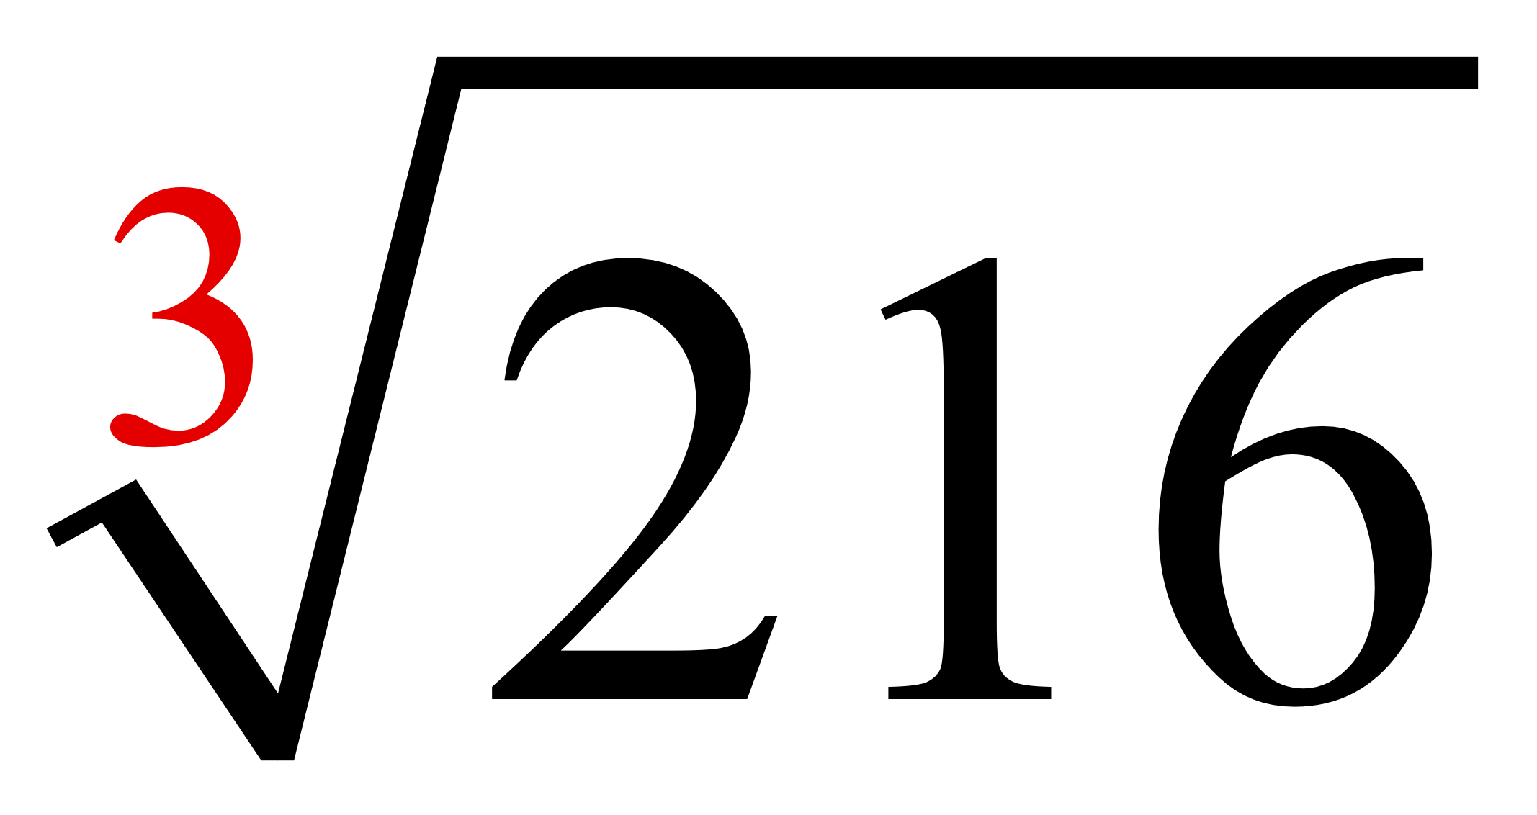
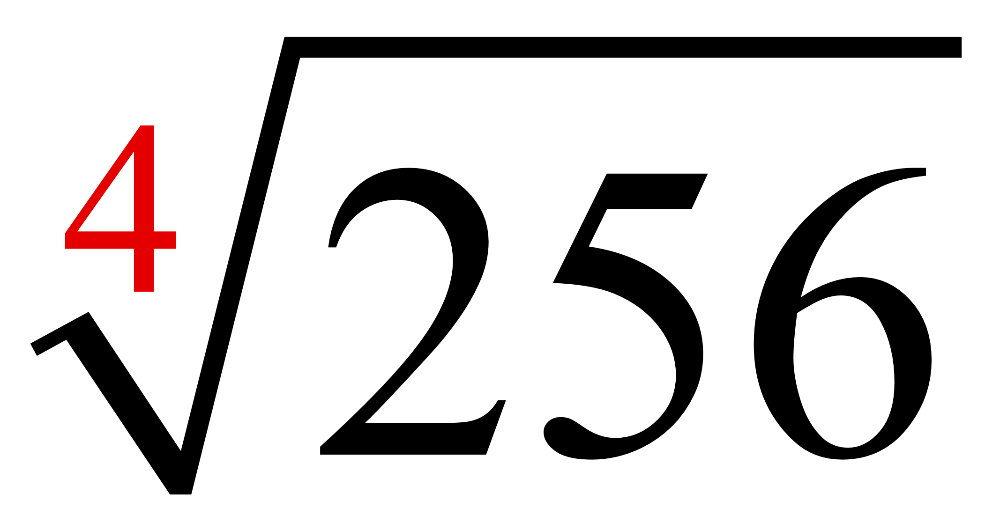
Classroom Example 1
Simplifying Higher Roots
Find each root.
a.
b.
c.
= 3, because 3³ = 27
= 6, because 6³ = 216
= 4, because 4⁴ = 256

Slide 6
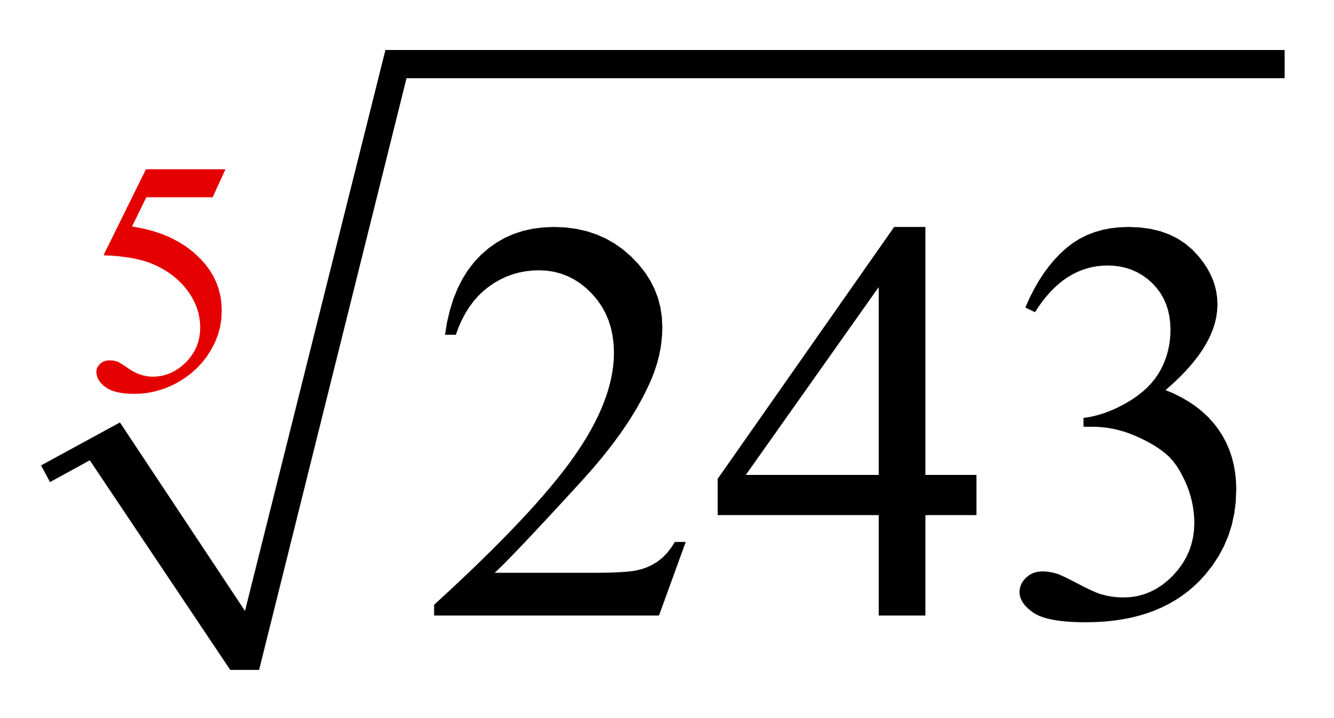
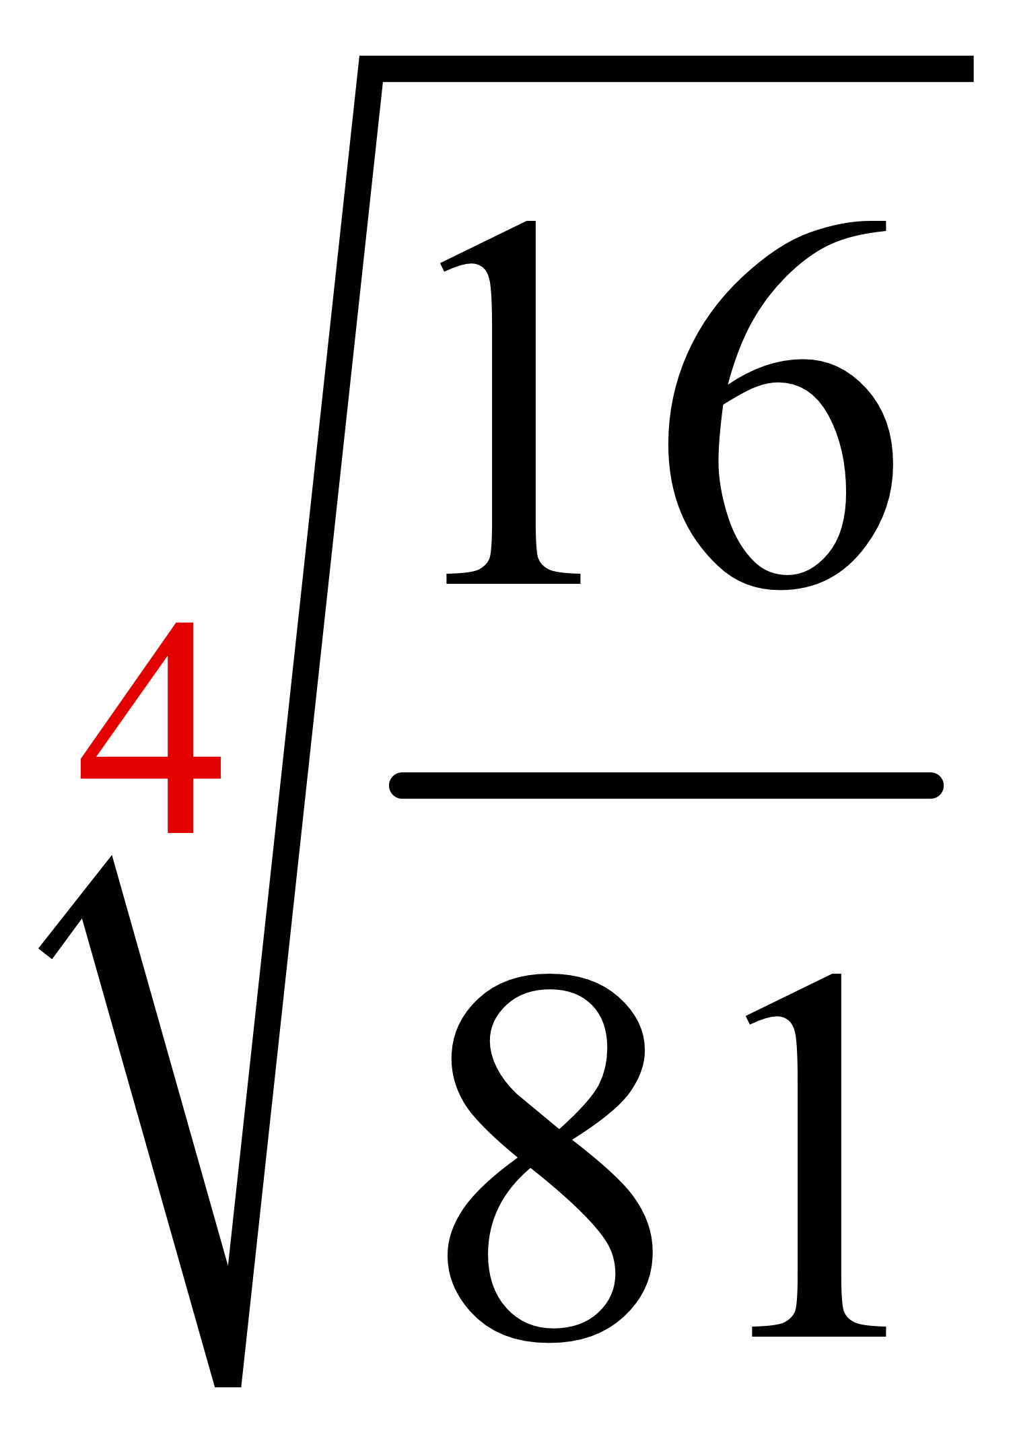
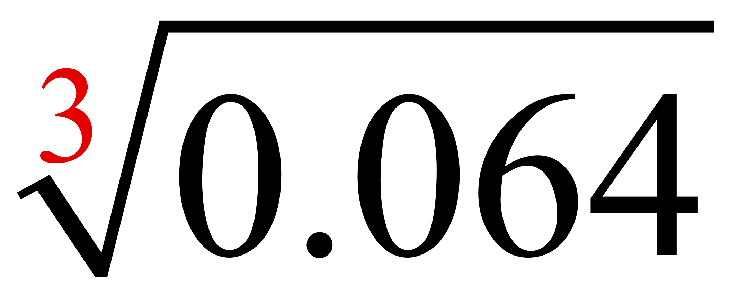
Classroom Example 1
Simplifying Higher Roots (cont.)
Find each root.
d.
e.
f.
= 3, because 3⁵ = 243
= 0.4, because 0.4³ = 0.064

Slide 7
Objective 2
Find principal roots.

Slide 8
Find principal roots.

Slide 9
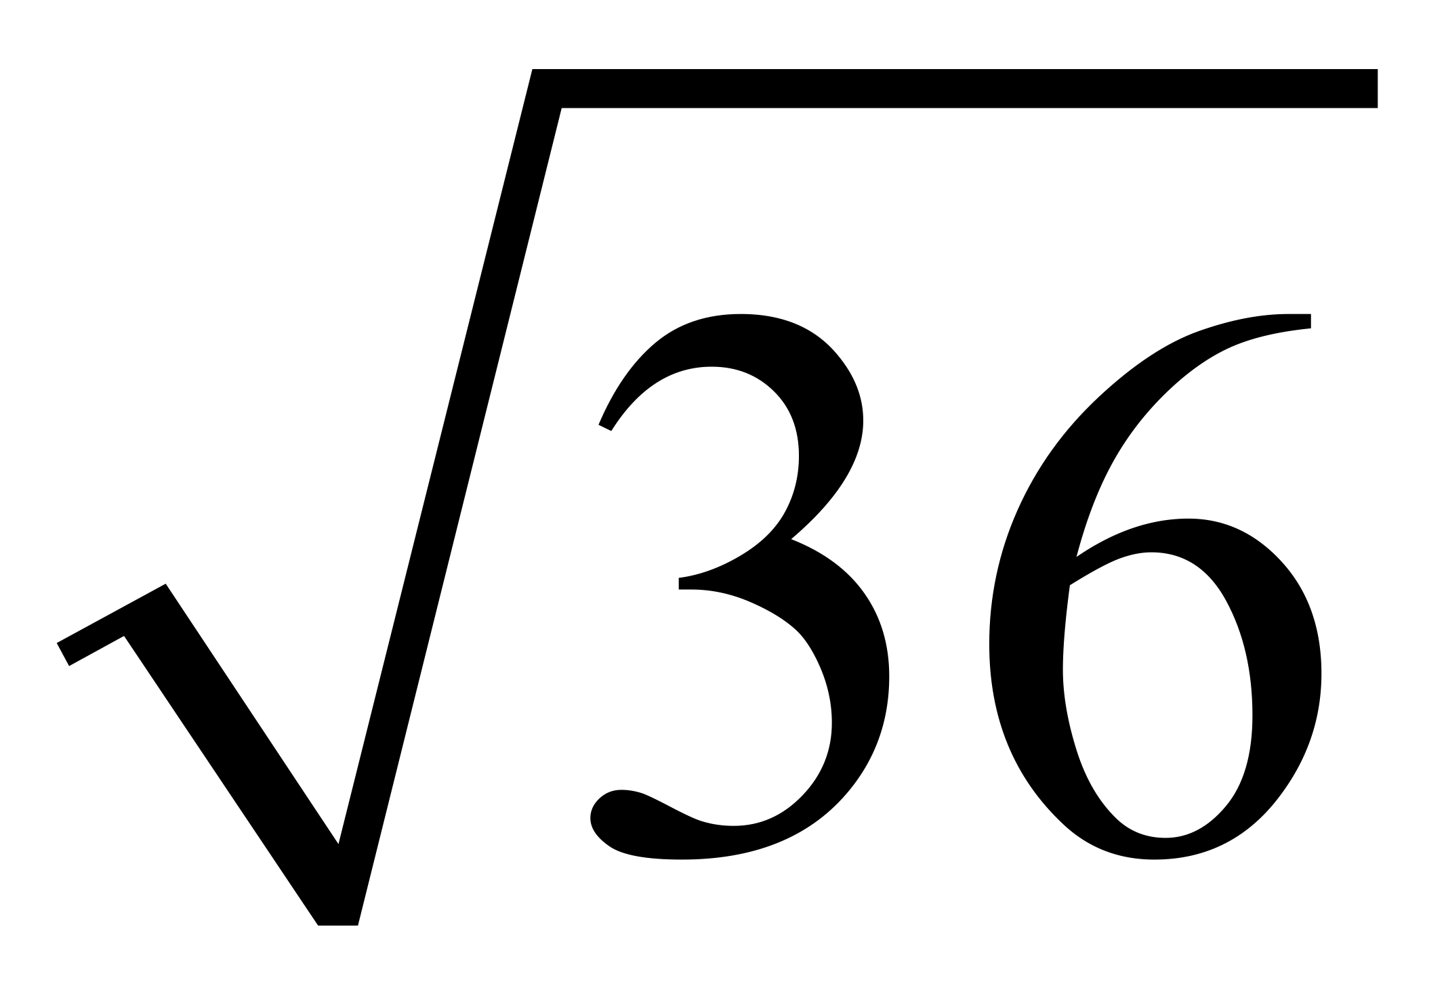
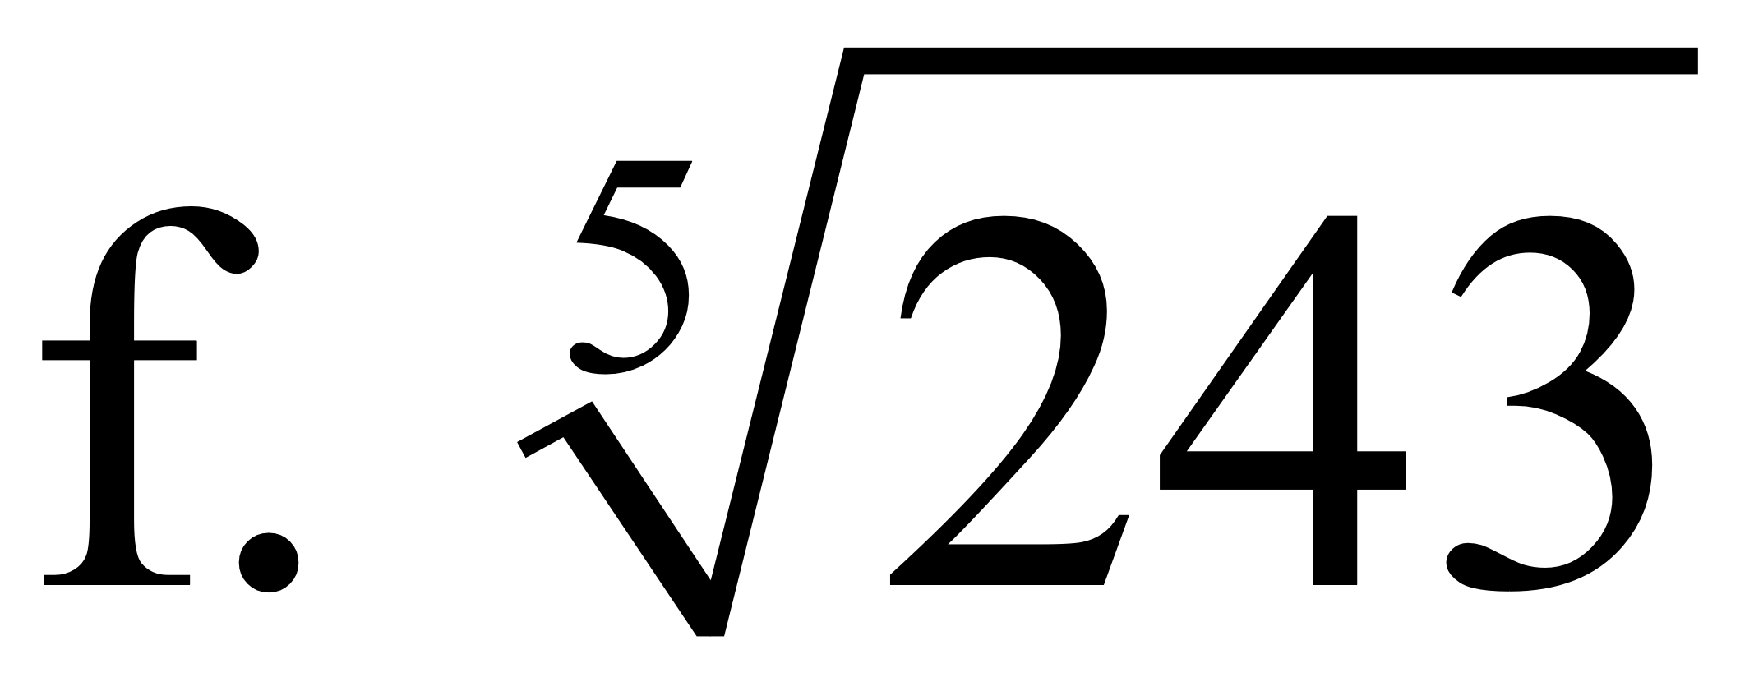
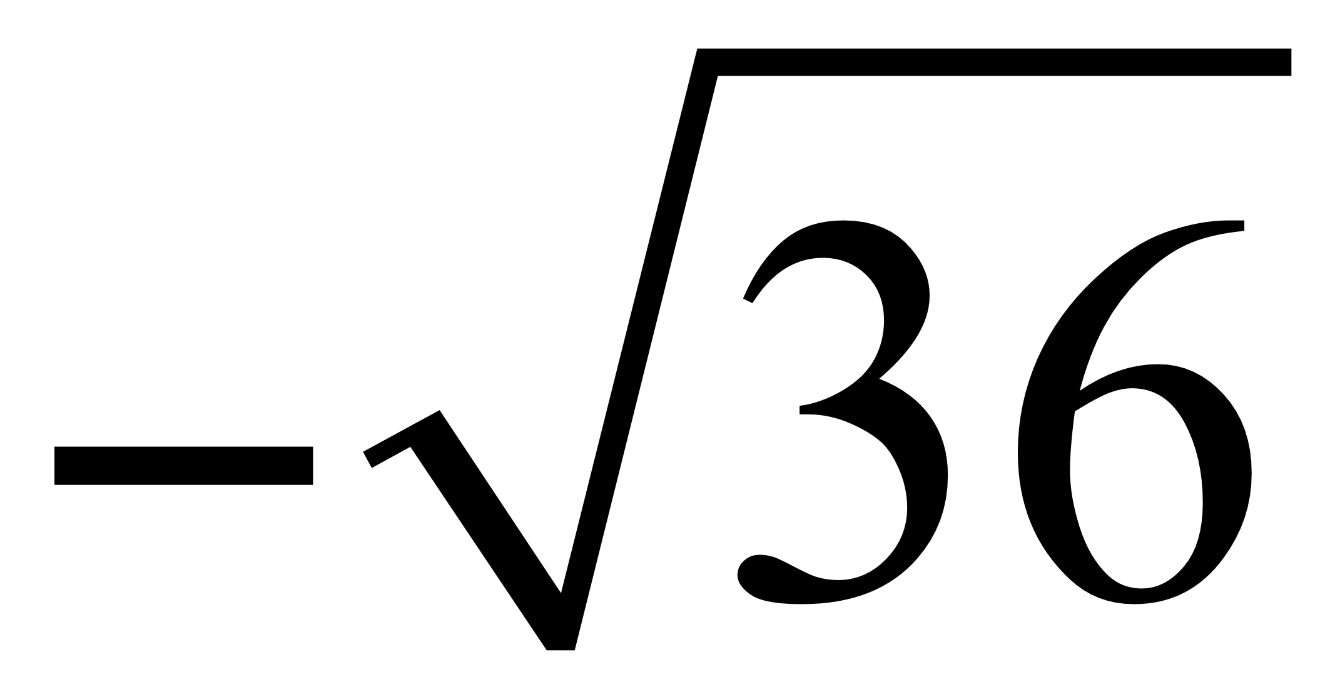
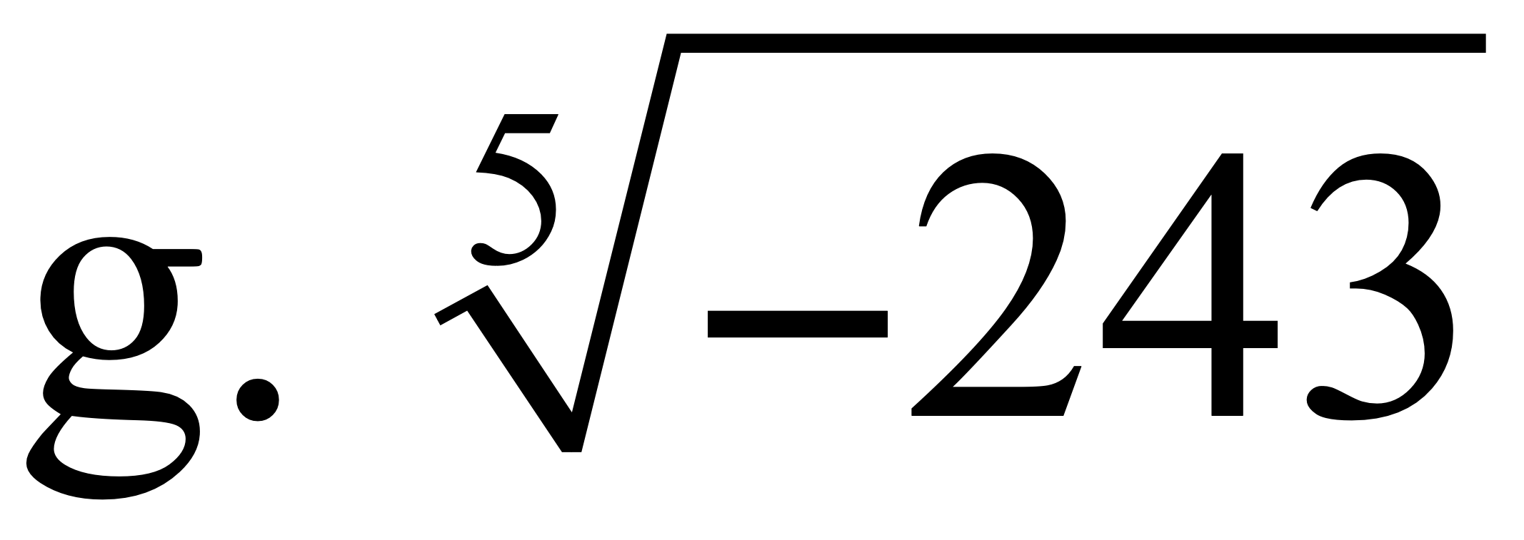
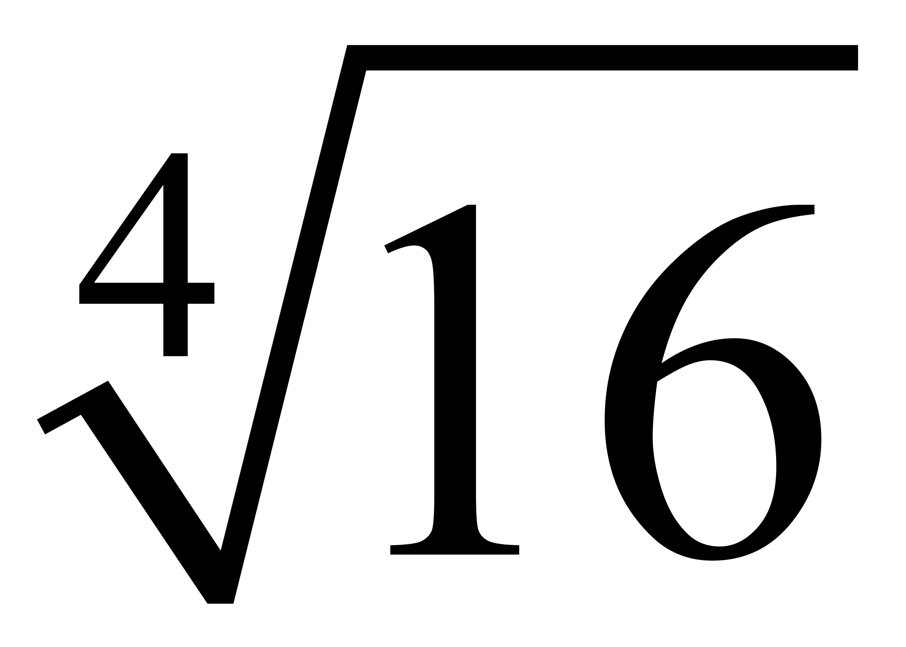
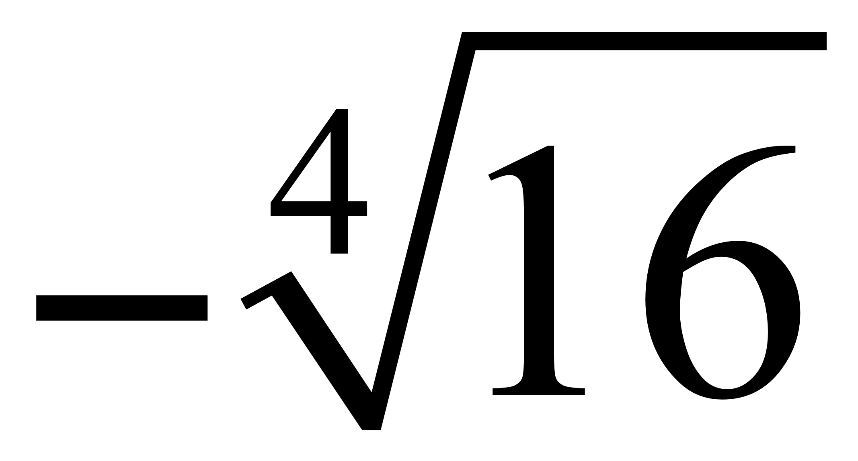
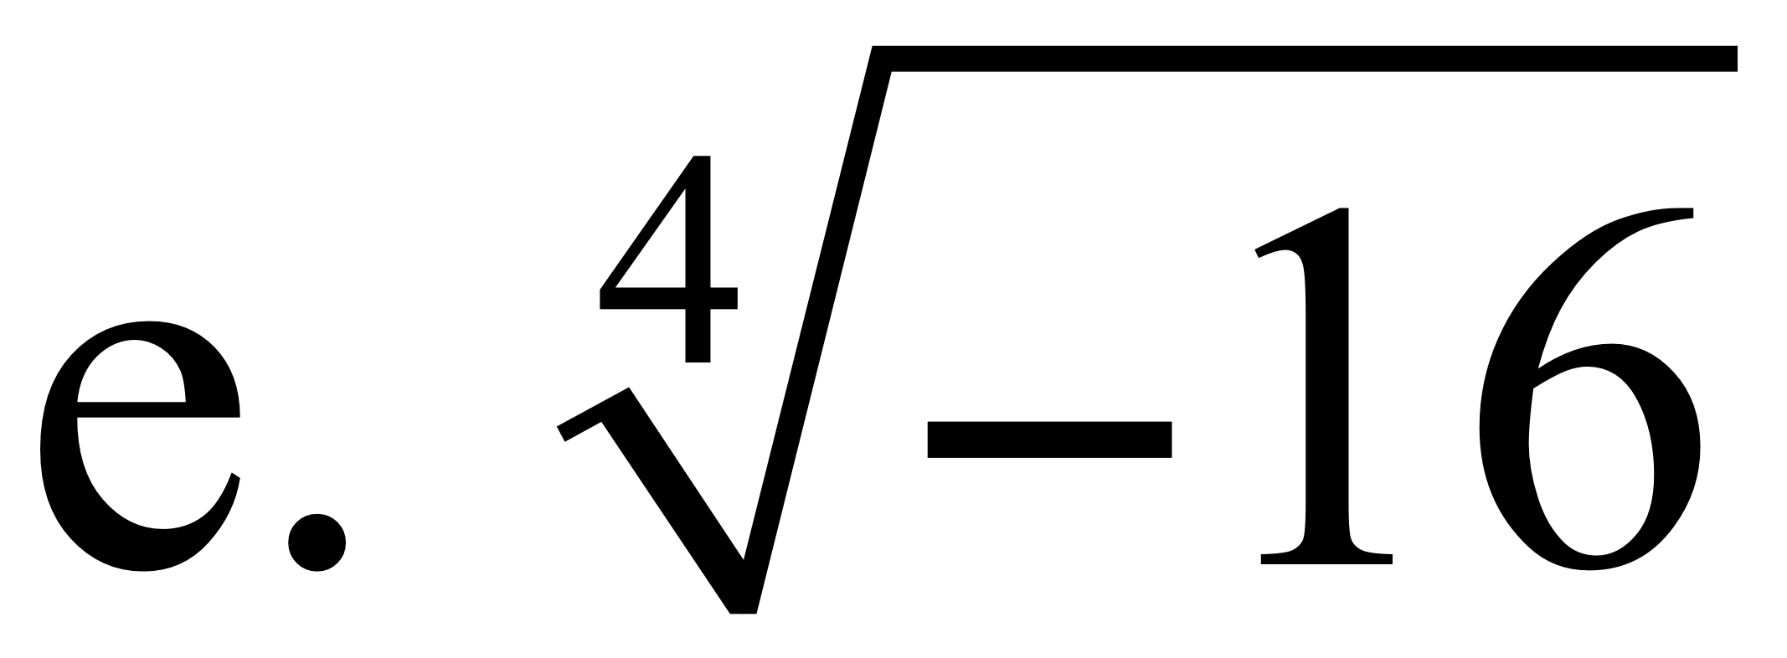
Classroom Example 2
Finding Roots
Find each root.
a.
b.
c.
d.
= 6
= 3
= –6
= –3
= 2
= –2
Not a real number

Slide 10
Objective 4
Find nth roots of nth powers.

Slide 11
Find nth roots of nth powers.

Slide 12
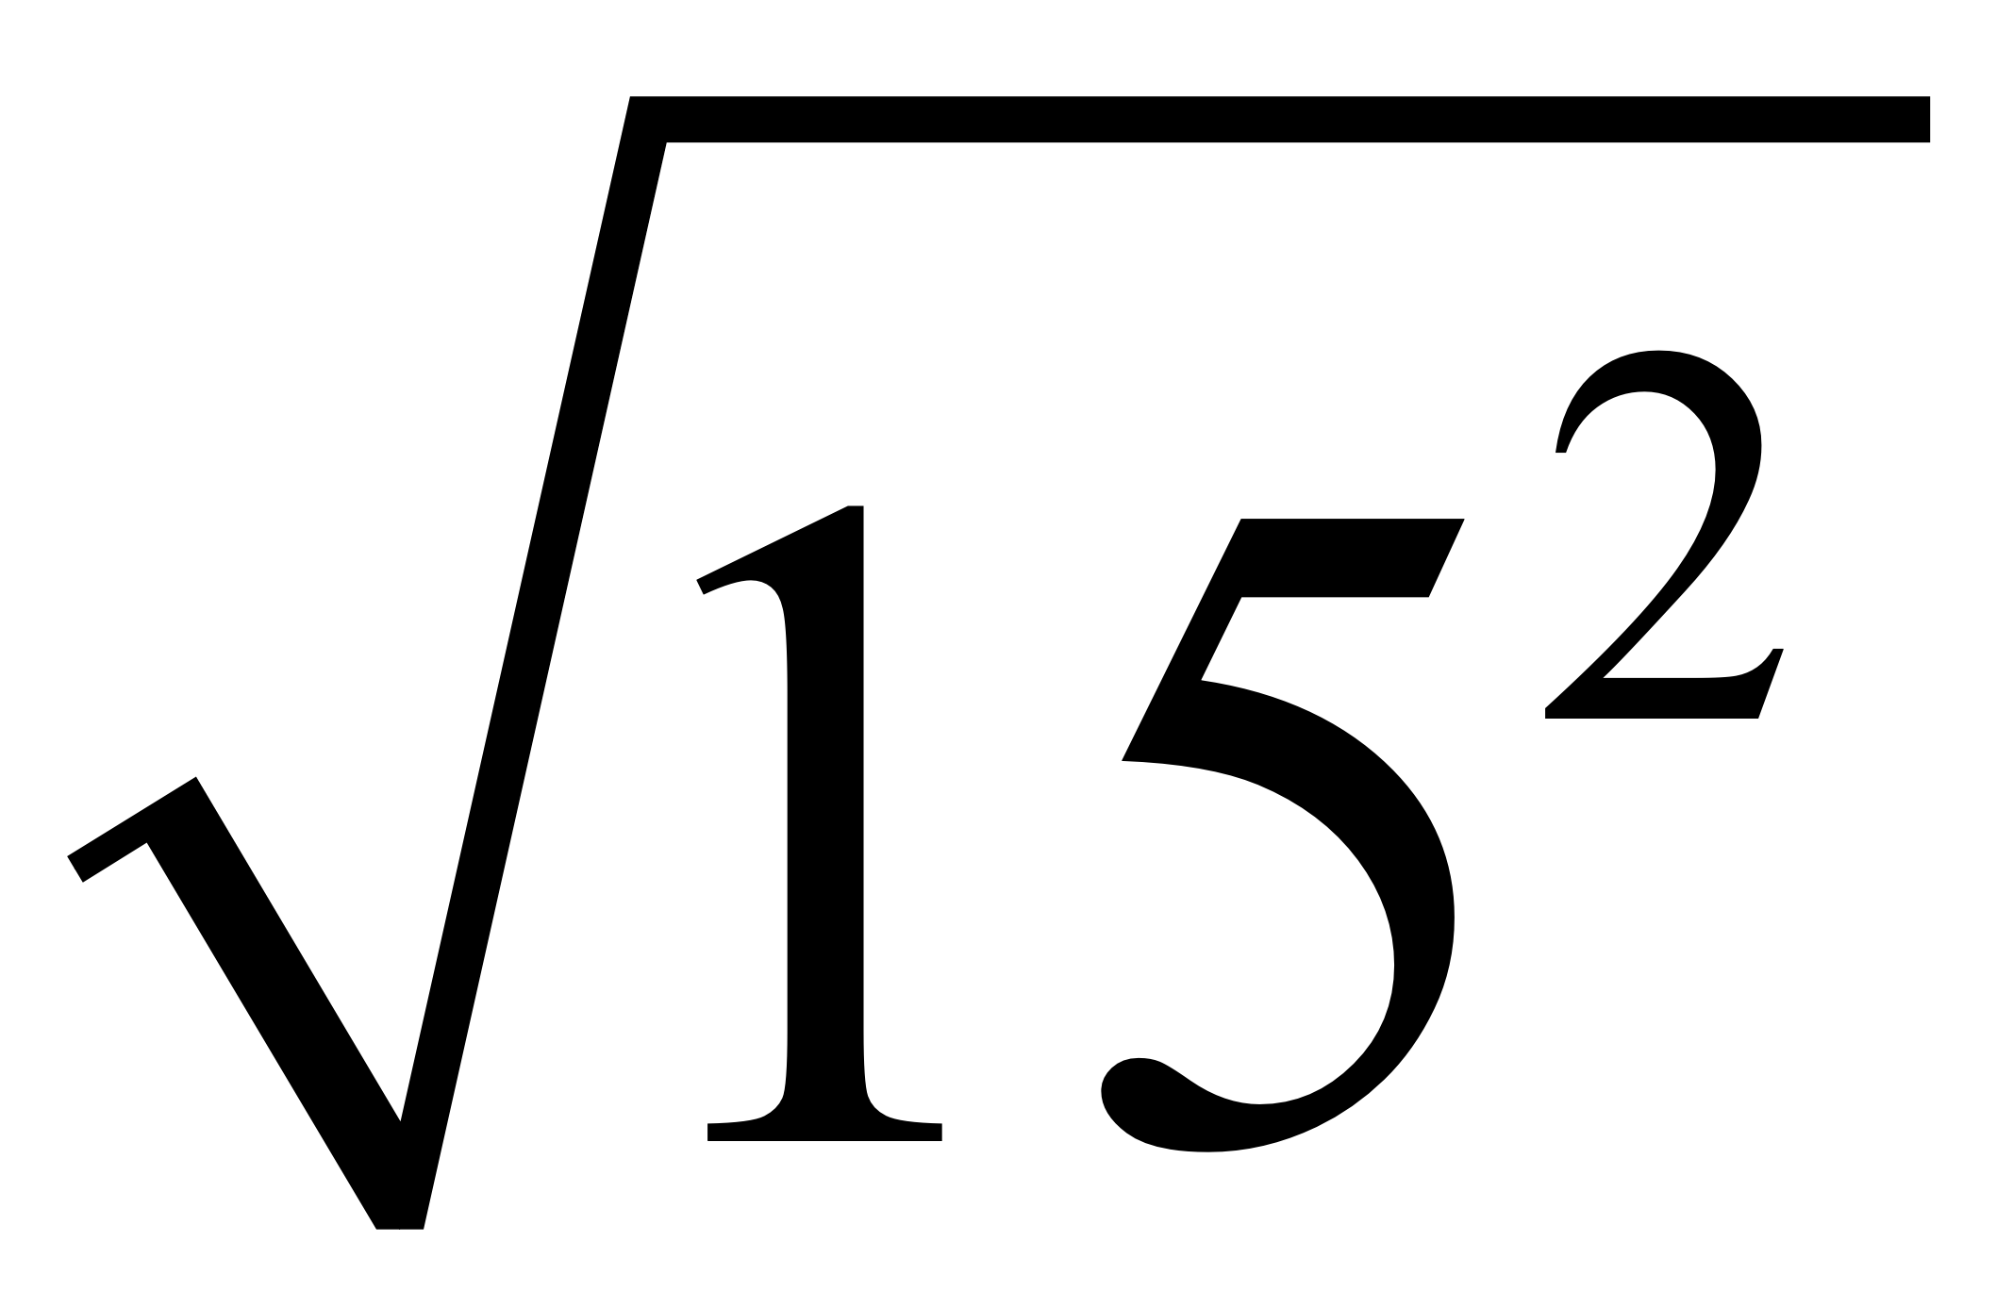
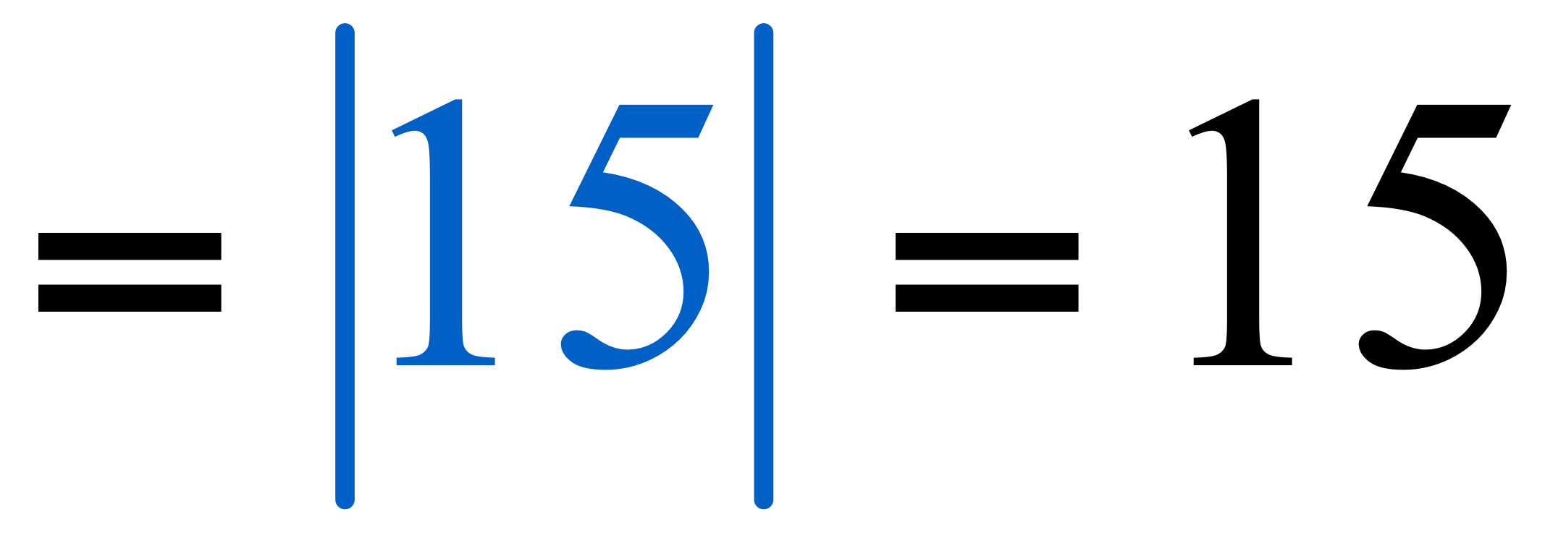
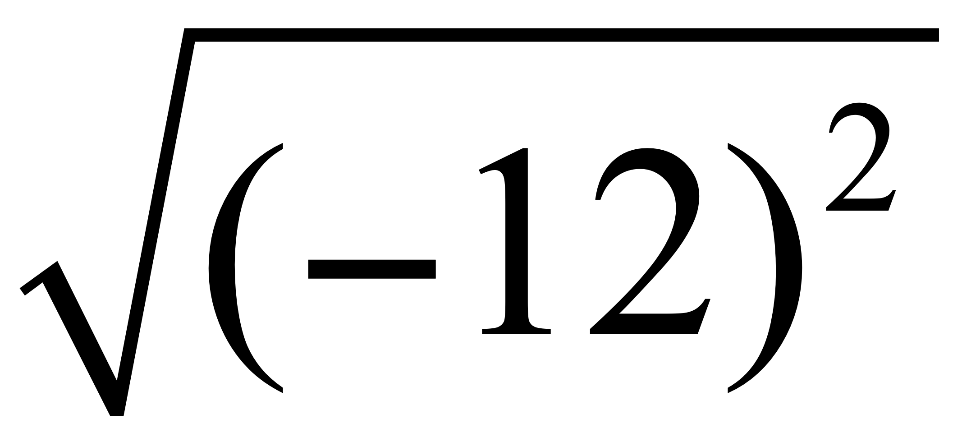
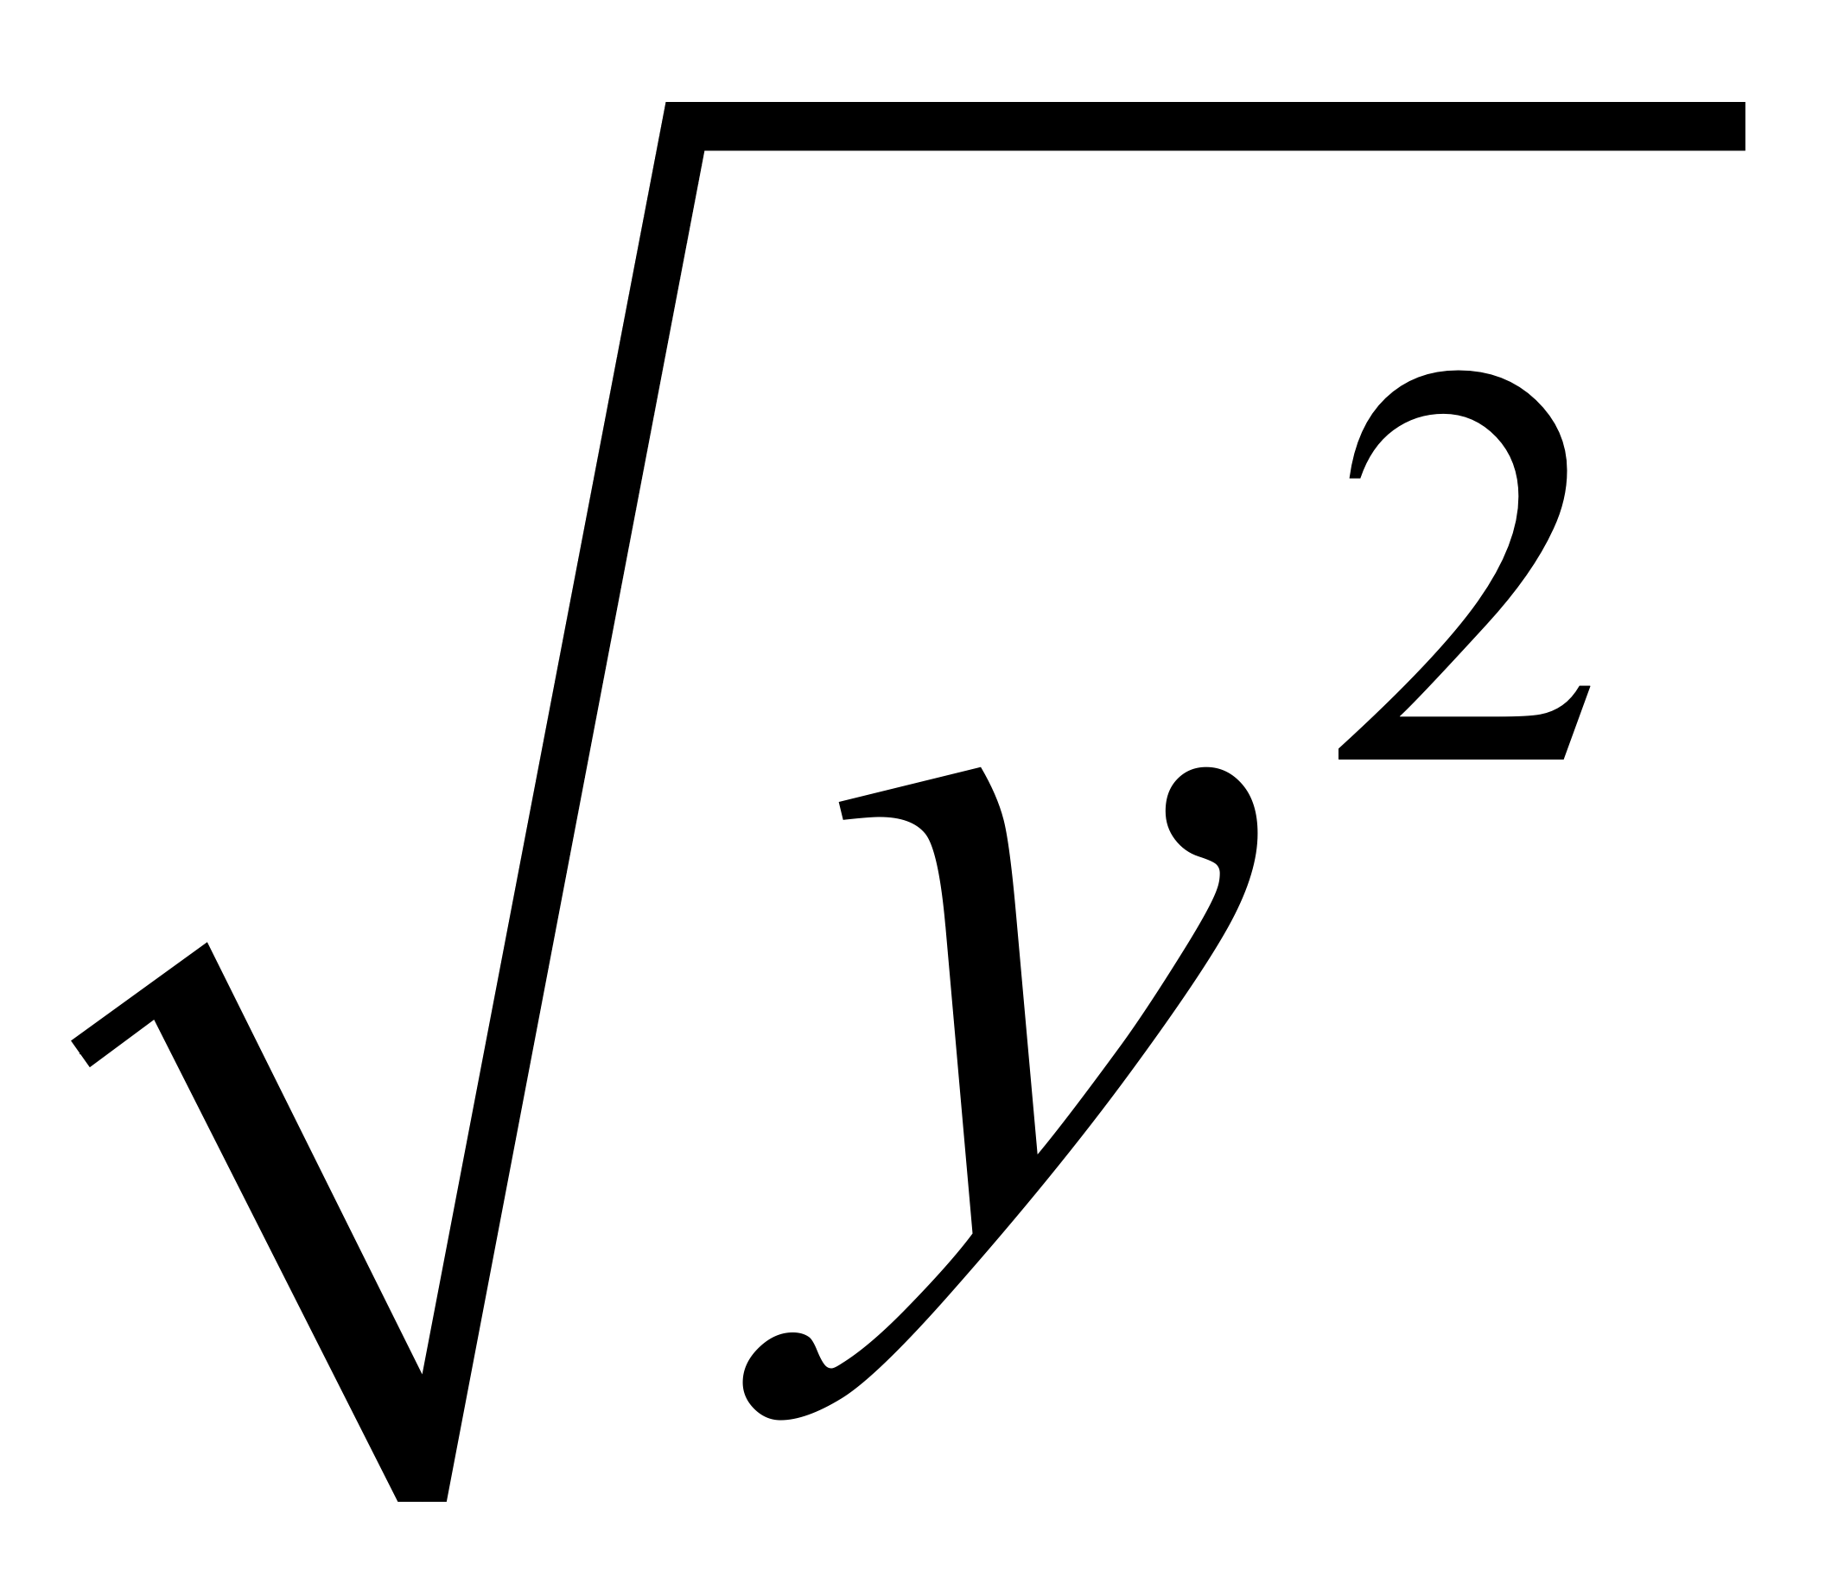
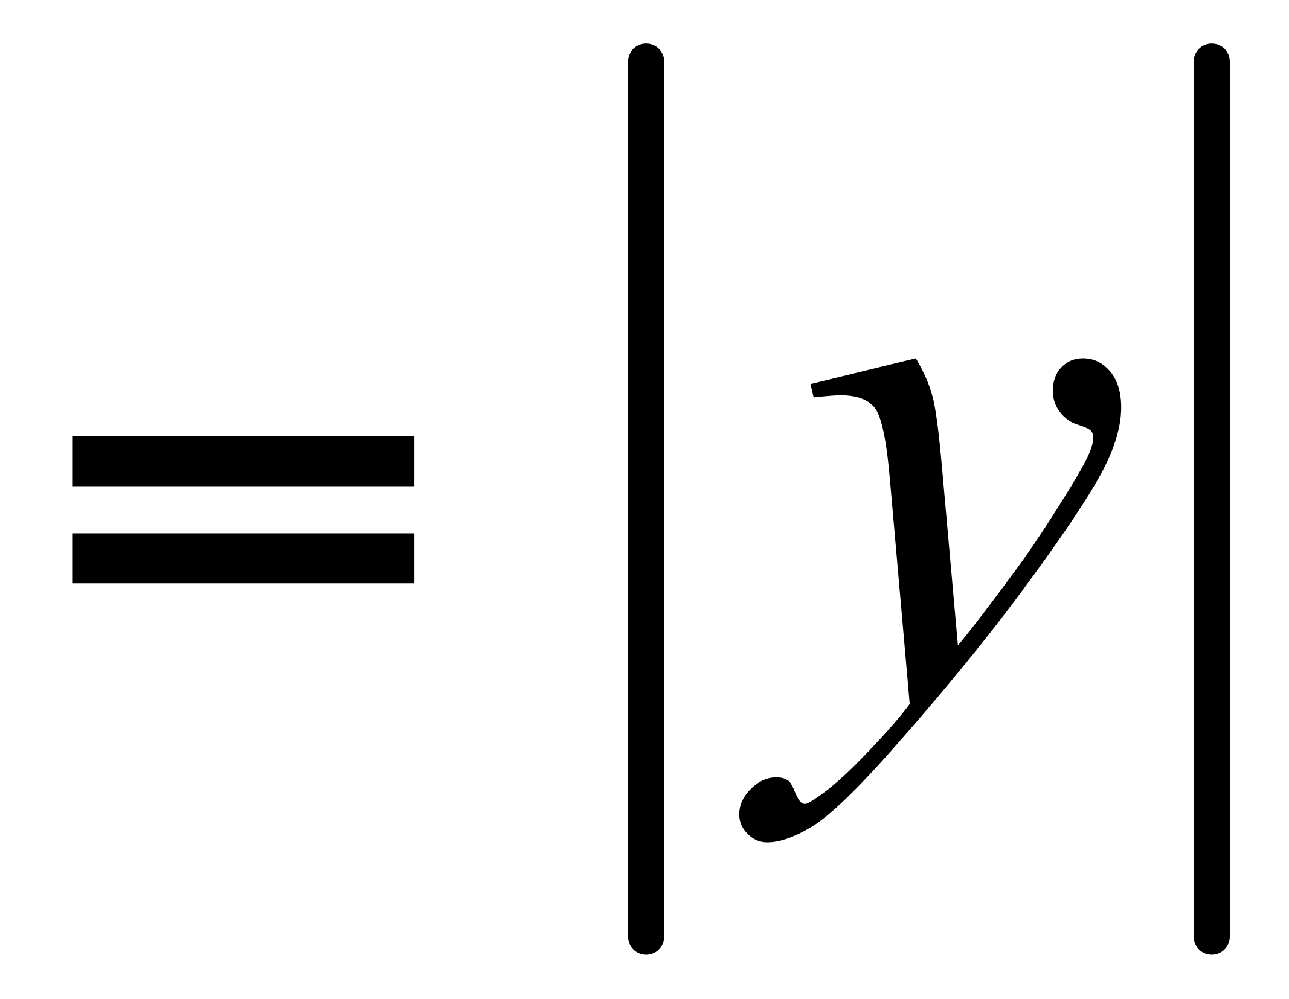
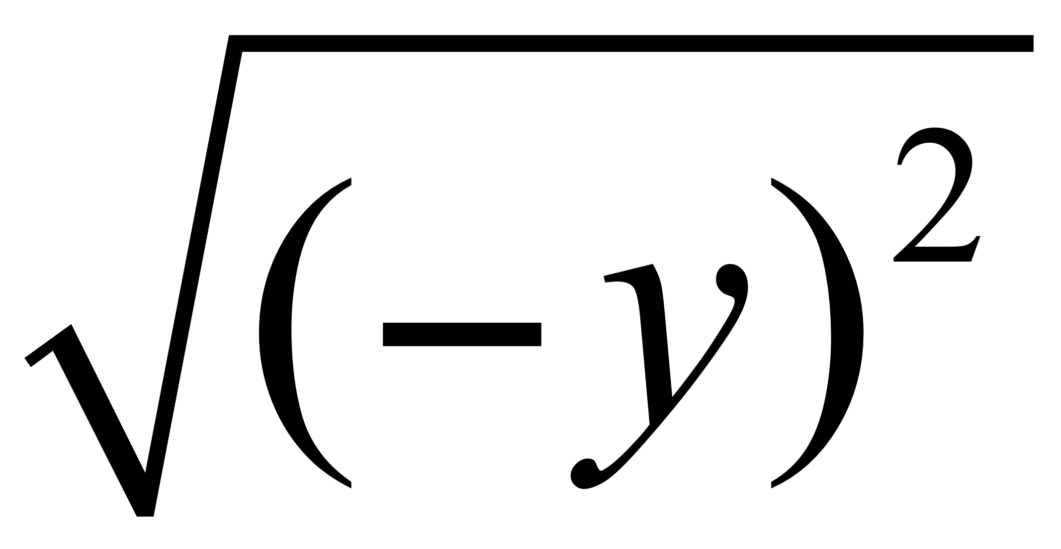
Classroom Example 4
Simplifying Square Roots Using Absolute Value
Find each square root.
a.
b.
c.
d.

Slide 13
Find nth roots of nth powers.

Slide 14
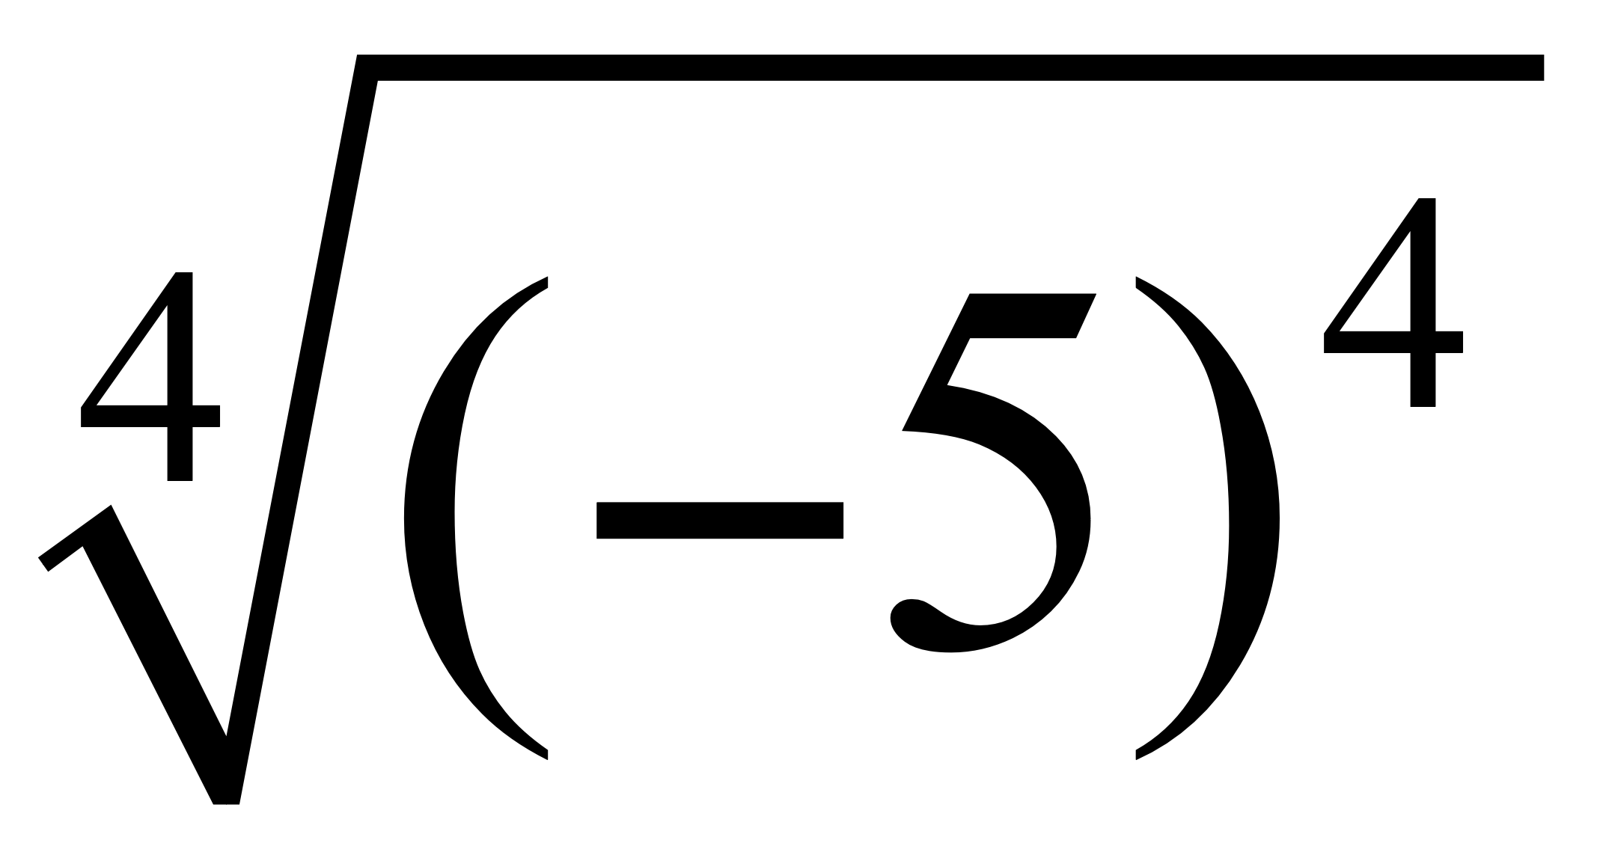
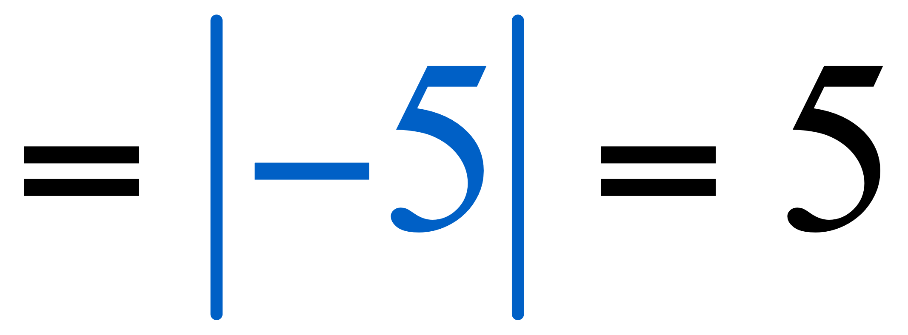
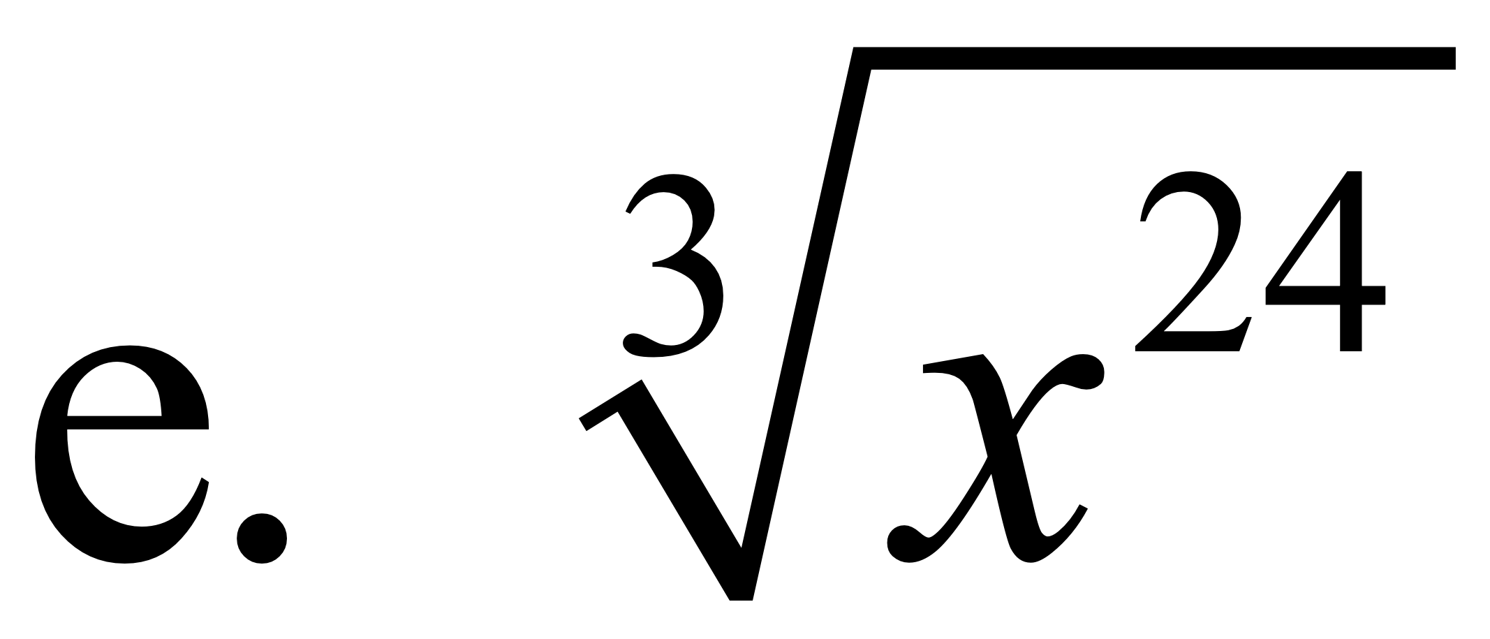
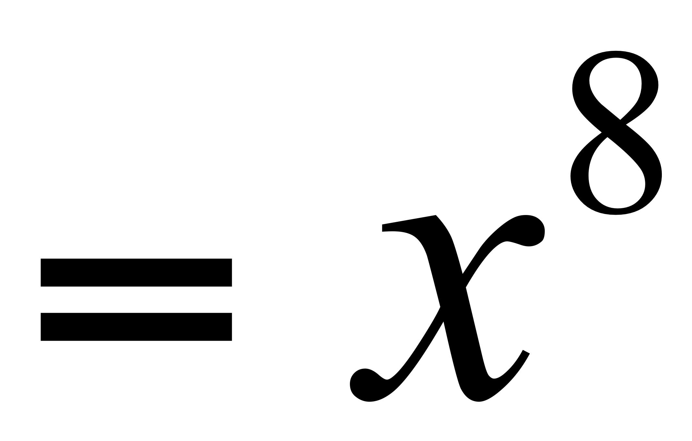
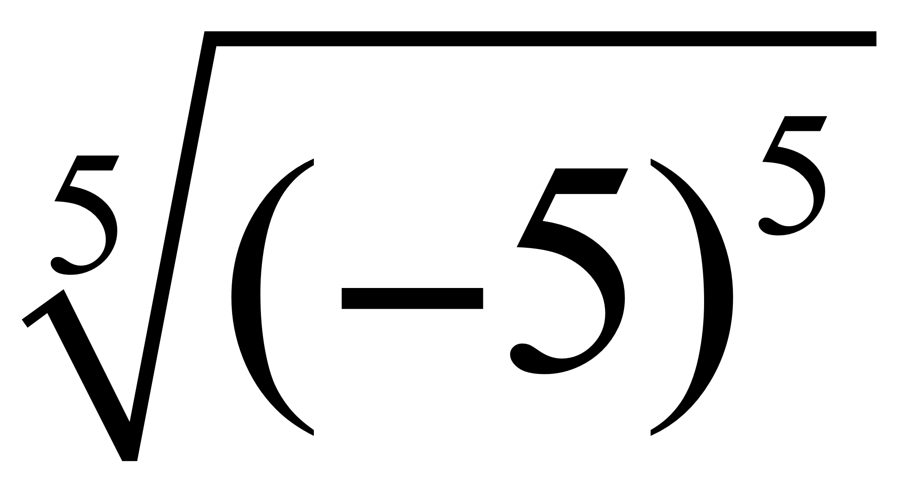
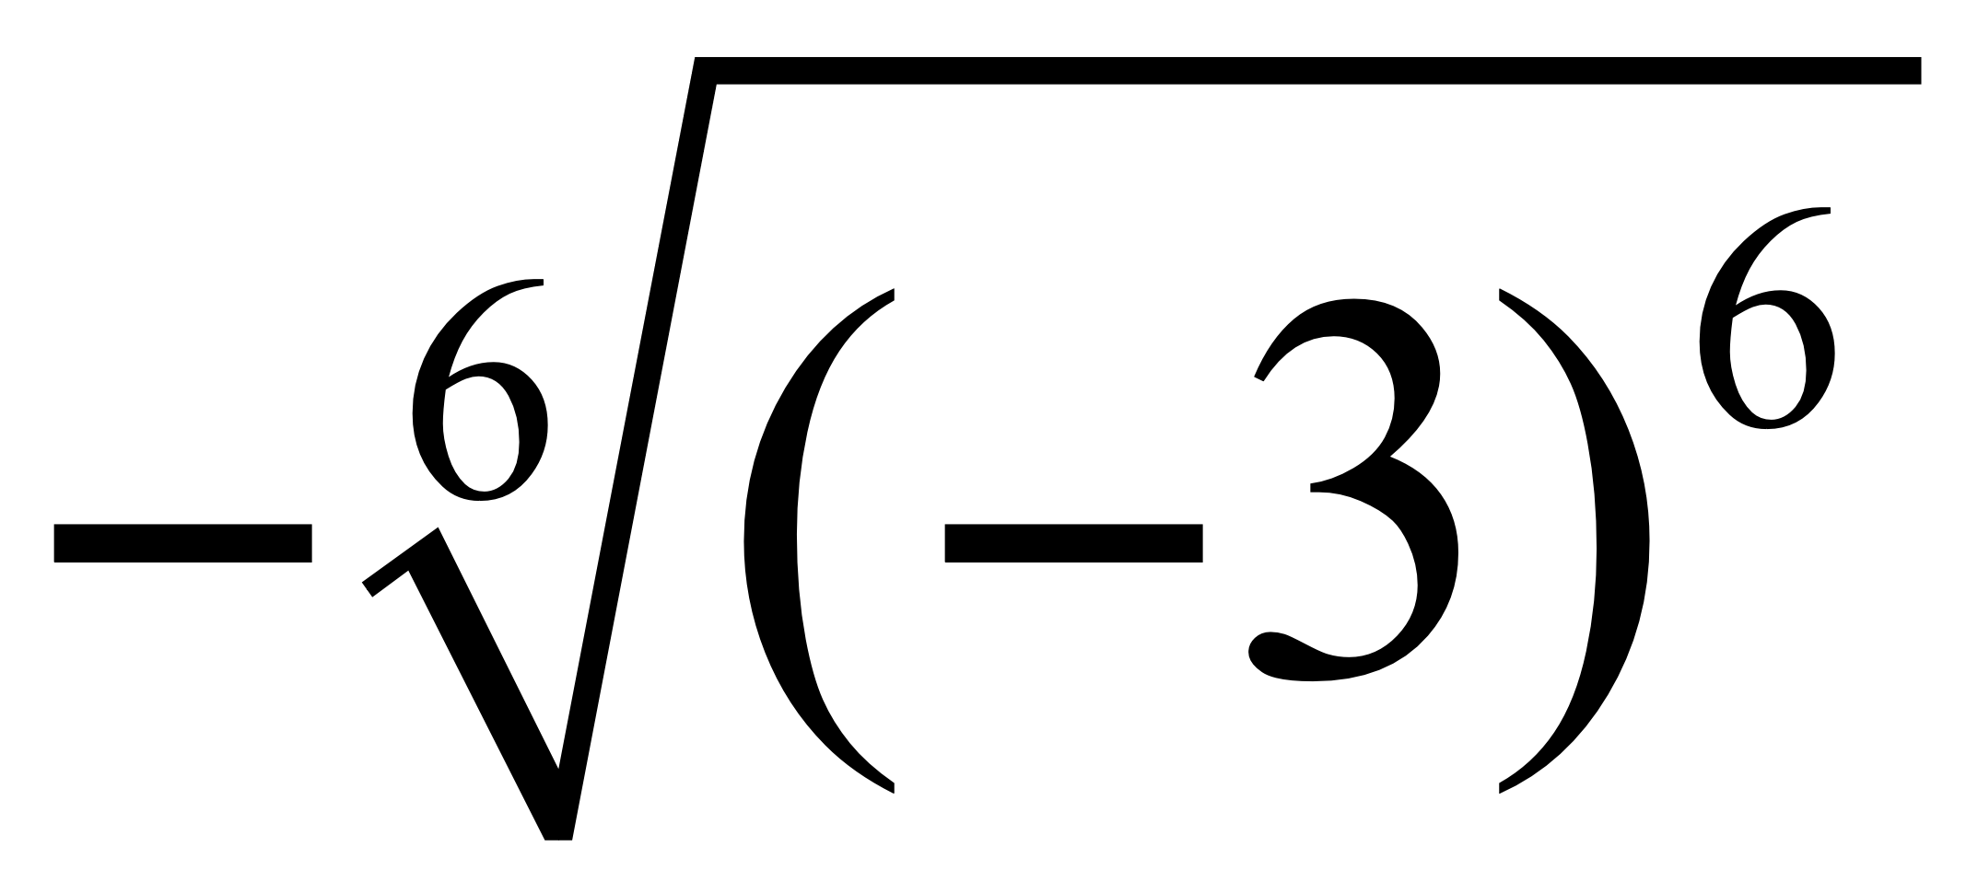
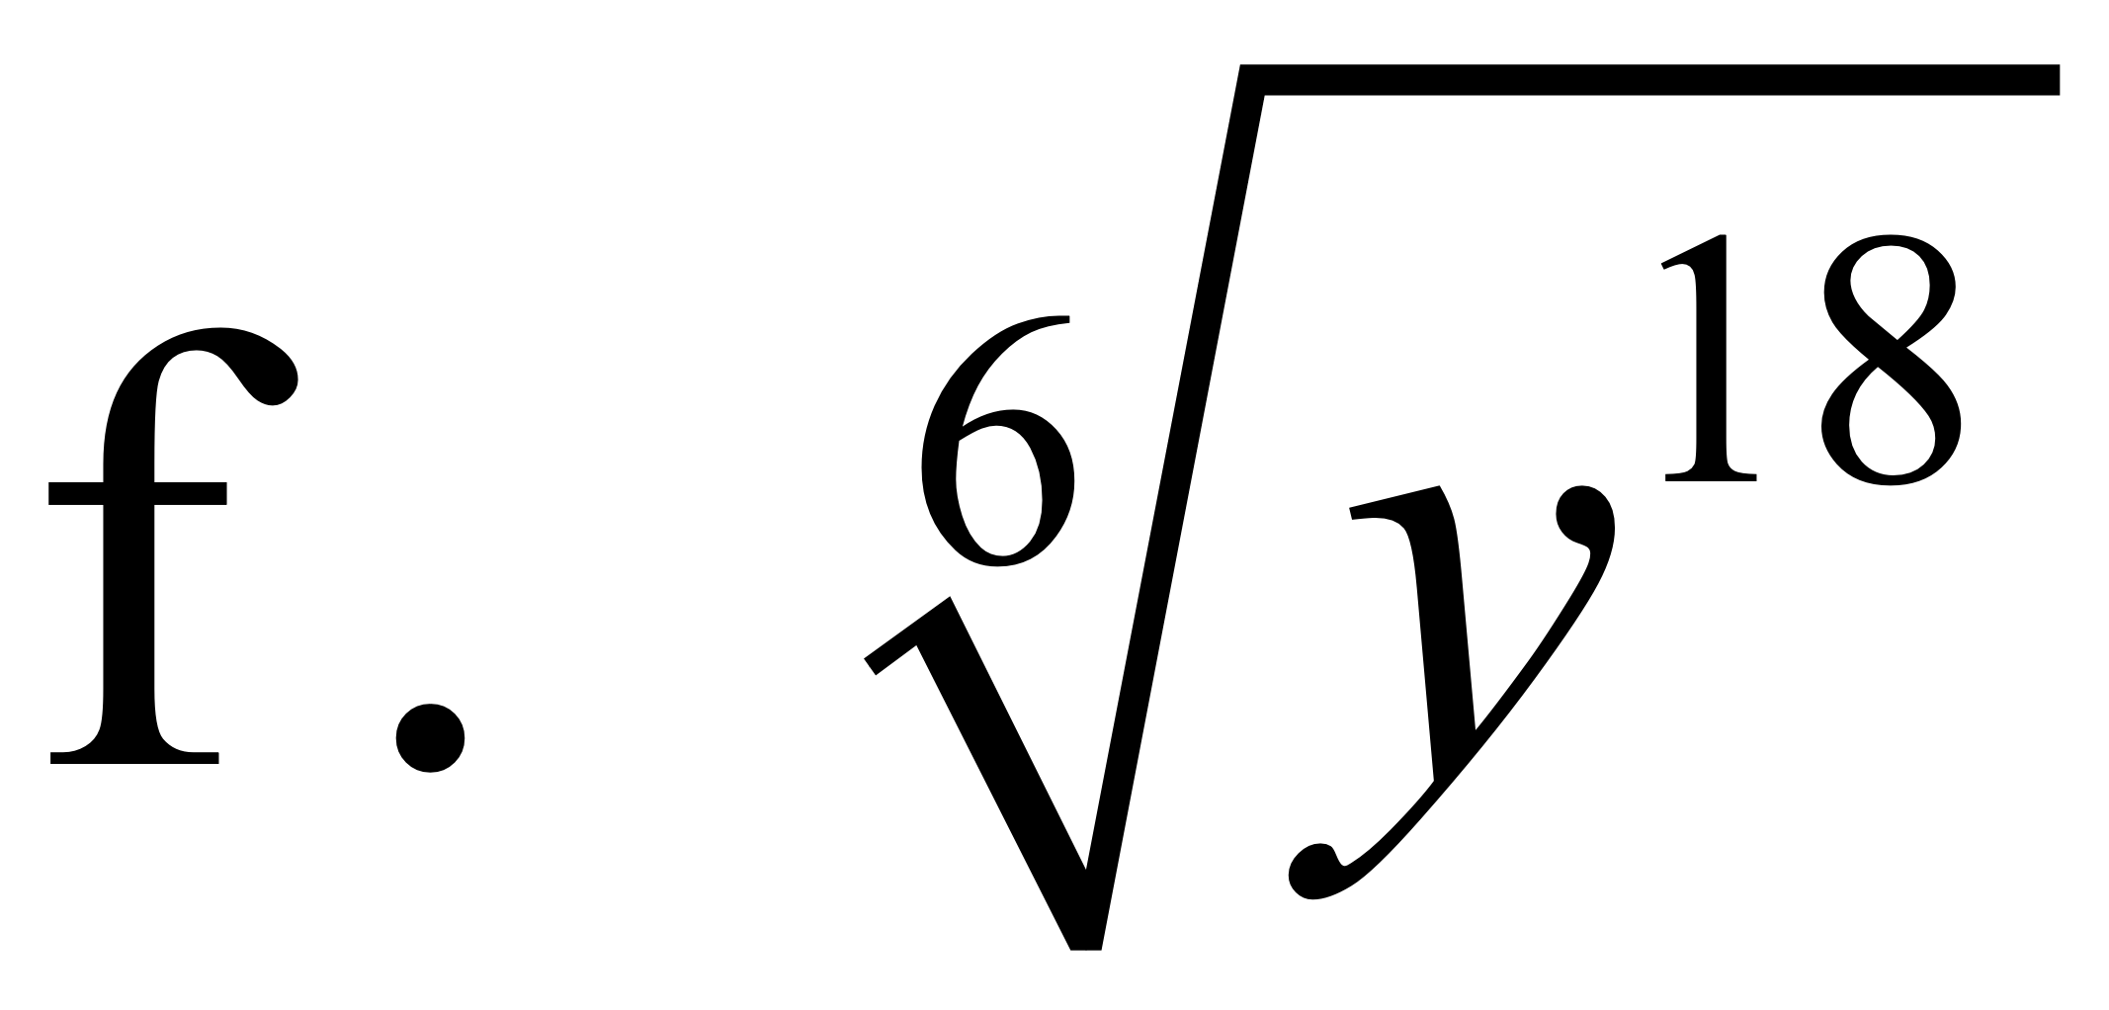
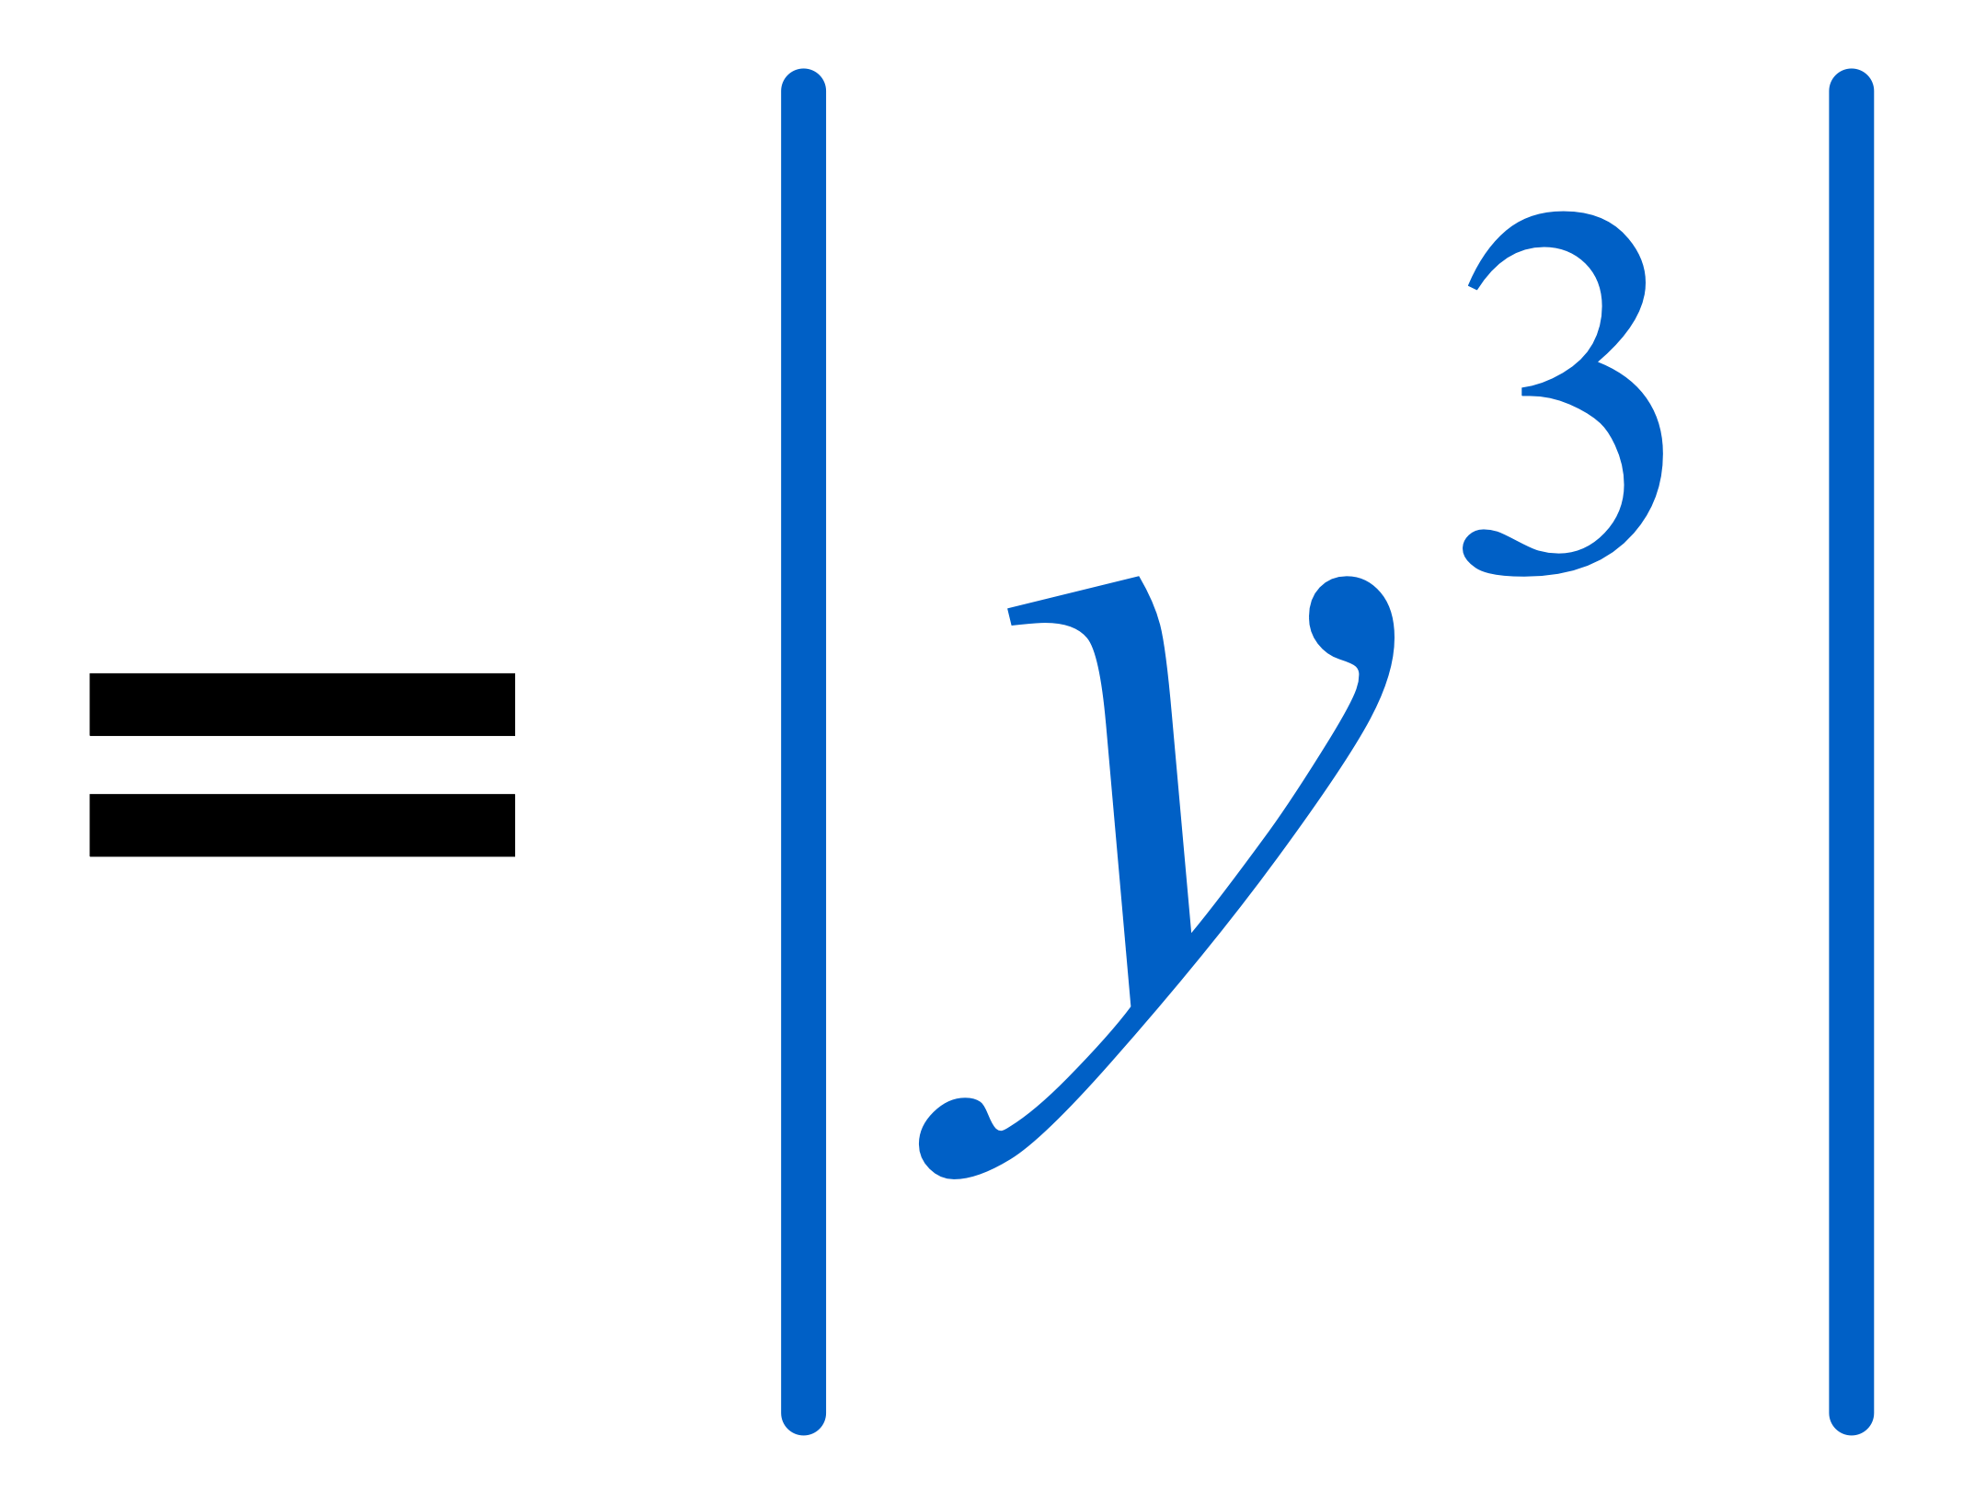
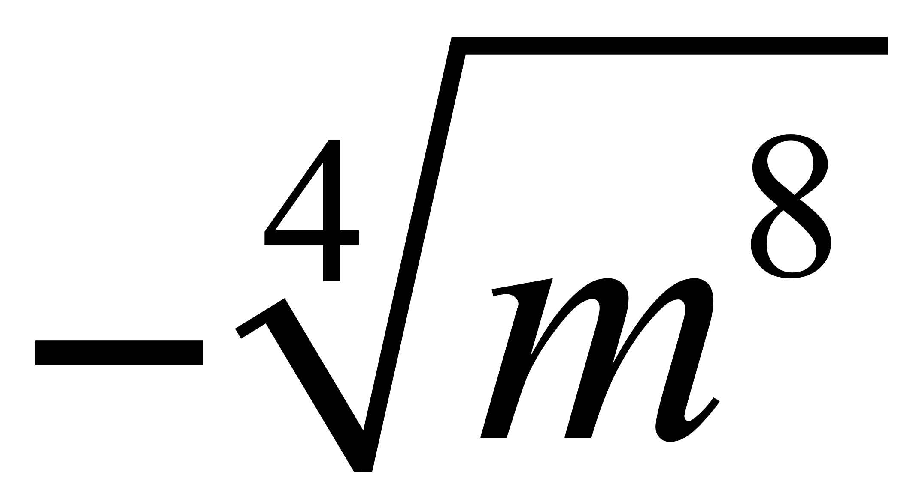
Classroom Example 5
Simplifying Higher Roots Using Absolute Value
Find each root.
a.
b.
c.
d.

Slide 15
Objective 5
Use a calculator to find roots.

Slide 16
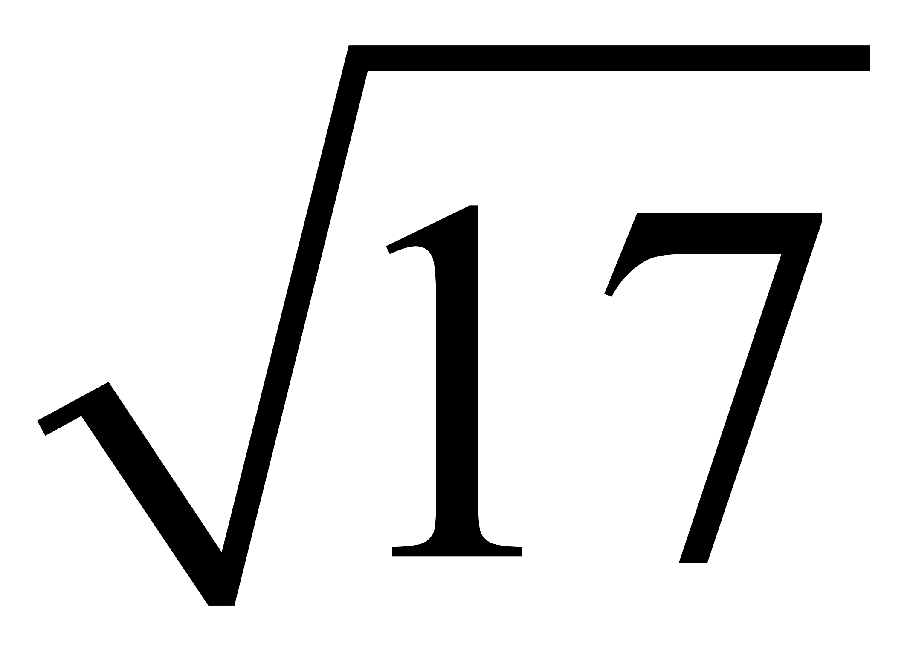
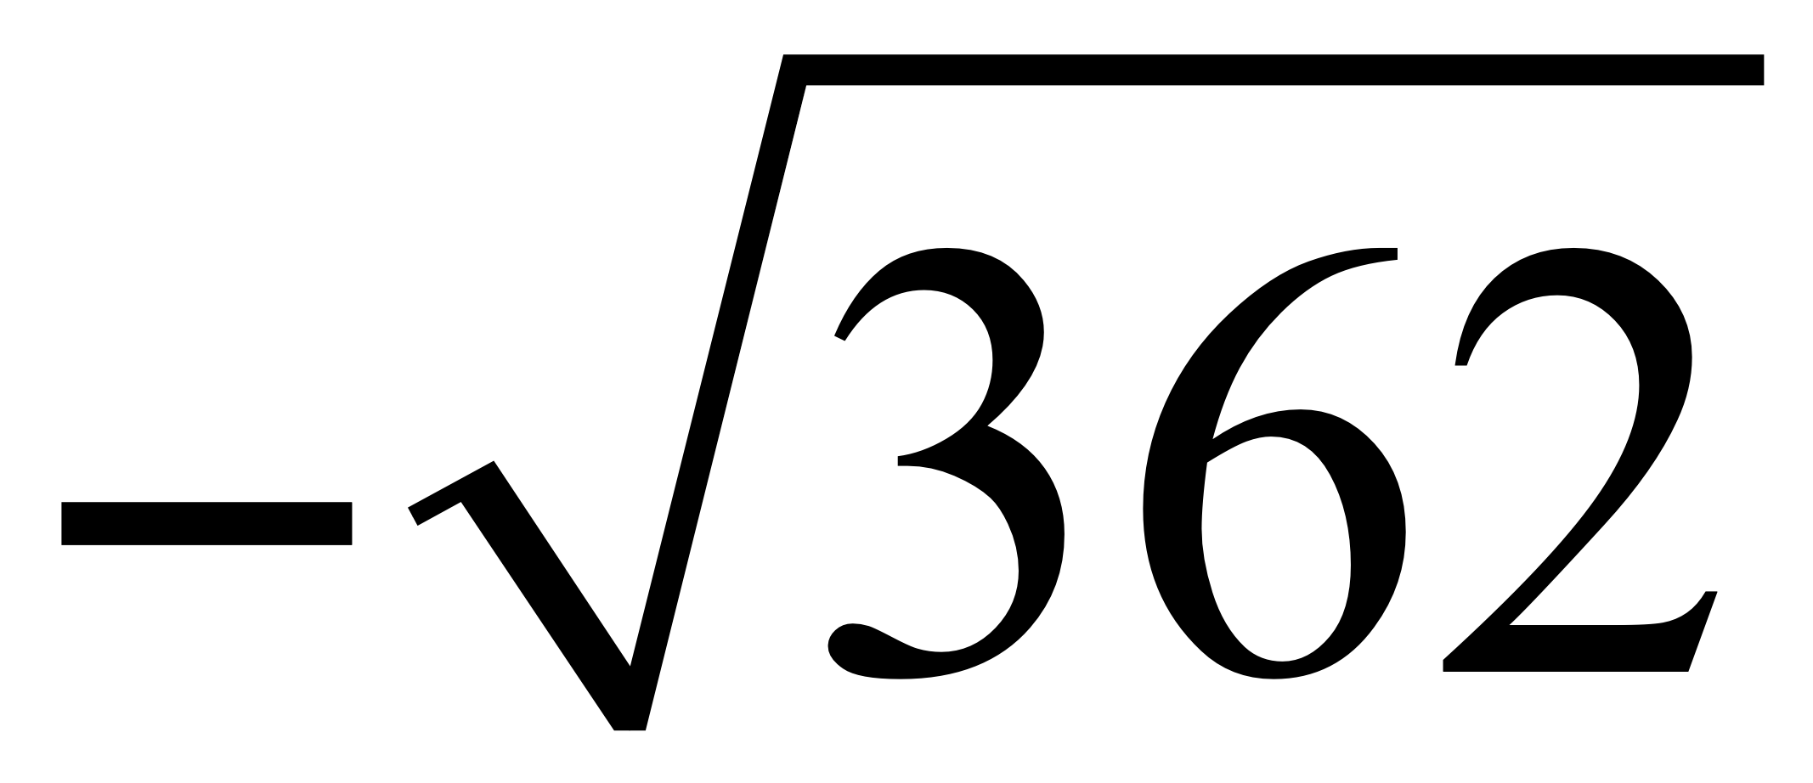
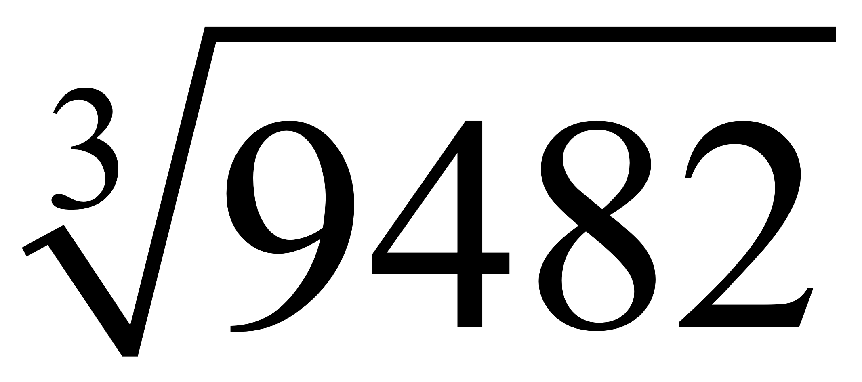
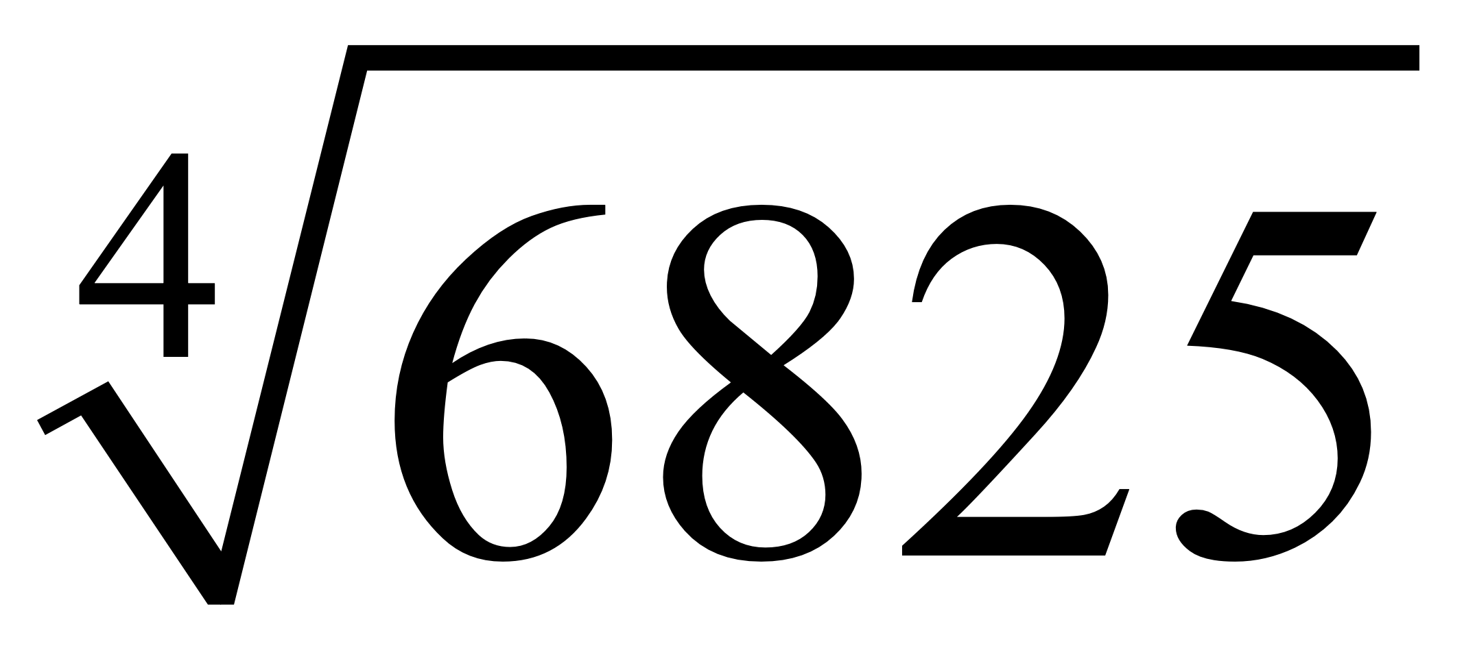
Classroom Example 6
Finding Approximations for Roots
Use a calculator to approximate each radical to three decimal places.
a.
b.
c.
d.
≈ 4.123
≈ –19.026
≈ 21.166
≈ 9.089

