Slide 2
Recall that the square root of a negative number is not a real number. The domain (x-values) of a square-root function is restricted to numbers that make the value under the radical sign greater than or equal to 0.
Key Rules:
*The domain and range are the set of nonnegative real numbers.
*The x-intercept and the y-intercept are at (0, 0).
*The function is neither even nor odd.
*It is increasing on the interval (0, ∞).
*It has a minimum value of 0 at x = 0.

Slide 3
Graphing Square Root Functions
LESSON 10-5
I
Additional Examples
Find the domain of each function.
a. y = x + 5
>
>
x + 5 0 Make the radicand 0.
–
–
>
x –5
–
The domain is the set of all numbers greater than or equal to –5.
b. y = 6 4x – 12
>
>
4x – 12 0 Make the radicand 0.
–
–
>
4x 12
–
>
x 3
–
The domain is the set of all numbers greater than or equal to 3.

Slide 4
Find the domain of the square-root function.
x– 4 ≥ 0
x + 3 ≥ 0
+ 4 + 4
–3 –3
x ≥ 4
x ≥ –3
The domain is the set of all real numbers greater than or equal to 4.
The domain is the set of all real numbers greater than or equal to –3.

Slide 5
Find the domain of the square-root function.
2x – 1 ≥ 0
3x – 5 ≥ 0
+1 +1
+ 5 +5
2x ≥ 1
3x ≥ 5
The domain is the set of all real numbers greater than or equal to .
The domain is the set of all real numbers greater than or equal to .

Slide 6
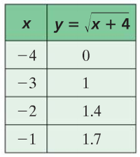
“Graphing Square Root Functions”
I
How do you graph a square root function?
To graph a square root function:
Make a function table with at least four x values. Make one of the x values the minimum value of x that makes the expression inside the radicand equal zero.
Plot the x and y value on the coordinate grid.
Connect the points to form a curve (should look like half of a parabola)
Examples:
Step 1. Function Table
Step 2. Plot the points.
Step 3. Connect the points to form a half parabola shape
Notice there are no x-values to the left of 0 because the domain is x ≥ 0.

Slide 7
Add a positive number to x.
Shift left h.
Add a negative number to x.
Shift right h.
Add a positive number to the radical.
Add a negative number to the radical.
Add a positive number to the radical.
Up k.
Down k.

Slide 8
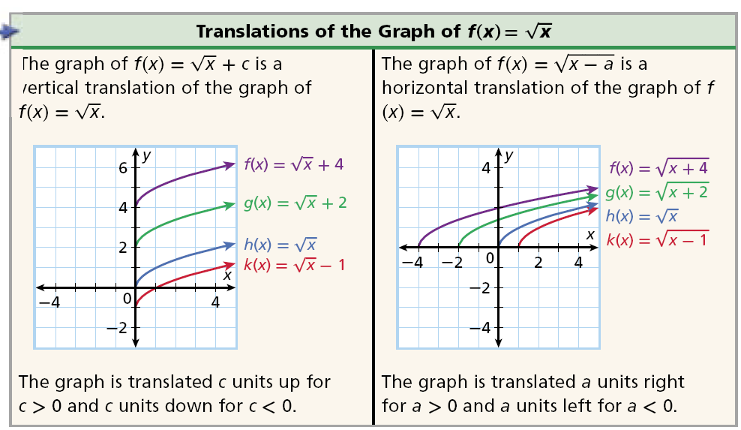
If a square-root function is given in one of these forms, you can graph the parent function and translate it vertically or horizontally.

Slide 9
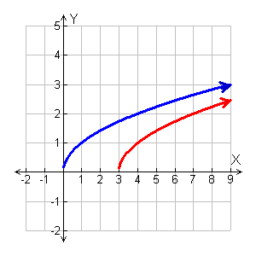
Graph .
Since this function is in the form f(x) =, you can graph it as a horizontal translation of the graph of f(x) =
Graph f(x) = and then shift the graph 3 units to the right.

Slide 10
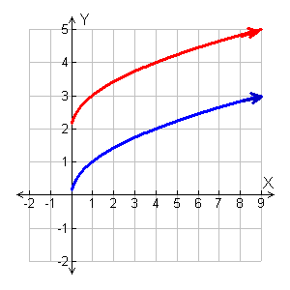
Graph each square root function.
Since this function is in the form f(x) = , you can graph it as a vertical translation of the graph of f(x) =
Graph f(x) = and then shift the graph 2 units up.

Slide 11
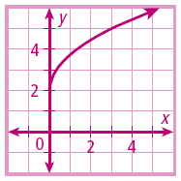
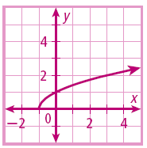
Graph each square-root function.
A.
B.

Slide 12
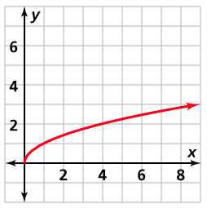
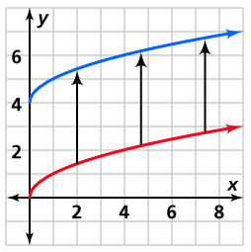
Graphing Square Root Functions
LESSON 10-5
Additional Examples
Graph y = x + 4 by translating the graph of
y = x .
For the graph y = x + 4,
the graph of y = x is shifted 4 units up.

Slide 13
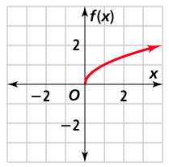
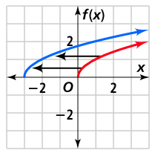
Graphing Square Root Functions
LESSON 10-5
Additional Examples
Graph ƒ(x) = x + 3 by translating the graph of
y = x .
For the graph ƒ(x) = x + 3,
the graph of y = x is shifted to the left 3 units.

Slide 14
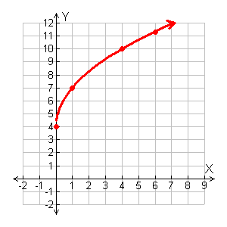
I
Graph .
Step 1 Choose x-values greater than or equal to 0 and generate ordered pairs.
Step 2 Plot the points. Then connect them with a smooth curve.
x
0
4
1
7
4
10
6
11.35

Slide 15
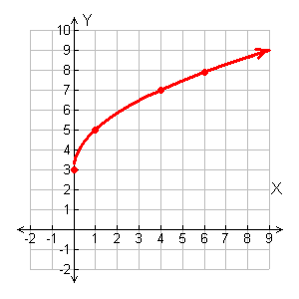
Graph .
Step 1 Choose x-values greater than or equal to 0 and generate ordered pairs.
Step 2 Plot the points. Then connect them with a smooth curve.
x
0
3
1
5
4
7
6
7.89

Slide 16
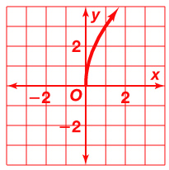
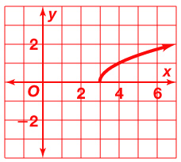
Graphing Square Root Functions
LESSON 10-5
1. Find the domain of the function ƒ(x) = 2x – 4.
A. Graph y = 3 x.
B. Graph y = x – 3.
4. Describe how to translate the graph of y = x
to obtain the graph of the function y = x – 15.
x > 2
Shift the graph to the right 15 units.

Slide 17
Graphing Square-root Functions
Domain:
all nonnegative numbers
Range:
all numbers greater than or equal to k
Domain:
Range:
x
y
0
1
4
9

Slide 18
Graphing Square-root Functions
Domain:
Range:
x
y
0
1
4
9

Slide 19
Graphing Square-root Functions
Domain:
Range:
x
y
0
1
4
9

Slide 20
Graphing Square-root Functions
Domain:
all numbers greater than or equal to h
Range:
all nonnegative numbers
Domain:
Range:
x
y
1
2
5
10

Slide 21
Graphing Square-root Functions
Domain:
Range:
x
y
-1
0
3
8

Slide 22
Graphing Square-root Functions
Domain:
Range:
x
y
4
5
8
13

Slide 23
Graphing Square-root Functions
Compare the Graphs
x
y
0
0
1
1
4
2
9
3

