Slide 1
Equations of Circles

Slide 2
A circle is the set of points
in a plane which are equal
distance from the center.

Slide 3
Centre-radius form of a circle
Center is at (h, k)
r is the radius of the circle
(h,k)
r

Slide 4
General Form of a Circle
Expand the brackets and make the RHS equal to 0.
Every term is on the left side, equal to 0.

Slide 5
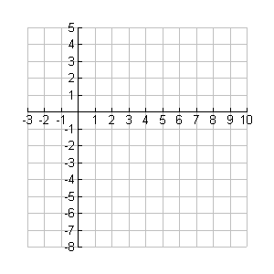
EX 1 Write an equation of a circle with center (3, -2) and a radius of 4.
h
k
r

Slide 6
EX 2 Write an equation of a circle with center (-4, 0) and a diameter of 10.
h
k
2r

Slide 7
EX 3 Write an equation of a circle with center (2, -9) and a radius of .
h
k
r

Slide 8
EX 4 Find the coordinates of the center and the measure of the radius.
Opposite signs!
( , )
6
-3
Take the square root!
Radius 5

Slide 9
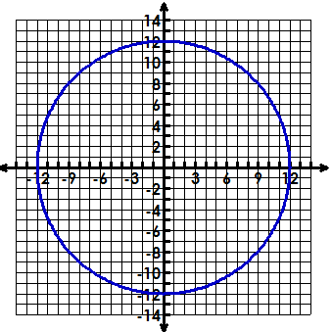
5. Find the center, radius, & equation of the circle.
The center is
The radius is
The equation is
(0, 0)
12
x² + y² = 144

Slide 10
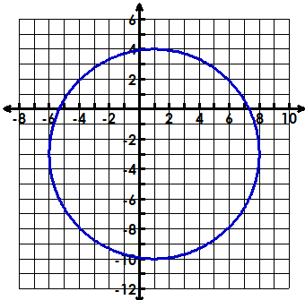
6. Find the center, radius, & equation of the circle.
The center is
The radius is
The equation is
(1, -3)
7
(x – 1)² + (y + 3)² = 49

Slide 11
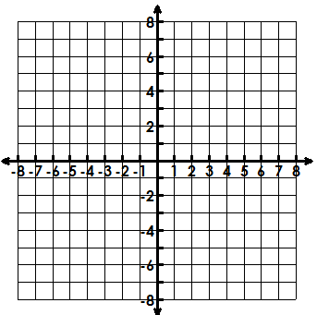
7. Graph the circle, identify the center & radius.
(x – 3)² + (y – 2)² = 9
Center (3, 2)
Radius of 3

Slide 12
Converting from general form to centre-radius form
Move the x terms together and the y terms together.
Move C to the other side.
Complete the square (as needed) for x.
Complete the square(as needed) for y.
Factor the left & simplify the right.

Slide 13
8. Write the centre-radius equation of the circle. State the center & radius.
Center: (4, 0) radius: 3

Slide 14
9. Write the centre-radius equation of the circle. State the center & radius.
Center: (-2, 3) radius: 4

Slide 15
10. Write the centre-radius equation of the circle. State the center & radius.

Slide 16
11. Write the general form of the equation of the circle given in centre-radius form.

Slide 17
Semicircles
Given the equation of a circle, we make y the subject.
Example: Write down the equation of the upper and lower semicircle, given
Therefore the equation of the upper semicircle is
And the equation of the lower semicircle is

Slide 18
