Slide 1
Trigonometry
θ

Slide 2
Definition of an angle
Terminal Ray
+ Counter clockwise
Initial Ray
- clockwise
Terminal Ray
Notes:
Emphasis direction of angle and sign

Slide 3
Coterminal angles – angles with a common terminal ray
Terminal Ray
Initial Ray
Notes:
Find second measure by difference from 2π.

Slide 4
Coterminal angles – angles with a common terminal ray
Terminal Ray
Initial Ray
Notes:
Find negative measure by adding 2π to previous negative angle.

Slide 5
Caution
A common error in trigonometry is using a calculator in degree mode when radian mode should be used.
Remember, if you are finding a circular function value of a real number, the calculator must be in radian mode.

Slide 6
Trigonometric Ratios

Slide 7
Basic ratio definitions
Hypotenuse
Opposite Leg
Reference Angle
θ
Adjacent Leg
Notes:
Review basic triangle definitions

Slide 8
Circle Trigonometry Definitions
(x, y)
Radius = r
Opposite Leg = y
Adjacent Leg = x
reciprocal functions
Notes:
Wait on clicks until after new definition comes in

Slide 9
Unit - Circle Trigonometry Definitions
(x, y)
Radius = 1
Opposite Leg = y
Adjacent Leg = x
1
Notes:
Unit circle rather than any radius, definitions are just coordinates of endpoint of terminal ray

Slide 10
Unit Circle – Trig Ratios
sin
cos
tan
(-, +)
(+, +)
(-, -)
(+, -)
Skip π/4’s
Reference Angles
Notes:
Develops basic chart – show how triangle is just adjusted by quadrant signs.

Slide 11
Unit Circle – Trig Ratios
sin
cos
tan
(-, +)
(+, +)
(-, -)
(+, -)

Slide 12
Unit Circle – Trig Ratios
sin
cos
tan
(-, +)
(+, +)
(0 , 1)
Quadrant Angles
(-1, 0)
(1, 0)
sin
cos
tan
0
/2π
0
1
0
1
0
Ø
(0, -1)
(-, -)
(+, -)
0
-1
0
View π/4’s
-1
0
Ø

Slide 13
Unit Circle – Radian Measure
sin
cos
tan
(-, +)
(+, +)
Quadrant Angles
sin
cos
tan
1
0
/2π
0
1
0
1
0
Ø
(-, -)
(+, -)
0
0
-1
Degrees
-1
0
Ø

Slide 14
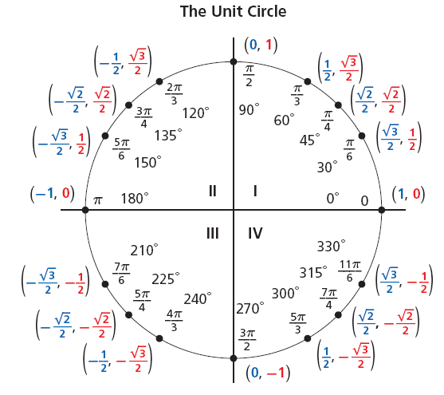



A unit circle is a circle with a radius of 1 unit. For every point P(x, y) on the unit circle, the value of r is 1. Therefore, for an angle θ in the standard position:

Slide 15
Graphing Trig Functions
f ( x ) = A sin bx

Slide 18
Amplitude is the height of graph measured from middle of the wave.
Amplitude
Center of wave
f ( x ) = A sin bx

Slide 19
f ( x ) = cos x
A = ½ , half as tall

Slide 20
f ( x ) = sin x
A = 2, twice as tall

Slide 21
Period of graph is distance along horizontal axis for graph to repeat (length of one cycle)
f ( x ) = A sin bx

Slide 22
f ( x ) = sin x
B = ½ , period is 4π

Slide 23
f ( x ) = cos x
B = 2, period is π

Slide 25
The End
Trigonometry Hipparchus, Menelaus, Ptolemy
Special Right Triangles The Pythagoreans
Graphs Rene’ DesCartes

Slide 26
Reference Angle Calculation
2nd Quadrant Angles
3rd Quadrant Angles
4th Quadrant Angles
Return

Slide 27
Unit Circle – Degree Measure
90
120
60
135
45
150
30
180
0/360
210
330
225
315
240
300
270
Return

Slide 28
Unit Circle – Degree Measure
sin
cos
tan
(-, +)
90
(+, +)
30
120
60
45
135
45
60
150
30
Quadrant Angles
180
0/360
sin
cos
tan
210
1
330
0/360
0
1
0
225
315
240
300
90
1
0
Ø
(-, -)
(+, -)
0
180
0
-1
270
Return
270
-1
0
Ø

Slide 29
Ex. # 3
Ex. # 4
Ex. # 5
Ex. # 6
return

Slide 30
Circle Trigonometry Definitions – Reciprocal Functions
(x, y)
Radius = r
Opposite Leg = y
Adjacent Leg = x
return
Notes:
Wait on clicks until after new definition comes in

Slide 31
Unit Circle – Radian Measure
1

