Slide 1
Graphs of Sine and Cosine Functions
4.5
Copyright © Cengage Learning. All rights reserved.

Slide 2
What You Should Learn
Sketch the graphs of basic sine and cosine functions
Use amplitude and period to help sketch the graphs of sine and cosine functions
Sketch translations of graphs of sine and cosine functions
Use sine and cosine functions to model real-life data

Slide 3
Basic Sine and Cosine Curves

Slide 4
Basic Sine and Cosine Curves
The graph of the sine function is a sine curve. I drew this curve using the table on your unit circle.
In Figure 4.43, the black portion of the graph represents one period of the function and is called one cycle of the sine curve.
The gray portion of the graph indicates that the basic sine wave repeats indefinitely to the right and left.
Figure 4.43

Slide 5
Basic Sine and Cosine Curves
The graph of the cosine function is shown in Figure 4.44. This was also drawn using points from the table on your unit circle handout.
Figure 4.44

Slide 6
Basic Sine and Cosine Curves
The domain of the sine and cosine functions is the set of all real numbers.
The range of each function is the interval [–1, 1]
and each function has a period 2π which is the horizontal length of one cycle of each graph.

Slide 7
Basic Sine and Cosine Curves
Do you see how this information is consistent with the basic graphs shown in Figures 4.43 and 4.44?
Figure 4.43
Figure 4.44

Slide 8
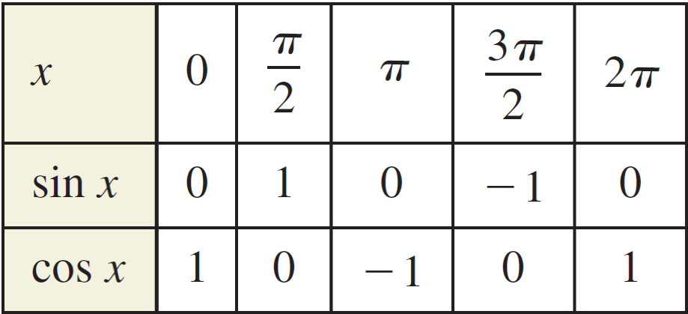
Basic Sine and Cosine Curves
To sketch the graphs of the basic sine and cosine functions by hand, it helps to note five key points in one period of each graph: the intercepts, the maximum points, and the minimum points. We will call this the Five Point Method.
The table below lists the five key points on the graphs of
y = sin x and y = cos x.

Slide 9
Basic Sine and Cosine Curves
Note in Figures 4.43 and 4.44 that the sine curve is symmetric with respect to the origin, whereas the cosine curve is symmetric with respect to the y-axis.
These properties of symmetry follow from the fact that the sine function is odd whereas the cosine function is even.

Slide 10
Example 1 – Library of Parent Functions: f (x) = sin x
Sketch the graph of g(x) = 2 sin x by hand on the interval [–π, 4π ].
Solution:
Note that g(x) = 2 sin x = 2(sin x) indicates that the y-values of the key points will have twice the magnitude of those on the graph of f (x) = sin x.
Divide the period 2π into four equal parts to get the key points

Slide 11
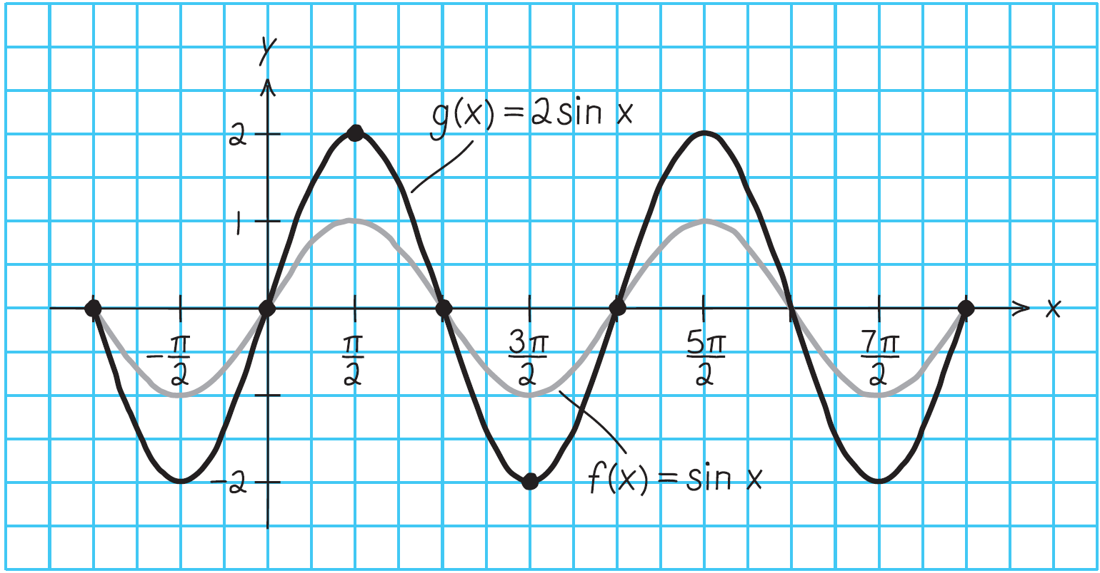
Example 1 – Solution
cont’d
By connecting these key points with a smooth curve and extending the curve in both directions over the interval [–π, 4π ], you obtain the graph shown in Figure 4.45.
Figure 4.45

Slide 12
Amplitude and Period of Sine and Cosine Curves

Slide 13
Amplitude and Period of Sine and Cosine Curves
Let us discuss the graphic effect of each of the constants a, b, c, and d in equations of the forms
y = d + a sin(bx – c) and y = d + a cos(bx – c).
The constant factor a in y = a sin x acts as a scaling factor—a vertical stretch or vertical shrink of the basic sine curve “stretch factor” = amplitude.
When | a | > 1, the basic sine curve is stretched, and when | a | < 1, the basic sine curve is shrunk.

Slide 14
Amplitude and Period of Sine and Cosine Curves
The result is that the graph of y = a sin x ranges between –a and a instead of between –1 and 1. The absolute value of a is the amplitude of the function y = a sin x.
The range of the function y = a sin x for a > 0 is –a ≤ y ≤ a.

Slide 15
Example 2 – Scaling: Vertical Shrinking and Stretching
On the same set of coordinate axes, sketch the graph of each function by hand.
a. b. y = 3 cos x
Solution:
a. Because the amplitude of is , the maximum value is and the minimum value is – .
Divide one cycle, 0 ≤ x ≤ 2π, into four equal parts to get the key points

Slide 16
Example 2 – Solution
cont’d
b. A similar analysis shows that the amplitude of y = 3 cos x is 3, and the key points are

Slide 17
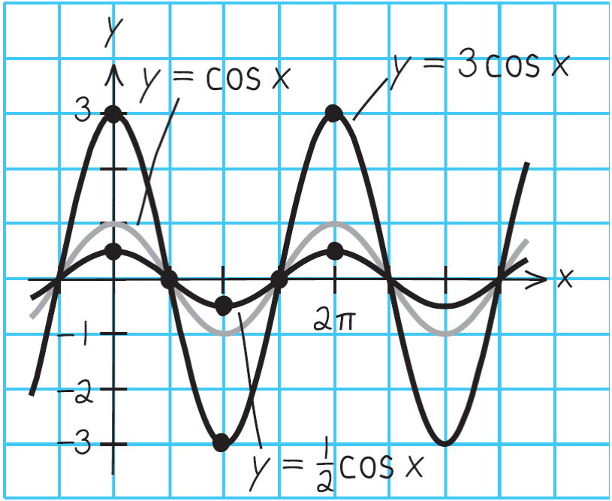
Example 2 – Solution
cont’d
The graphs of these two functions are shown in Figure 4.46.
Notice that the graph of
is a vertical compression of the graph of y = cos x and the graph of
y = 3 cos x
is a vertical stretch of the graph of y = cos x.
Figure 4.46

Slide 18
Amplitude and Period of Sine and Cosine Curves
Next, consider the effect of the positive real number b on the graphs of y = a sin bx and y = a cos bx.

Slide 19
Amplitude and Period of Sine and Cosine Curves
Note that when 0 < b < 1, the period of y = a sin bx is greater than 2π and represents a horizontal stretching of the graph of y = a sin x.
Similarly, when b > 1, the period of y = a sin bx is less than 2π and represents a horizontal shrinking of the graph of y = a sin x.

Slide 20
Translations of Sine and Cosine Curves

Slide 21
Translations of Sine and Cosine Curves
The constant c in the general equations
y = a sin(bx – c) and y = a cos(bx – c)
creates horizontal translations (shifts) of the basic sine and cosine curves.
To find the horizontal shift, first factor b out of the parentheses.

Slide 22
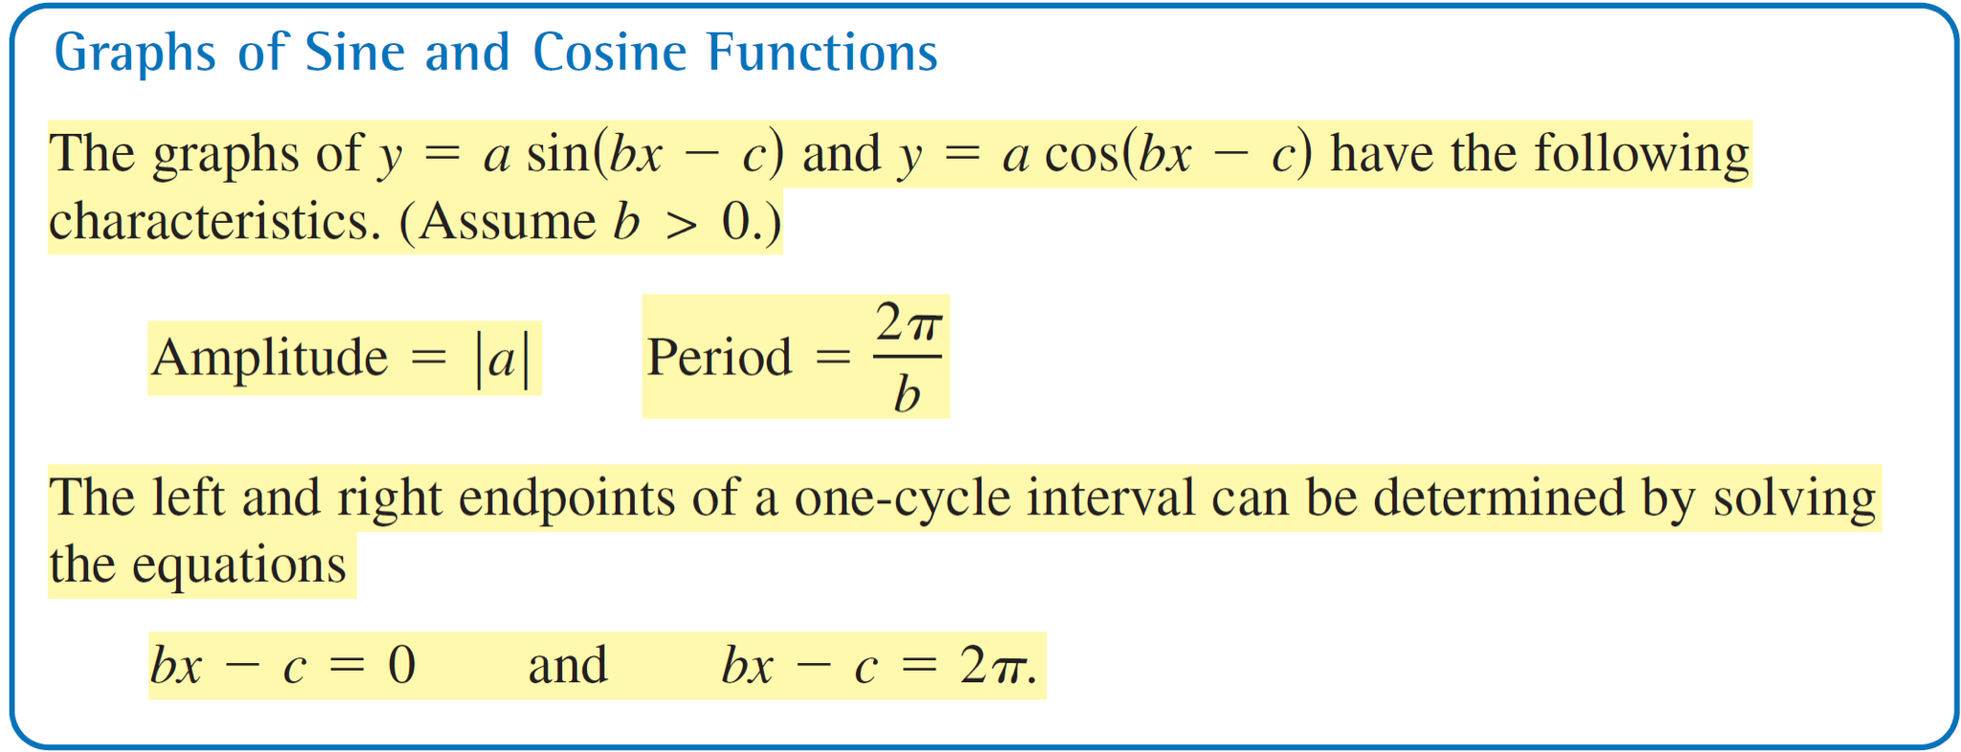
Translations of Sine and Cosine Curves
This implies that the period of y = a sin(bx – c) is 2π /b, and the graph of y = a sin bx is shifted by an amount c/b. The number c/b is the phase shift.

Slide 23
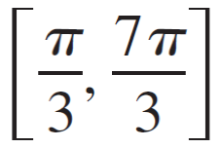
Example 4 – Horizontal Translation
Analyze the graph of
Solution:
The amplitude is , the horizontal shift is to the right, and the period is 2π.
Therefore, the interval which corresponds to one cycle of the graph is

Slide 24
Example 4 – Solution
cont’d
Dividing this interval into four equal parts produces the following key points.

Slide 25
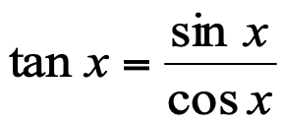
Tangent Function
Graph of the Tangent Function
To graph y = tan x, use the identity .
At values of x for which cos x = 0, the tangent function is undefined and its graph has vertical asymptotes.
y
Properties of y = tan x
1. Domain : all real x
2. Range: (–∞, +∞)
x
3. Period: π
4. Vertical asymptotes:
period:

Slide 26
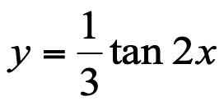
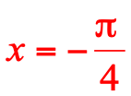
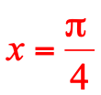
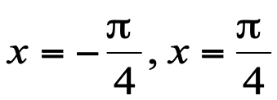
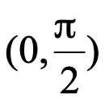
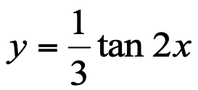
Example: Tangent Function
Example: Find the period and asymptotes and sketch the graph of
y
1. Period of y = tan x is .
2. Find consecutive vertical
asymptotes by solving for x:
x
Vertical asymptotes:
3. Plot several points in
4. Sketch one branch and repeat.

