Slide 1
Other Trigonometric Functions
65
Copyright © Cengage Learning. All rights reserved.

Slide 2
What You Should Learn
Sketch the graphs of secant and cosecant functions.
Sketch the graphs of cotangent functions.
Introduce and Use Inverse Trig Functions

Slide 3
Graph of the Reciprocal Functions

Slide 4
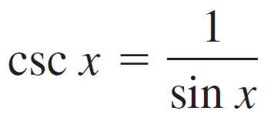
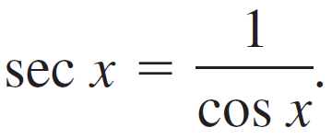
Graph of the Reciprocal Functions
The graphs of the two remaining trigonometric functions can be obtained from the graphs of the sine and cosine functions using the reciprocal identities
and
For instance, at a given value of x, the y-coordinate for sec x is the reciprocal of the y-coordinate for cos x. Of course, when x = 0, the reciprocal does not exist.

Slide 5
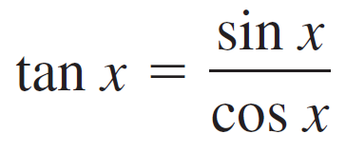
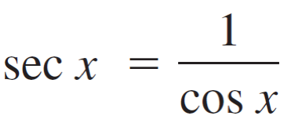
Graph of the Reciprocal Functions
Near such values of x, the behavior of the secant function is similar to that of the tangent function. In other words, the graphs of and
have vertical asymptotes at x = π/2 + nπ (i.e., the values at which the cosine is zero).

Slide 6
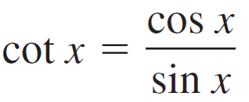
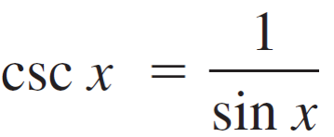
Graph of the Reciprocal Functions
Similarly,
and
have vertical asymptotes where sin x = 0—that is, at x = nπ.

Slide 7
Graph of the Reciprocal Functions
To sketch the graph of a secant or cosecant function, you should first make a sketch of its reciprocal function. For instance, to sketch the graph of y = csc x, first sketch the graph of y = sin x. Then take the reciprocals of the y-coordinates to obtain points on the graph of y = csc x.

Slide 8
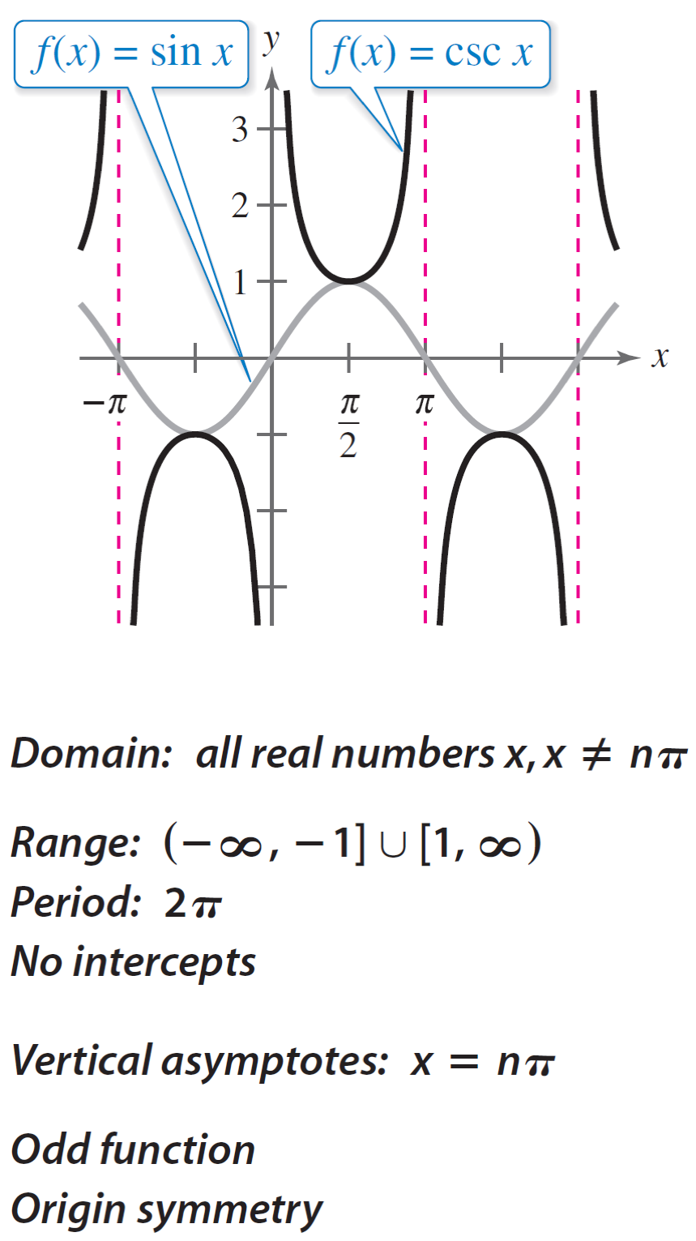
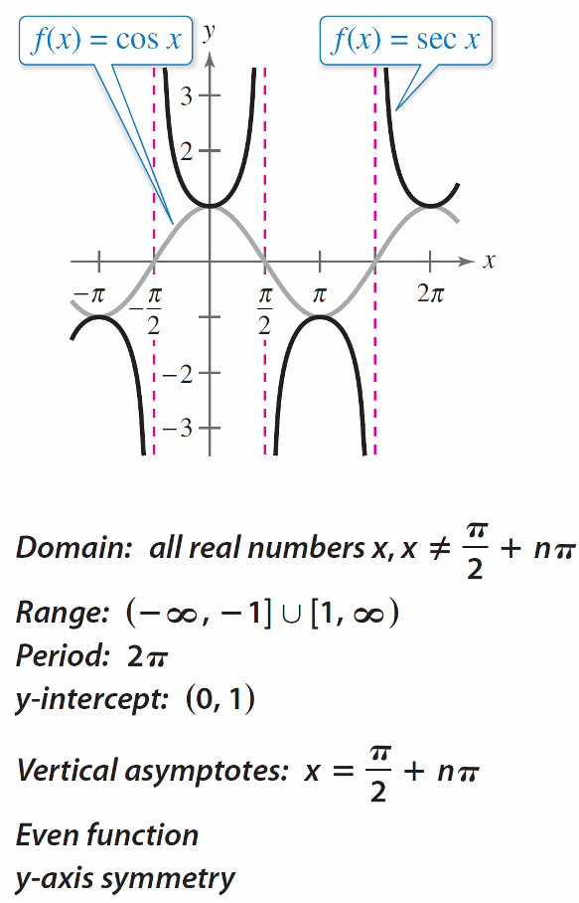
Graph of the Reciprocal Functions
The basic characteristics of the parent cosecant and secant functions are summarized below
Figure 4.60

Slide 9
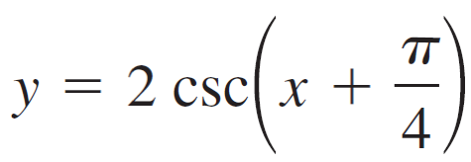
Example 4 – Library of Parent Functions: f (x) = csc x
Sketch the graph of by hand.
Solution: Begin by sketching the graph of
For this function, the amplitude is 2, it is shifted to the left, and the period is 2π.

Slide 10
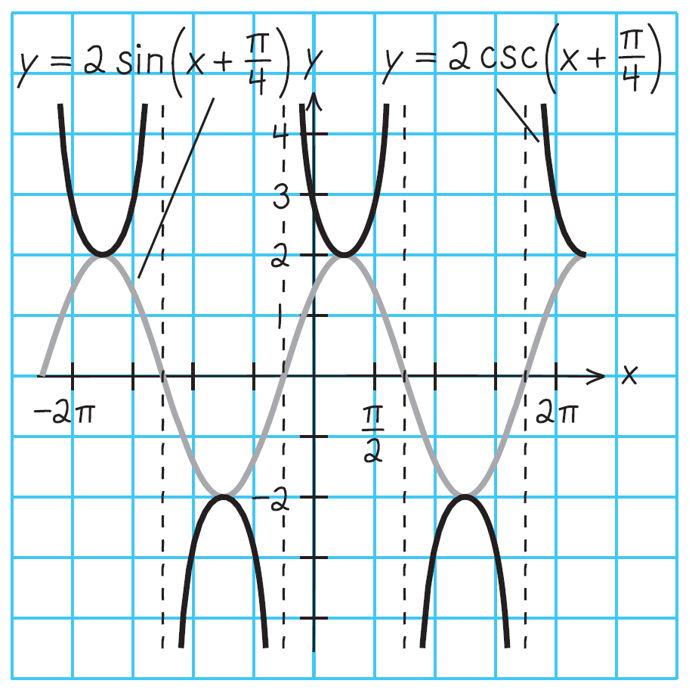
Example 4 – Solution
cont’d
The graph of this sine function is represented by the gray curve in Figure 4.62.
Figure 4.62

Slide 11
Graph of the Cotangent Function

Slide 12
Graph of the Cotangent Function
The graph of the parent cotangent function is similar to the graph of the parent tangent function. It also has a period of π.

Slide 13
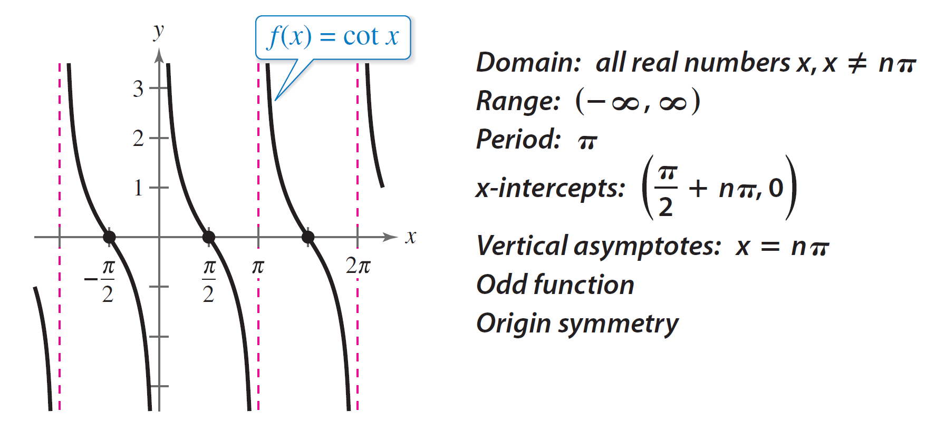
Graph of the Cotangent Function
However, from the identity you can see that the cotangent function has vertical asymptotes when sin x is zero. The basic characteristics of the parent cotangent function are summarized below

Slide 14
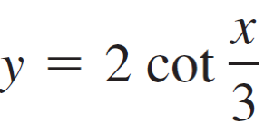
Example 3 – Library of Parent Functions: f (x) = cot x
Sketch the graph of by hand.
Solution:

Slide 15
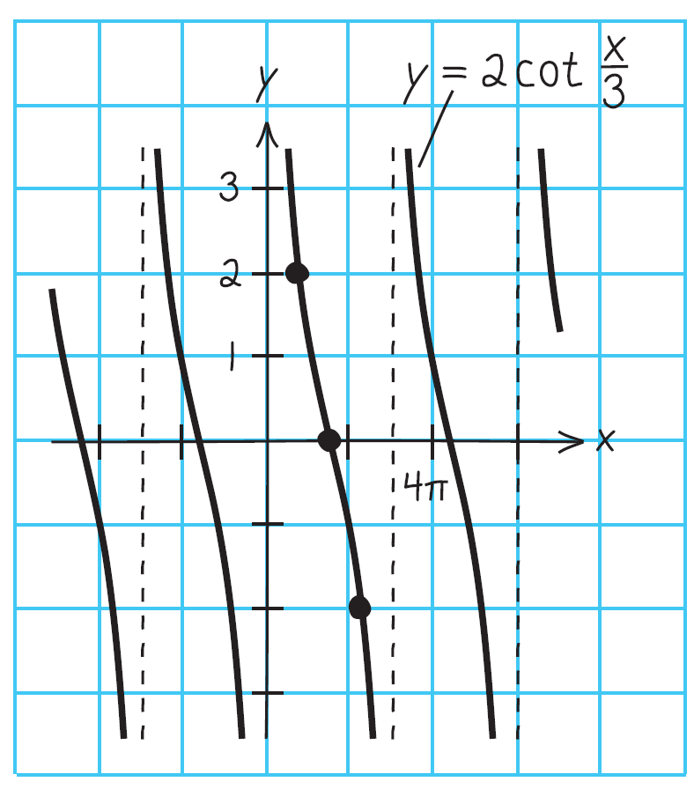
Example 3 – Solution
cont’d
The asymptotes occur where cotangent is undefined.
Three cycles of the graph are shown below.

