Slide 1
Inverse Trigonometric Functions
66

Slide 2
What You Should Learn
Evaluate and graph inverse sine functions
Evaluate and graph other inverse trigonometric functions
Evaluate compositions of trigonometric functions

Slide 3
Inverse Sine Function

Slide 4
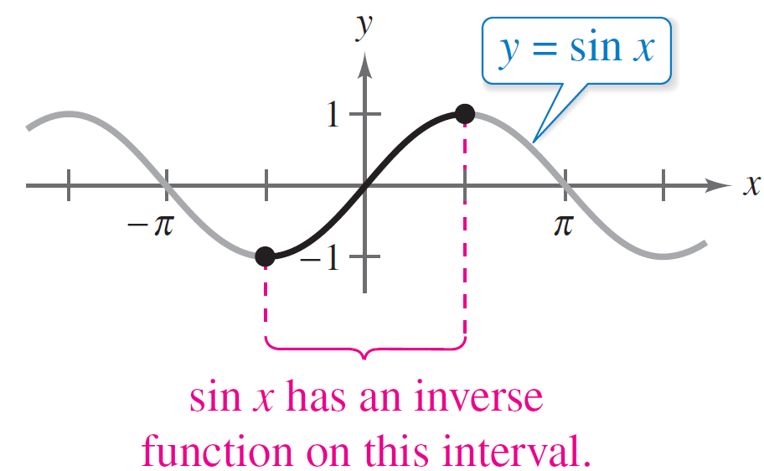
Inverse Sine Function
We have know that for a function to have an inverse function, it must be one-to-one—that is, it must pass the Horizontal Line Test.
In Figure 4.67 it is obvious that y = sin x does not pass the test because different values of x yield the same y-value.
Figure 4.67

Slide 5
Inverse Sine Function
However, when you restrict the domain to the interval –π /2 ≤ x ≤ π /2 (corresponding to the black portion of the graph in Figure 4.67), the following properties hold.
1. On the interval [–π /2, π /2], the function y = sin x is increasing.
2. On the interval [–π /2, π /2], y = sin x takes on its full range of values, –1 ≤ sin x ≤ 1.
3. On the interval [–π /2, π /2], y = sin x is one-to-one.

Slide 6
Inverse Sine Function
So, on the restricted domain –π /2 ≤ x ≤ π /2, y = sinx has a unique inverse function called the inverse sine function. It is denoted by
y = arcsin x or y = sin^{–1} x.
The notation sin^{–1} x is consistent with the inverse function notation f ^{–1}(x). The arcsin x notation (read as “the arcsine of x”) comes from the association of a central angle with its intercepted arc length on a unit circle.

Slide 7
Inverse Sine Function
So, arcsin x means the angle (or arc) whose sine is x. Both notations, arcsin x and sin^{–1} x, are commonly used in mathematics, so remember that sin^{–1} x denotes the inverse sine function rather than 1/sin x. The values of arcsin x lie in the interval –π /2 ≤ arcsin x ≤ π /2.

Slide 8
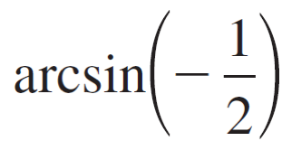
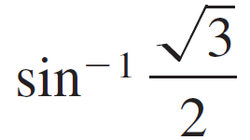
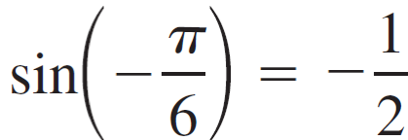
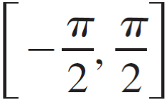
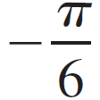
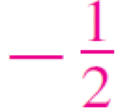
Example 1 – Evaluating the Inverse Sine Function
If possible, find the exact value.
a. b. c. sin^{–1} 2
Solution:
a. Because , and lies in , it follows that
Angle whose sine is

Slide 9
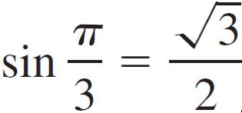
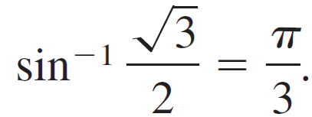
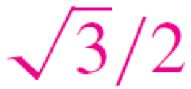
Example 1 – Solution
cont’d
b. Because , and lies in , it follows that
c. It is not possible to evaluate y = sin^{–1} x at x = 2 because there is no angle whose sine is 2. Remember that the domain of the inverse sine function is [–1, 1].
Angle whose sine is

Slide 10
Example 2 – Graphing the Arcsine Function
Sketch a graph of y = arcsin x by hand.
Solution:
By definition, the equations
y = arcsin x and sin y = x
are equivalent for –π /2 ≤ y ≤ π /2. So, their graphs are the same. For the interval [–π /2, π /2] you can assign values to y in the second equation to make a table of values.

Slide 11
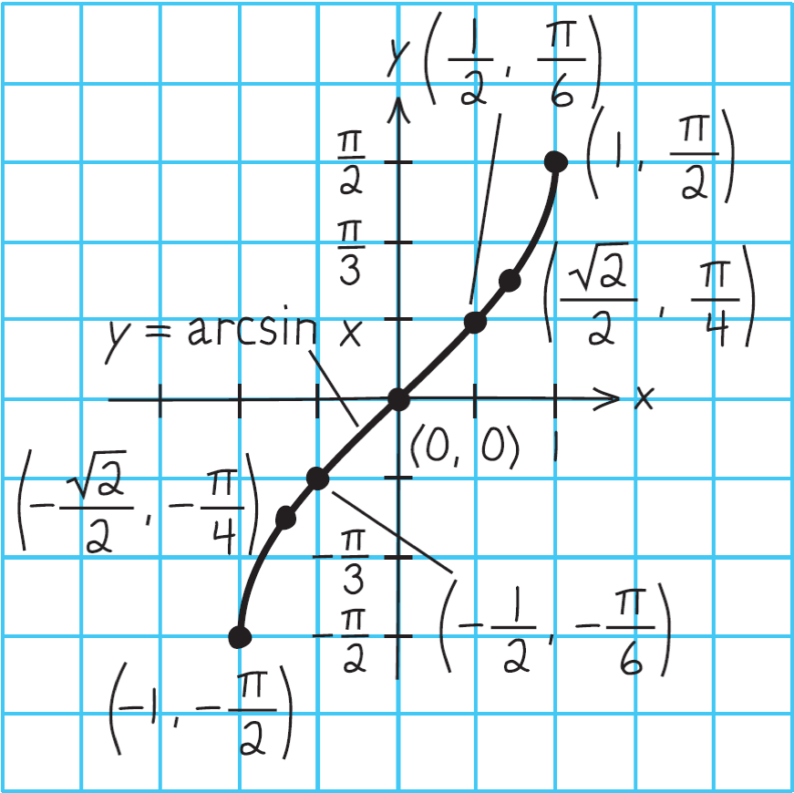
Example 2 – Solution
cont’d
Then plot the points and connect them with a smooth curve. The resulting graph of y = arcsin x is shown in Figure 4.68.
Figure 4.68

Slide 12
Example 2 – Solution
cont’d
Note that it is the reflection (in the line y = x) of the black portion of the graph in Figure 4.67.
Remember that the domain of y = arcsin x is the closed interval [–1, 1] and the range is the closed interval [–π /2, π /2].
Figure 4.67

Slide 13
Other Inverse Trigonometric Functions

Slide 14
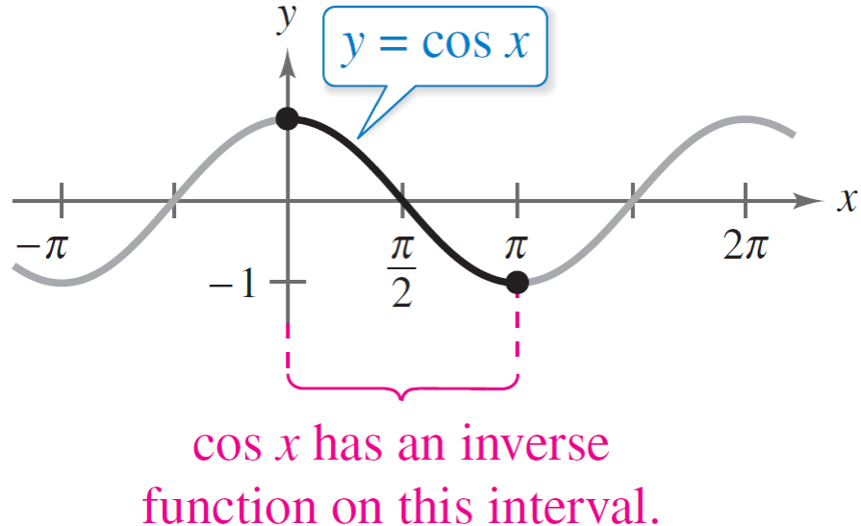
Other Inverse Trigonometric Functions
The cosine function is decreasing and one-to-one on the interval 0 ≤ x ≤ π, as shown in Figure 4.69.
Figure 4.69

Slide 15
Other Inverse Trigonometric Functions
Consequently, on this interval the cosine function has an inverse function—the inverse cosine function—denoted by
y = arccos x or y = cos^{–1} x.
Because y = arccos x and x = cos y are equivalent for 0 ≤ y ≤ π, their graphs are the same, and can be confirmed by the following table of values.

Slide 16
Other Inverse Trigonometric Functions
Similarly, you can define an inverse tangent function by restricting the domain of y = tan x to the interval (–π /2, π /2).
The inverse tangent function is denoted by
y = arctan x or y = tan ^{–1} x.
Because y = arctan x and x = tan y are equivalent for –π /2 < y < π /2 their graphs are the same, and can be confirmed by the following table of values.

Slide 17
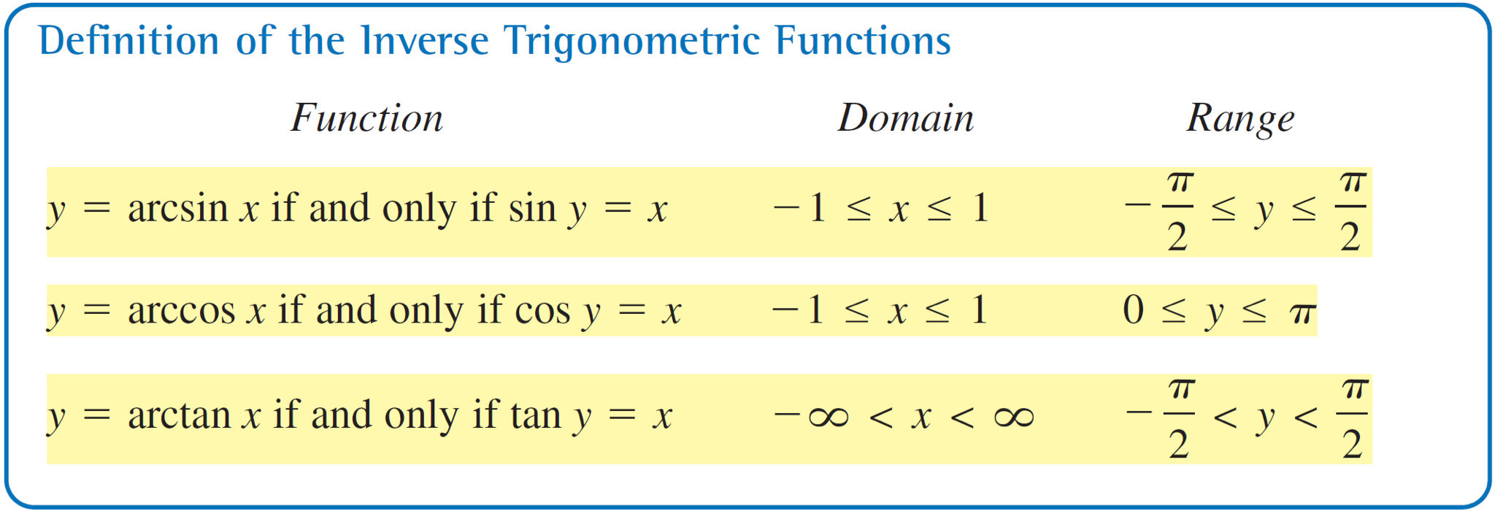
Other Inverse Trigonometric Functions
The following list summarizes the definitions of the three most common inverse trigonometric functions.

Slide 18
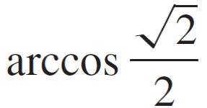
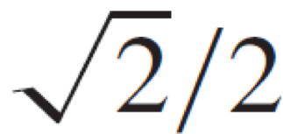
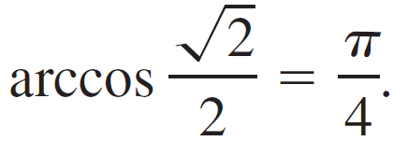
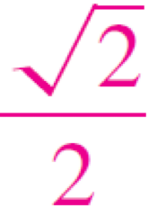
Example 3 – Evaluating Inverse Trigonometric Functions
Find the exact value.
a. b. cos^{–1}(–1)
c. arctan 0 d. tan^{–1}(–1)
Solution:
a. Because cos(π /4) = , and π /4 lies in [0, π], it follows that
Angle whose cosine is

Slide 19
Example 3 – Solution
cont’d
b. Because cosπ = –1 and π lies in [0, π] it follows that
cos^{–1}(–1) = π.
c. Because tan 0 = 0, and 0 lies in (–π /2, π /2), it follows that
arctan 0 = 0.
d. Because tan(–π /4) = –1 and –π /4 lies in (–π /2, π /2), it follows that
Angle whose cosine is –1
Angle whose tangent is 0s
Angle whose tangent is –1

Slide 20
Compositions of Functions

Slide 21
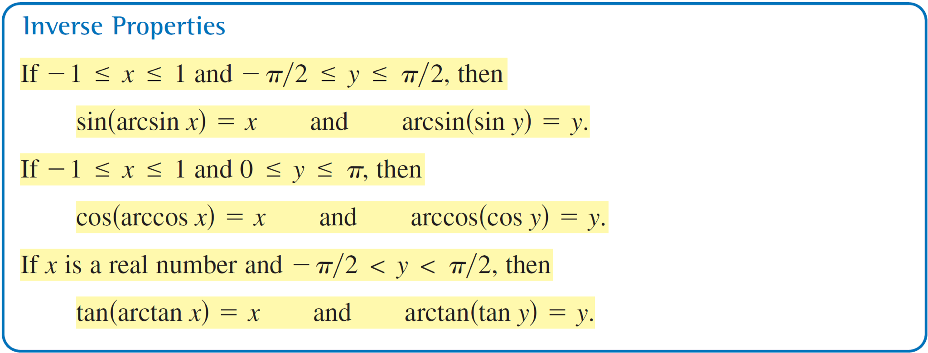
Compositions of Functions
We have know that for all x in the domains of f and f ^{–1}, inverse functions have the properties
f (f ^{–1}(x)) = x and f ^{–1}(f (x)) = x.

Slide 22
Compositions of Functions
Keep in mind that these inverse properties do not apply for arbitrary values of x and y. For instance,
In other words, the property
arcsin(sin y) = y
is not valid for values of y outside the interval [–π /2, π /2].

Slide 23
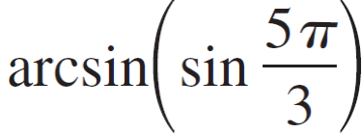
Example 6 – Using Inverse Properties
If possible, find the exact value.
a. tan[arctan(–5)] b.
c. (cos^{–1}π )
Solution:
a. Because –5 lies in the domain of the arctangent function, the inverse property applies, and you have
tan[arctan(–5)] = –5.

Slide 24
Example 6 – Solution
cont’d
b. In this case, 5π /3 does not lie within the range of the arcsine function, –π /2 ≤ y ≤ π /2. However, 5π /3 is coterminal with
which does lie in the range of the arcsine function, and you have
c. The expression cos(cos^{–1}π) is not defined because cos^{–1}π is not defined. Remember that the domain of the inverse cosine function is [–1, 1].

