Slide 1
Lesson 2: Transformers: More Than Meets the y’s
Structures of Quadratic Expressions

Slide 2
Write equations for functions that are transformations of $f\left(x\right)=x^{2}.$
Find efficient methods for graphing transformations of $f\left(x\right)=x^{2}.$

Slide 3
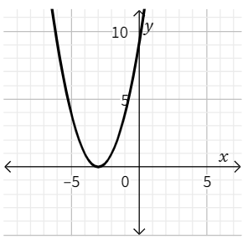
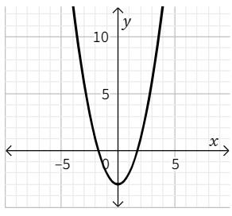
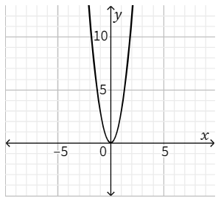
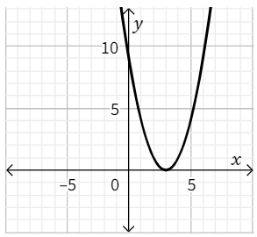
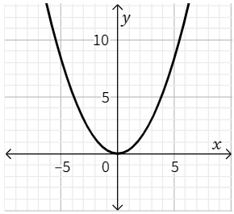
Transformers: More Than Meets the y’s
Without using technology, match each of the equations with the graph of the function. Be careful; there are more graphs than equations!
1. 2. 3.
4. 5.
$f\left(x\right)=x^{2}−3$
$f\left(x\right)={\left(x−3\right)}^{2}$
$f\left(x\right)=\frac{1}{3}x^{2}$
$f\left(x\right)=3x^{2}$

Slide 4
Transformers: More Than Meets the y’s
In the previous lesson, you learned about transformations of the graph of $f\left(x\right)=x^{2}$ . In this lesson, you will be writing equations and graphing functions that have more than one transformation. It will be a lot easier if you know a few points on $f\left(x\right)=x^{2}$ that we can use for comparisons. We’ll call them anchor points.

Slide 5
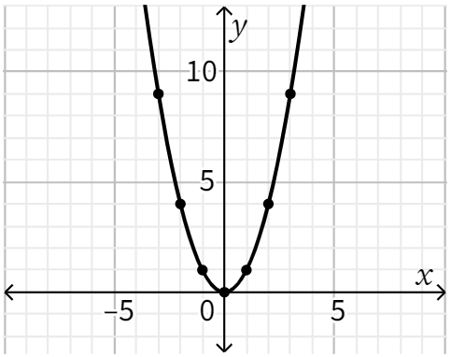
Transformers: More Than Meets the y’s
Identify each anchor point on the graph of $f\left(x\right)=x^{2}.$
Anchor Points:
Vertex (_____, _____)
(1, _____) and (-1, _____)
(2, _____) and (-2, _____)
(3, _____) and (-3, _____)
Line of Symmetry: $x=_____$

Slide 6
Transformers: More Than Meets the y’s
Independently, begin working on Problem #2.

Slide 7
Transformers: More Than Meets the y’s
Write the equation for each problem below. Use a second representation to check your equation.

Slide 8
Transformers: More Than Meets the y’s
The area of a square with side length $x$, where the side length is decreased by $3$, the area is multiplied by $2$, and then $4$ square units are added to the area.

Slide 9
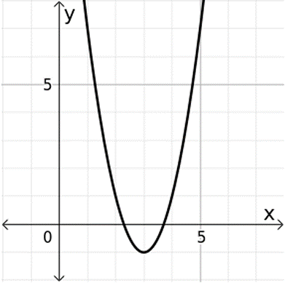
Transformers: More Than Meets the y’s
3.

Slide 10
Transformers: More Than Meets the y’s
4.
$$x$$ | $$f(x)$$
-4 | 7
-3 | 2
-2 | -1
-1 | -2
0 | -1
1 | 2
2 | 7
3 | 14
4 | 23

Slide 11
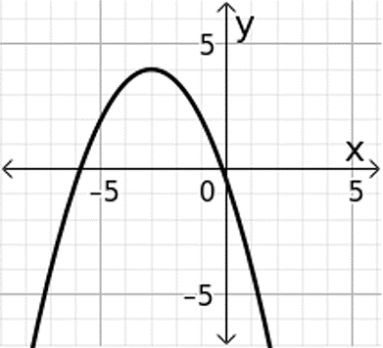
Transformers: More Than Meets the y’s
5.

Slide 12
Transformers: More Than Meets the y’s
Graph each equation without using technology. Be sure to have the exact vertex and at least two correct points on either side of the line of symmetry.
$f\left(x\right)=−x^{2}+3$
$g\left(x\right)={\left(x+2\right)}^{2}−5$
$h\left(x\right)=3{\left(x−1\right)}^{2}+2$

Slide 13
Transformers: More Than Meets the y’s
9. Given: $f\left(x\right)=a{\left(x−h\right)}^{2}+k$
What point is the vertex of the parabola?
What is the equation of the line of symmetry?
How can you tell if the parabola opens up or down?
How do you identify the vertical stretch?

Slide 14
Transformers: More Than Meets the y’s
Does it matter in which order transformations are done? Explain why or why not.

Slide 15
Think about applying the transformations to the parent function $f\left(x\right)=2^{x}$.
What point makes sense to use as an anchor point on this function?
What do you think is the equation of the function with a horizontal shift left $3$?
How does the horizontal shift on $y=2^{x}$ work like the horizontal shift on $y=x^{2}$?

Slide 16
Vertex form of a quadratic equation: _______________
Vertex: __________ Line of symmetry: ________ Vertical stretch: _______ | Opens upward: _______ Opens downward: ______

Slide 17
Quick-graph method for graphing quadratics:
$y={\left(x−4\right)}^{2}−3$
$y=−{\left(x+2\right)}^{2}+5$
$y=2{\left(x+1\right)}^{2}−5$

Slide 18
Graph each of the following quadratic functions. Be sure to have at least three accurate points on either side of the line of symmetry.
$y={\left(x+1\right)}^{2}−3$

Slide 19
Graph each of the following quadratic functions. Be sure to have at least three accurate points on either side of the line of symmetry.
2. $y=−x^{2}+5$

Slide 20
The standard form for a quadratic equation is $y=ax^{2}+bx+c$. In each of the following equations, identify the values for $a$, $b$, and $c$.
$y=3x^{2}−7x+12$
$f\left(x\right)=9x^{2}+4x−8$
$g\left(x\right)=2x^{2}+11x+15$
$h\left(x\right)=−5x^{2}+41x+36$

Slide 21
Use the table to identify the vertex, the equation for the line of symmetry, and state the number of $x$-intercept(s) the parabola will have, if any. State whether the vertex will be a minimum or a maximum.
Vertex:
Line of symmetry:
X-int(s):
Minimum or maximum?
$$x$$ | $$y$$
$$−4$$ | $$9$$
$$−3$$ | $$2$$
$$−2$$ | $$−3$$
$$−1$$ | $$−6$$
$$0$$ | $$−7$$
$$1$$ | $$−6$$
$$2$$ | $$−3$$

