Slide 1
Lesson 1: Brutus Bites Back
Functions and Their Inverses

Slide 2
Which One Doesn’t Belong?
Decide which of the representations below doesn’t belong and write your reason for selecting it.
A. Yasmin earns $5$ dollars each hour that she babysits.
B.
Hours | Dollars Earned
1$1$ | 5$5$
2$2$ | 10$10$
3$3$ | 15$15$
4$4$ | 20$20$
C.
D.

Slide 3
Model a relationship between two quantities by using either quantity as the input variable.

Slide 4
Brutus Bites Back
A couple years ago, Carlos and Clarita started earning money by taking care of pets while the pets’ owners are away. Due to their amazing mathematical analysis and their loving care of the cats and dogs that they take in, Carlos and Clarita have made their business very successful. To keep the hungry dogs fed, they must regularly buy Brutus Bites, the favorite food of all the dogs.
Notes:
Begin the lesson by ensuring that students understand the context. The important feature of the context for students to know is that they are planning to buy dog food that is priced by the pound.

Slide 5
Brutus Bites Back
Carlos and Clarita have been searching for a new dog food supplier and have identified two possibilities. The Canine Catering Company, located in their town, sells $7$pounds of food for $\$5$. Customers buy the food in bulk so they can purchase any amount. The amounts of food purchased often include fractions of a pound, such as $2.6$pounds or $3.9$pounds.
Carlos thought about how much they would pay for a given amount of food and drew this graph:
Notes:
Begin the lesson by ensuring that students understand the context. The important feature of the context for students to know is that they are planning to buy dog food that is priced by the pound.

Slide 6
Brutus Bites Back
The Canine Catering Company, located in their town, sells $7$pounds of food for $\$5$. Customers buy the food in bulk so they can purchase any amount. The amounts of food purchased often include fractions of a pound, such as $2.6$pounds or $3.9$pounds.
1. Make a table, and write the equation of the function that Carlos graphed using $D$ for dollars and $P$ for pounds.
Notes:
Discuss problems 1–4, beginning with a student who made tables for both problems 1 and 2. Point out that the inputs and outputs have been switched, and ask the class what that might mean. Continue with a student who has written an equation for both problems 1 and 2. Ask the class what they notice about the slopes of the two lines to help them observe that the slopes are reciprocals. Tell the class that these two equations are examples of inverse functions.

Slide 7
Brutus Bites Back
Clarita thought about how much food they could buy for a given amount of money and drew this graph:
2. Make a table, and write the equation of the function that Clarita graphed using $D$ for dollars and $P$ for pounds.
Notes:
Discuss problems 1–4, beginning with a student who made tables for both problems 1 and 2. Point out that the inputs and outputs have been switched, and ask the class what that might mean. Continue with a student who has written an equation for both problems 1 and 2. Ask the class what they notice about the slopes of the two lines to help them observe that the slopes are reciprocals. Tell the class that these two equations are examples of inverse functions.

Slide 8
Brutus Bites Back
Looking online, Carlos found a company that will sell $8$pounds of Brutus Bites for $\$6$ plus a flat $\$5$ shipping charge for each order. The company advertises that they will sell any amount of food at the same price per pound.

Slide 9
Brutus Bites Back
5. Model the relationship between the price and the amount of food with a table, graph, and equation using Carlos’s approach.
Carlos’s approach:
Notes:
As students begin working individually on problem 5, do a quick check to see that they are using the information from the context to find representations for the function. Watch for how students are finding new values for the graphs and writing equations so different methods can be used in the discussion. After most students have completed problem 5, ask students to share their work with partners, and then finish the task working with partners or small groups.

Slide 10
Brutus Bites Back
5. Model the relationship between the price and the amount of food with a table, graph, and equation using Carlos’s approach.
Carlos’s approach:
Notes:
Begin the discussion with problem 5. Have a student share an equation and graph, and discuss with the class the features of the function that make it linear.

Slide 11
Brutus Bites Back
6. Model the relationship between the price and the amount of food with a table, equation, and graph using Clarita’s approach.
Clarita’s approach:
Notes:
Then, have a student share similar work for problem 6, beginning with a student who has written an equation by switching the variables and taking the reciprocal of the slope. Use the context to show how the equation of the inverse must be consistent with the original function.

Slide 12
Brutus Bites Back
5. Model the relationship between the price and the amount of food with a table, graph, and equation using Carlos’s approach.
6. Model the relationship between the price and the amount of food with a table, equation, and graph using Clarita’s approach.
Notes:
Highlight the features of the function in problem 5, and compare it to the function in problem 6. Demonstrate that the graphs are reflections over y=x, using a piece of patty paper.

Slide 13
Which company should Clarita and Carlos buy their Brutus Bites from? Why?
Notes:
(optional)

Slide 14
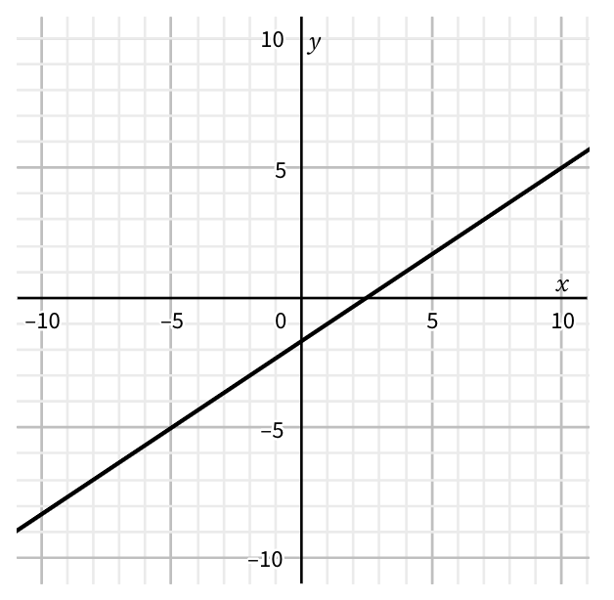
Decide which of the representations below doesn’t belong and write your reason for selecting it.
A.
C.
$x$ | $f(x)$
-2 | $$9$$
$$−1$$ | $$7$$
$$0$$ | $$5$$
$$1$$ | $$3$$
2 | 1
B. $f\left(x\right)=−\frac{2}{9}x$

