Slide 1
Lesson 5 Inverse Universe
Functions and Their Inverses
Notes:
The purpose of this lesson is for students to become fluent in finding inverses given any representation. They compare features of two functions, which may be represented differently, to determine if they are inverses. Students find strategies that can be applied flexibly to find the inverse, no matter the representation. Students justify that the functions they have matched are inverses, which may be done by composition (^). The formal method for verifying inverses using composition is reinforced in the discussion with examples given.

Slide 2
Match a function and its inverse given a table, a graph, or an equation.
Use a representation of a function to create a second representation.

Slide 3
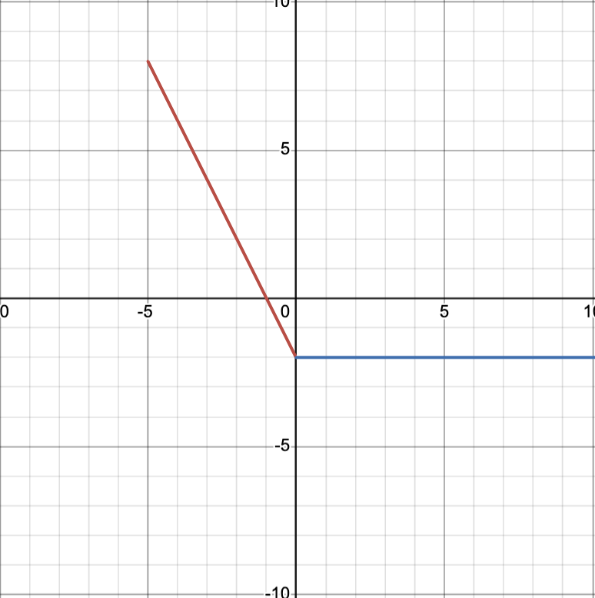
Inverse Universe
Notes:
Starting with card A1, discuss each pair of matching cards. Begin by asking the student who shares how they used the information from the card to create a new representation and then how they matched the function with its inverse. Highlight information about the functions that support identifying the inverse, such as if the function is quadratic, then the inverse will contain a square root. In each case, ask the student to justify the inverse and have the class determine whether the justification is sufficient or if they have suggestions to strengthen the argument. (MP3) After sharing a pair of cards that contain equations, possibly A2 and B3, demonstrate how to prove that two functions are inverses by composition (^)

Slide 4
Inverse Universe
Notes:
Starting with card A1, discuss each pair of matching cards. Begin by asking the student who shares how they used the information from the card to create a new representation and then how they matched the function with its inverse. Highlight information about the functions that support identifying the inverse, such as if the function is quadratic, then the inverse will contain a square root. In each case, ask the student to justify the inverse and have the class determine whether the justification is sufficient or if they have suggestions to strengthen the argument. (MP3) After sharing a pair of cards that contain equations, possibly A2 and B3, demonstrate how to prove that two functions are inverses by composition (^)

Slide 5
Inverse Universe
Notes:
Starting with card A1, discuss each pair of matching cards. Begin by asking the student who shares how they used the information from the card to create a new representation and then how they matched the function with its inverse. Highlight information about the functions that support identifying the inverse, such as if the function is quadratic, then the inverse will contain a square root. In each case, ask the student to justify the inverse and have the class determine whether the justification is sufficient or if they have suggestions to strengthen the argument. (MP3) After sharing a pair of cards that contain equations, possibly A2 and B3, demonstrate how to prove that two functions are inverses by composition (^)

Slide 6
Verify inverse functions using the definition:
$f\left(x\right)$ and $g\left(x\right)$ are inverses if and only if $f\left(g\left(x\right)\right)=x$ and $g\left(f\left(x\right)\right)=x$.

Slide 7
If $f(x)$ is given as an equation and $g(x)$ is given as a table, I could tell if they were inverses by:

Slide 8
Use properties of exponents to write an equivalent expression. Write your answer in exponential form with positive exponents.
1. $\sqrt[5]{x^{2}}⋅\sqrt[3]{x}$
2. Given: $f\left(x\right)=5x−7$ and $g\left(x\right)=\frac{\left(x+7\right)}{5}$
Calculate $f\left(g\left(x\right)\right)$ and $g\left(f\left(x\right)\right)$ for the pair of functions. Are $f\left(x\right)$ and $g\left(x\right)$ inverses?

