Slide 1
Lesson 1:
Log Logic
Logarithmic Functions

Slide 2
Find exact and estimated values of logarithms.
Make conjectures about logarithm properties.

Slide 3
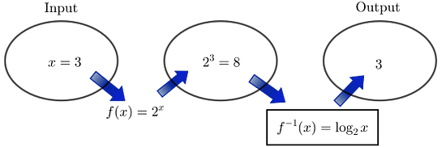
Log Logic
We began thinking about logarithms as inverse functions for exponentials in Tracking the Tortoise. Logarithmic functions are interesting and useful on their own.
We showed the inverse relationship between exponential and logarithmic functions using a diagram like the one shown:
Notes:
Begin by working through each of the examples at the beginning of the task with students. These examples remind students of their introduction to the inverse relationship between exponents and logarithms from Unit 1. After demonstrating with base ‌, show how base works similarly. Emphasize that the pattern is the same for any base, where the logarithm tells the power to which the base is raised to get the argument.

Slide 4

Log Logic
We could summarize this relationship by saying:
$2^{3}=8$ so, $\log_{2}8=3$

Slide 5
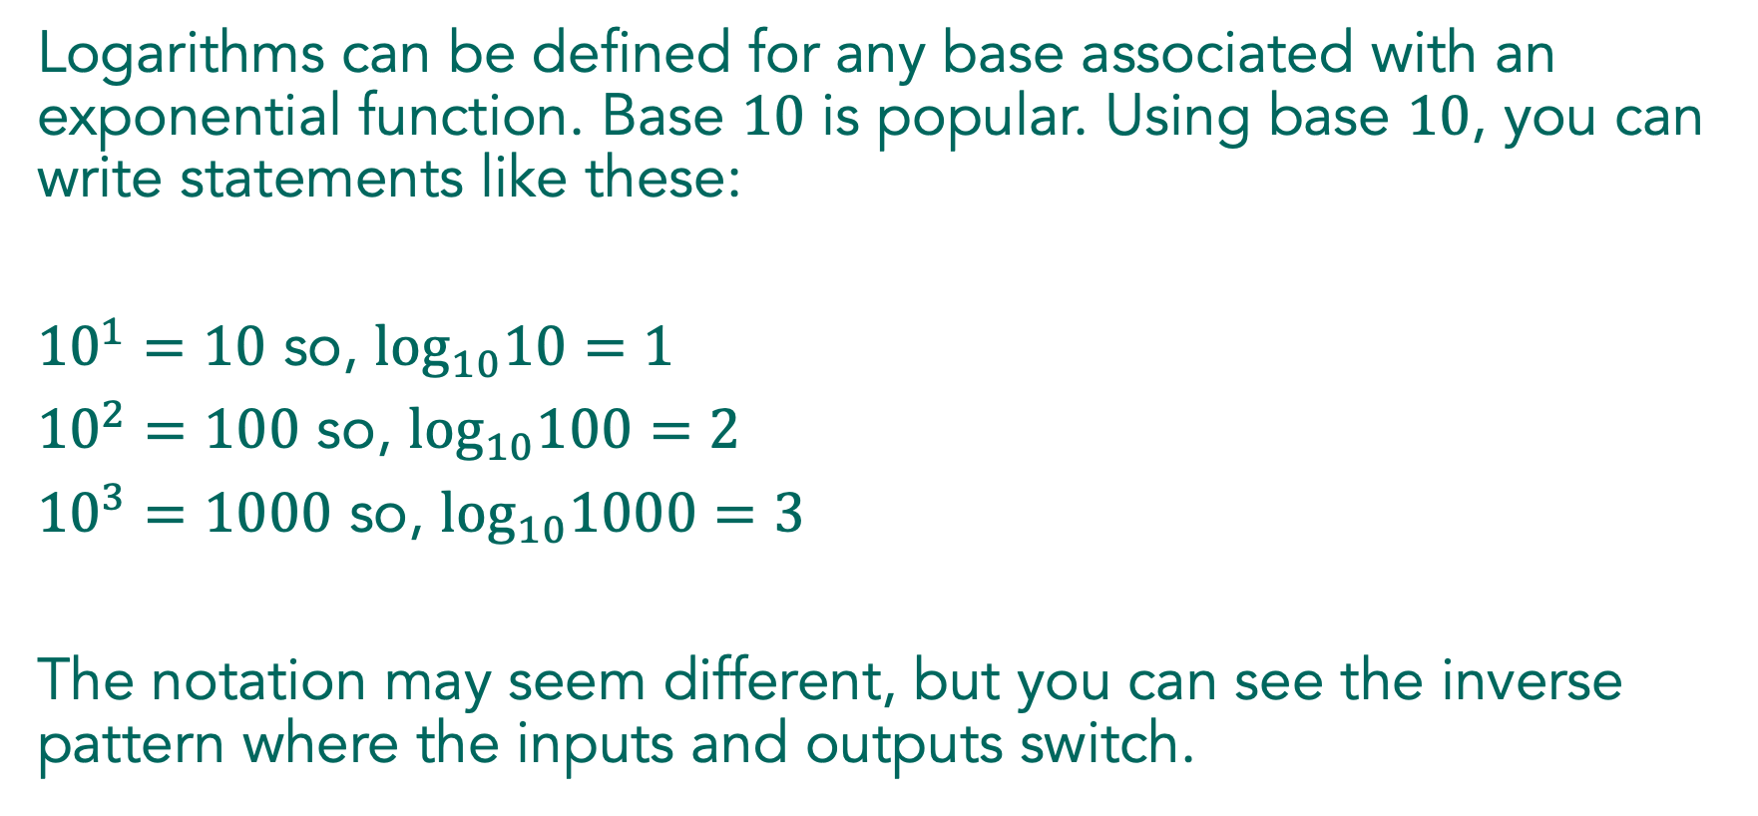
Log Logic
Logarithms can be defined for any base associated with an exponential function. Base $10$ is popular. Using base $10$, you can write statements like these:
${10}^{1}=10$ so, $\log_{10}10=1$
${10}^{2}=100$ so, $\log_{10}100=2$
${10}^{3}=1000$ so, $\log_{10}1000=3$
The notation may seem different, but you can see the inverse pattern where the inputs and outputs switch.

Slide 6
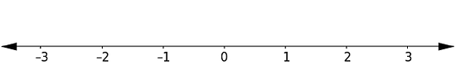

Log Logic
Place the following expressions on the number line. Explain how you knew where to place each expression.
  $$b. \log_{3}9$$
Notes:
Work on problem 1 together, modeling the expectations for the justification and thinking about placing each logarithmic expression on a number line for students. Begin with problem B.

Slide 7
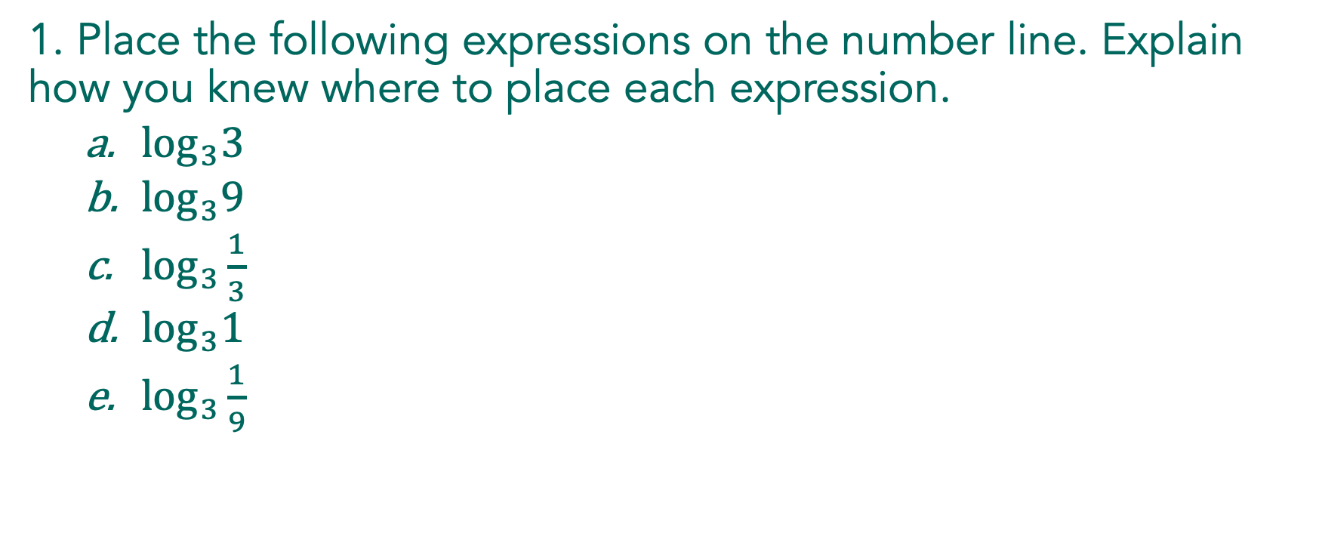
Log Logic
1. Place the following expressions on the number line. Explain how you knew where to place each expression.
  $\log_{3}3$
  $\log_{3}9$
  $\log_{3}\frac{1}{3}$
  $\log_{3}1$
  $\log_{3}\frac{1}{9}$
Notes:
Work on problem 1 together, modeling the expectations for the justification and thinking about placing each logarithmic expression on a number line for students. Begin with problem B.

Slide 8

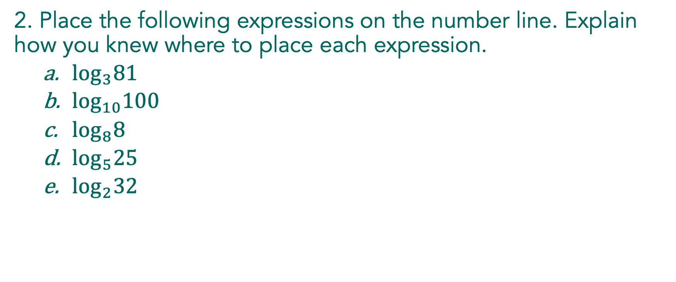
Log Logic
2. Place the following expressions on the number line. Explain how you knew where to place each expression.
  $\log_{3}81$
  $\log_{10}100$
  $\log_{8}8$
  $\log_{5}25$
  $\log_{2}32$

Slide 9

Log Logic
2. Place the following expressions on the number line. Explain how you knew where to place each expression.
  $\log_{3}81$
  $\log_{10}100$
  $\log_{8}8$
  $\log_{5}25$
  $\log_{2}32$

Slide 10
Pause and Reflect
What patterns are you using to find values for logarithms?
Notes:
Give students about one minute to reflect on their work and record their answers. Then ask them to share their reflection with a partner and continue working to complete the task in pairs or small groups.

Slide 11
Log Logic
With your partner, continue working on problems 3-14.

Slide 12
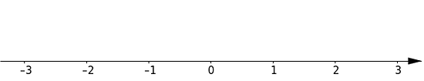

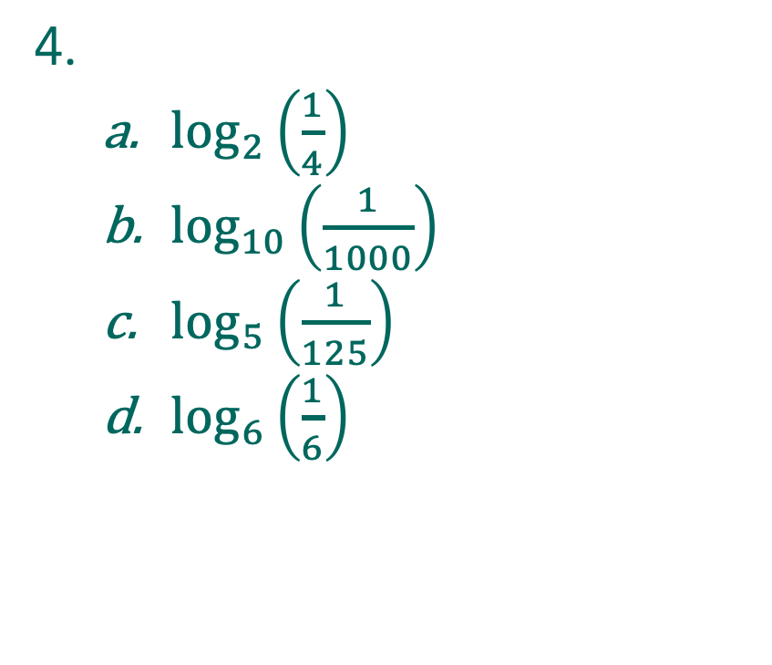
Log Logic
3.
  $\log_{7}7$
  $\log_{9}9$
  $\log_{11}1$
  $\log_{10}1$
4.
  $\log_{2}\left(\frac{1}{4}\right)$
  $\log_{10}\left(\frac{1}{1000}\right)$
  $\log_{5}\left(\frac{1}{125}\right)$
  $\log_{6}\left(\frac{1}{6}\right)$
Notes:
Select students for problems 3–4 who have placed the logarithmic expressions on the number line and written conjectures about how to evaluate the logarithms in the problems.

Slide 13
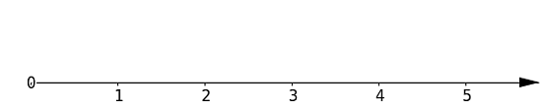



Log Logic
6.
  $\log_{2}5$
  $\log_{5}10$
  $\log_{6}1$
  $\log_{5}5$
  $\log_{10}5$
7.
  $\log_{10}50$
  $\log_{10}150$
  $\log_{10}1000$
  $\log_{10}500$
Notes:
Identify a student to share problem 6 who has estimated values for the logarithms and can describe their process for doing so. For problem 7, find a student who noticed that the logarithmic values increase as the arguments increase.

Slide 14


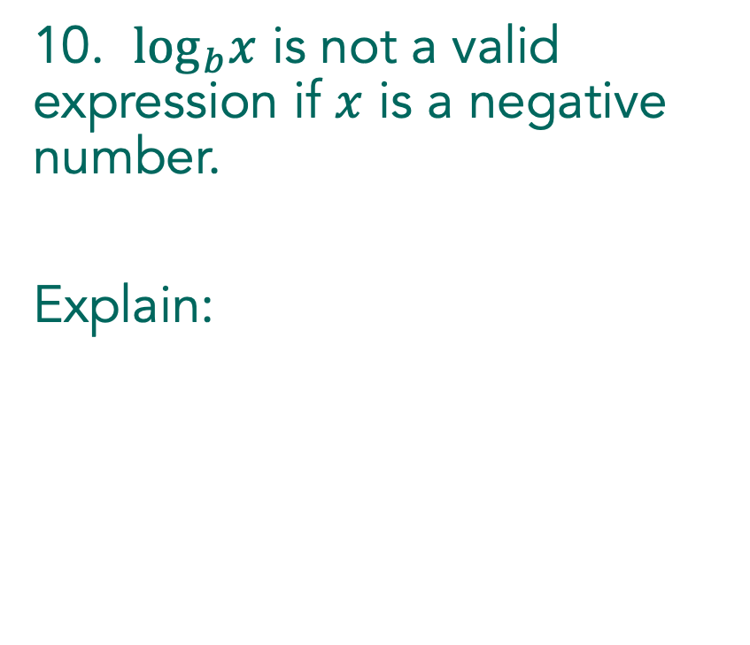
Log Logic
8.
  $\log_{3}3^{2}$
  $\log_{5}5^{−2}$
  $\log_{6}6^{0}$
  $\log_{4}4^{−1}$
  $\log_{2}2^{3}$
10. $\log_{b}x$ is not a valid expression if $x$ is a negative number.
Explain:
Notes:
Choose a student to share problem 8 who has a conjecture possibly expressed in words, rather than symbolically. To wrap up the discussion, find a student for problem 10 who has ideas, not necessarily correct, about whether the argument of a logarithm can be negative.

Slide 15

Find the value of: $b^{\log_{b}n}$.
For what values of $b$ and $n$ is your answer correct?

Slide 16
Properties of Logarithms:

Slide 17
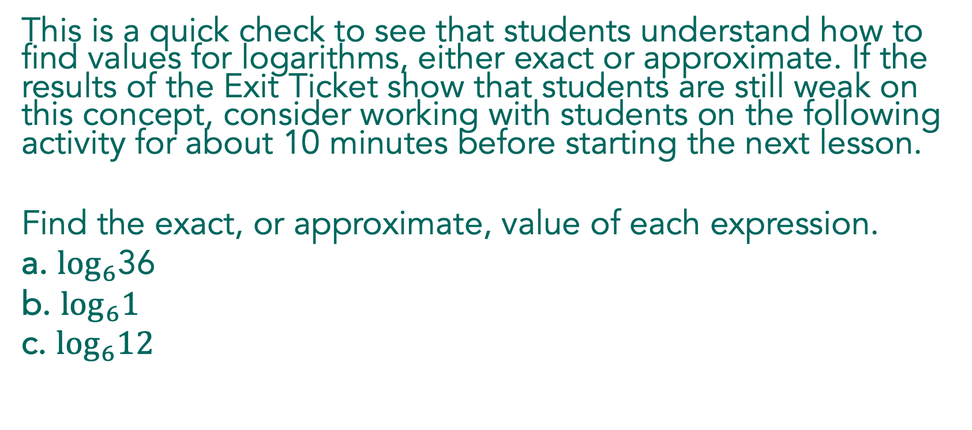
This is a quick check to see that students understand how to find values for logarithms, either exact or approximate. If the results of the Exit Ticket show that students are still weak on this concept, consider working with students on the following activity for about 10 minutes before starting the next lesson.
Find the exact, or approximate, value of each expression.
a. $\log_{6}$36
b. $\log_{6}1$
c. $\log_{6}12$

Slide 18
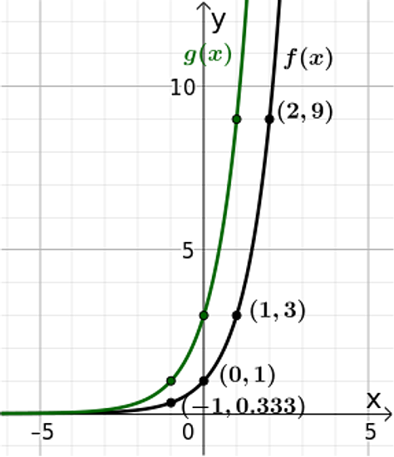
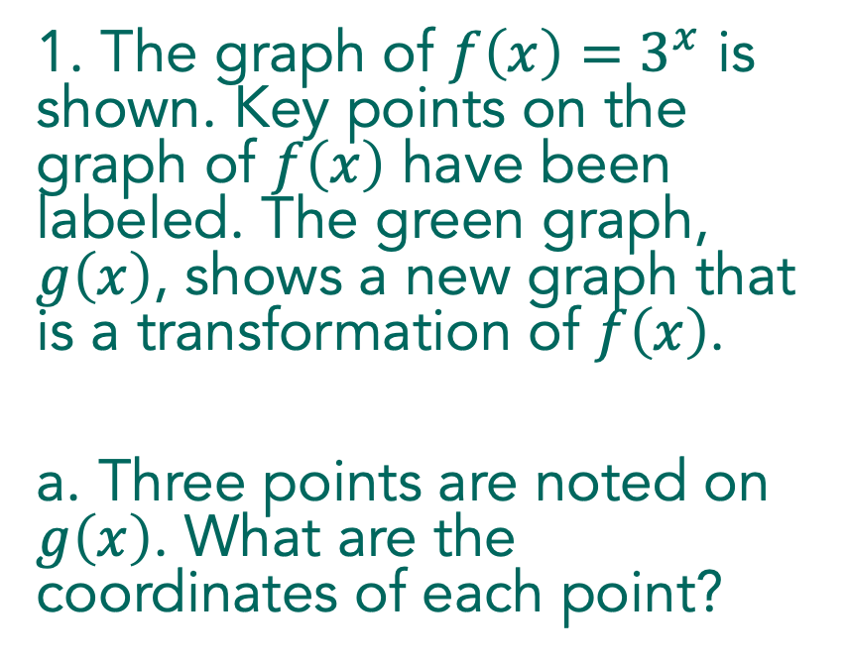
1. The graph of $f\left(x\right)=3^{x}$ is shown. Key points on the graph of $f\left(x\right)$ have been labeled. The green graph, $g\left(x\right)$, shows a new graph that is a transformation of $f\left(x\right)$.
a. Three points are noted on $g\left(x\right)$. What are the coordinates of each point?

Slide 19
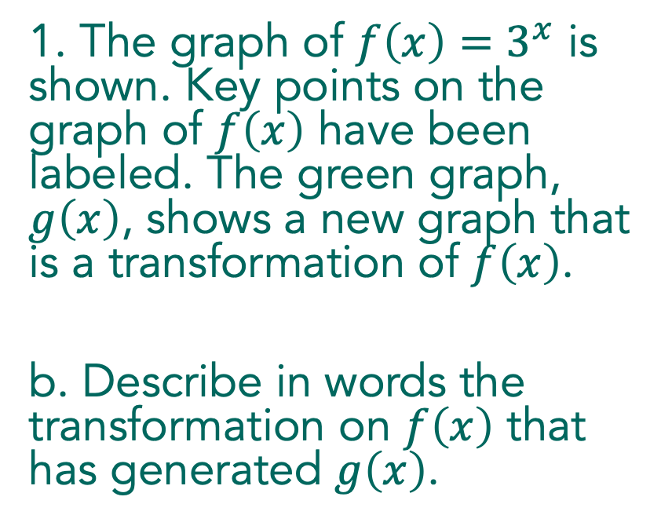
1. The graph of $f\left(x\right)=3^{x}$ is shown. Key points on the graph of $f\left(x\right)$ have been labeled. The green graph, $g\left(x\right)$, shows a new graph that is a transformation of $f\left(x\right)$.
b. Describe in words the transformation on $f\left(x\right)$ that has generated $g\left(x\right)$.

Slide 20
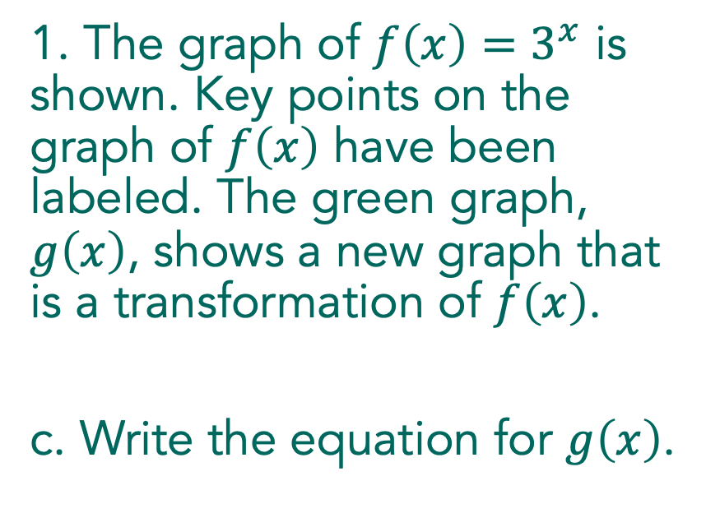
1. The graph of $f\left(x\right)=3^{x}$ is shown. Key points on the graph of $f\left(x\right)$ have been labeled. The green graph, $g\left(x\right)$, shows a new graph that is a transformation of $f\left(x\right)$.
c. Write the equation for $g\left(x\right)$.

Slide 21

2. Rewrite $\frac{{24}^{−1}}{{16}^{−1}}$ as an integer or a fraction in lowest terms.

